Slide 1
Draft Guidelines for
Suspending Marsh Monitoring
Based on Stage Data
Pete Rawlik
Restoration Sciences Department
SFWMD
March 2, 2010

Slide 2
Rationale
The surface water quality samples at internal marsh stations must be representative
Previous guidance has defined the lower limits of representative sampling to be a minimum clear water depth of 10 cm
Sampling records reveal that EPA marsh stations routinely drop below 10 cm and are not sampled
  From 1/1/2007 to 5/1/2009 there were 2,233 station visits, 683 (30%) were No Bottle samples
It is now possible to remotely determine when water depths are too low to sample and then reduce the number of unsuccessful site visits

Slide 3
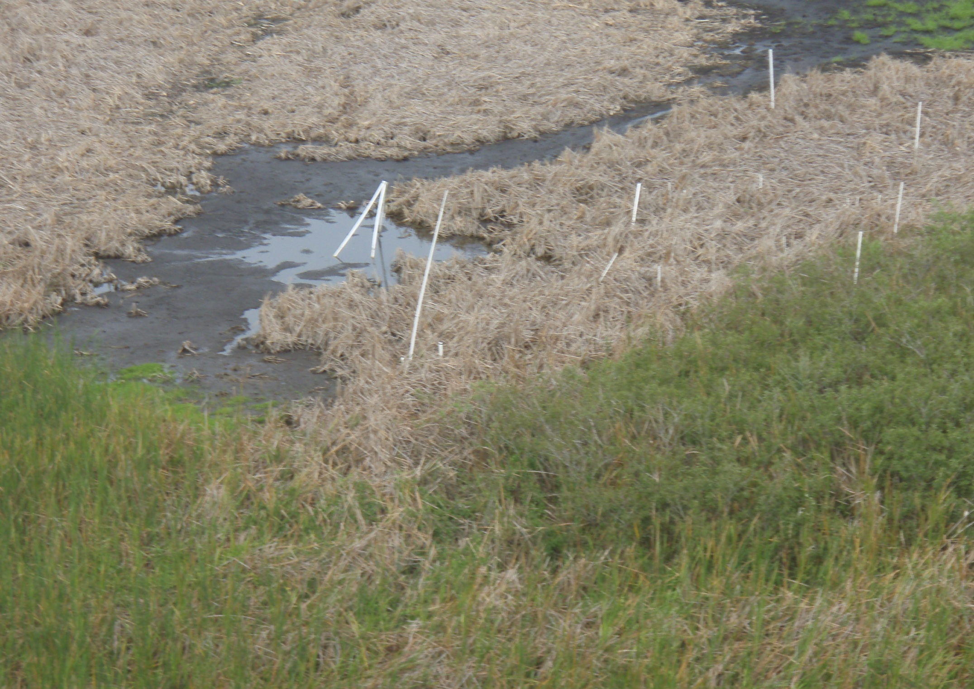
WCA-2A F1 6/28/07

Slide 4
Methodology
Compare historical stages to total clear water depth and determine at what stage sampling is no longer successful (<10 cm)

Slide 5
Stage and Depth
Clear Water Depth (Meters)
Stage (Feet)

Slide 6
Considerations
Be conservative, err on the side of caution during development and application
Use as few gages as possible
  Reduces decision making process and potential errors
  Reduces review effort if something goes wrong
  Reduces the number of gages that must be maintained for support
Use real-time data when possible, but an average from the previous day is acceptable

Slide 7
Using Grouped Stations
The Water Quality Monitoring Division (WQMD) considers the grouped criteria easier to manage and more protective than site specific criteria
  Cons
    Requires visits to some stations that may have gone dry earlier than others in the grouping
  Pros
    Requires a single trigger stage for the group
    Suspends stations grouped geographically, which eliminates whole areas from fight visits
Notes:
The Water Quality Monitoring Division (WQMD) believes that the grouped criteria will be easier to manage and be more protective than site specific criteria

Slide 8
WCA-1
Water quality monitoring in WCA-1 is required by the Settlement Agreement and the TP Rule
Both mandates are subject to a minimum of 10 cm of clear water
The Settlement Agreement Compliance Calculation requires that the average stage at gages 1-7, 1-8C, and 1-9 be at or above 15.42 feet
Data from all 3 gages are available hourly on the Everglades Depth Estimation Network (EDEN) website

Slide 9
Average stage (1-7,1-8c, 1-9) in WCA-1 since January 2005

Slide 10
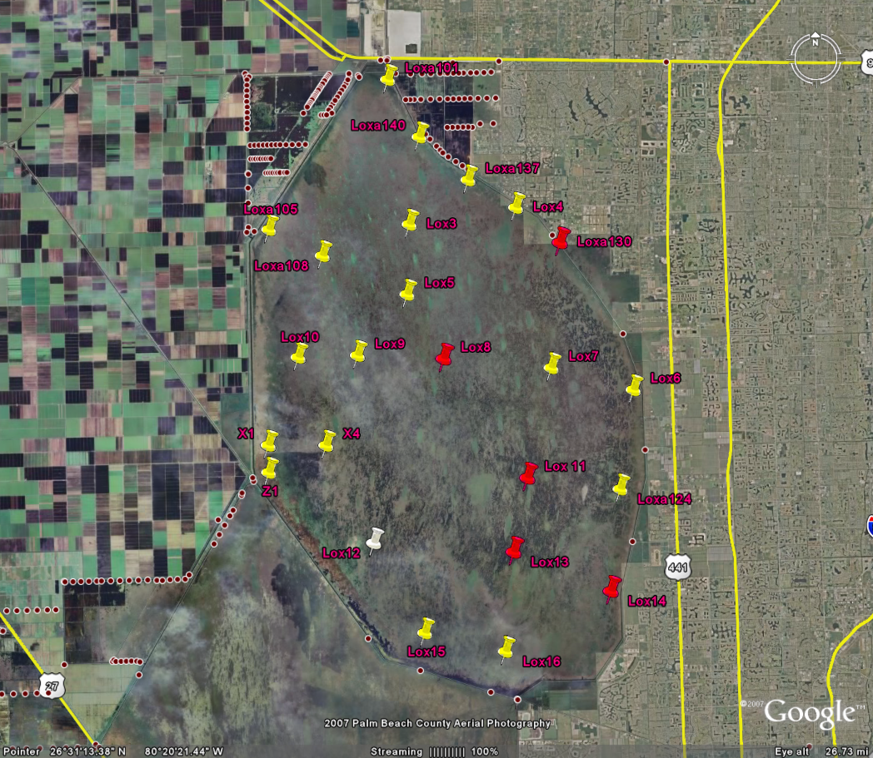
Indicates a station that was no longer collected below an average stage of 15.42 feet
3 gage average <15.40 feet
Indicates a station that was still collected at an average stage of 15.27 feet
3 gage average <15.00 feet
Indicates a station that was still collected at an average stage of 15.18 feet

Slide 11
WCA-2A
Water quality monitoring in WCA-2A is required by the Settlement Agreement and the TP Rule
There are no stage-based requirements for either mandate in WCA-2A
Both mandates are subject to a minimum of 10 cm of clear water
Variation in the topography of WCA-2A requires that the area be divided into 3 zones using two stage gages

Slide 12
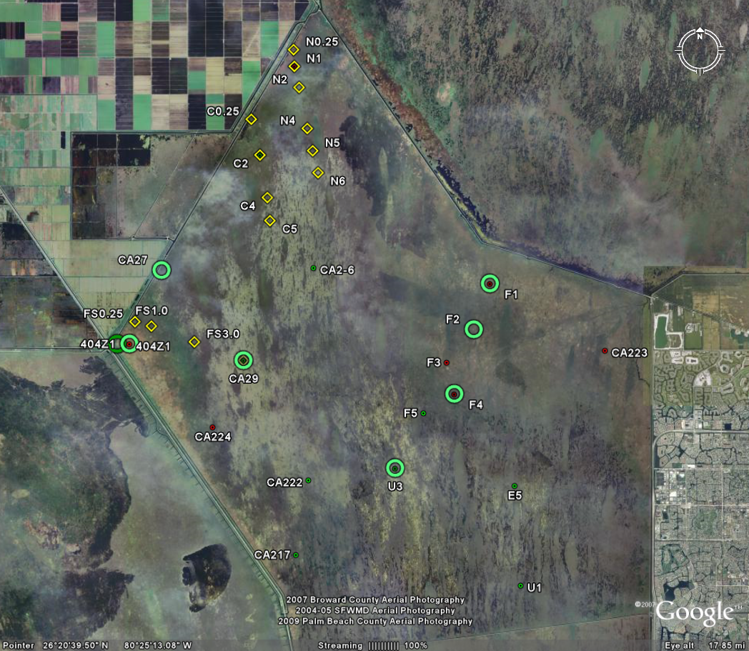
Eden 11 gage <10.80 feet
2-17 gage <11.25 feet
2-17 gage <10.75 feet

Slide 13
Historical 2-17 Stage

Slide 14
Historic EDEN 11 Stage
Minimum sampling stage

Slide 15
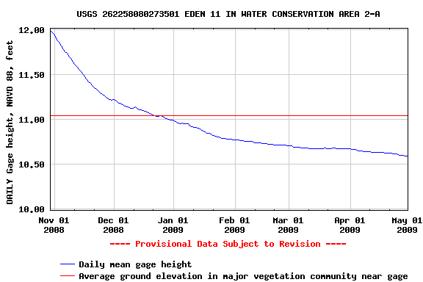
10.8 ft
Minimum sampling stage

Slide 16
WCA-3
Water quality monitoring in WCA-3 is required by the Settlement Agreement and the TP Rule
There are no stage-based requirements for either mandate in WCA-3
Both mandates are subject to a minimum of 10 cm of clear water
Variation in the topography of WCA3 requires that the area be divided into seven zones using four stage gages

Slide 17
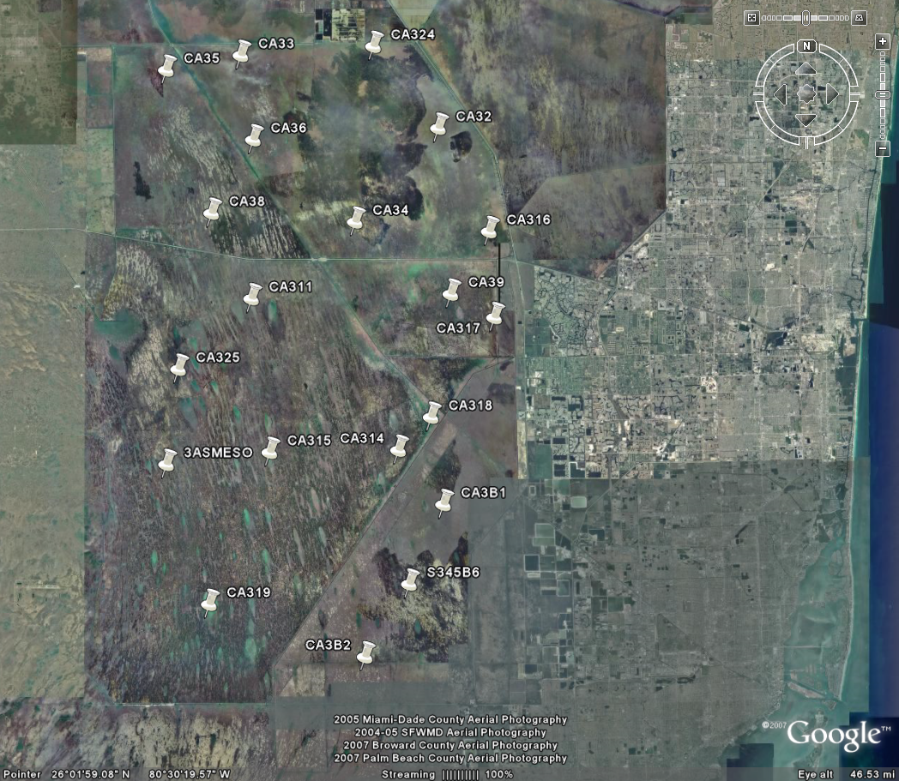
3ANE gage <9.90 feet
3AN1W1
gage <10.60 feet
3ANE gage <9.30 feet
S340T gage <8.0 feet
S340T gage <7.60 feet
S340T gage <7.80 feet
3BS1W1_H gage <5.10 feet

Slide 18
How does this help?
Using nine stage gages, the water depths in twelve zones in four WCAs, can be predicted to be below a minimum sampling depth
With this information, helicopter flights can be scheduled to optimize collection and minimize flights that produce no data
Analysis of the last 2 years shows that suspension would be rare, but when it occurs, many stations would be affected for substantial staff and cost savings

Slide 19
The Gas Tank Analogy

Slide 20
Status Reports
In response to concerns that mistakes might be made and unreported, we propose an annual review
Restoration Sciences will prepare an annual report detailing:
  the status and trends of the 9 gages,
  the history of water depth at the marsh stations in relation to the relevant gages
  recommendations for modifying the guidance

Slide 21
Is this consistent with the Settlement Agreement?
The stage guidance is an alternative field sampling protocol for screening out marsh stations that will be below the minimum sampling depth.
The Settlement Agreement allows for changes in field sampling protocol if approved by the TOC (Appendix D, Page 6).
The TOC has previously adjusted the methodology used to determine sampling depth
  10 cm criteria
  Clear water depth as opposed to total water depth
  “Paluga Pole”

Slide 22
Request
The SFWMD asks that the TOC approve the proposed guidance and the annual status report

