Slide 1
AHED Arc Hydro Enhanced Database
Stakeholder Training and Outreach

Slide 2
Topics
Why are we here?
Introducing Arc Hydro - Video
What is Arc Hydro?
What is AHED?
Extended and Enhanced Arc Hydro
Why we thought we needed it
Project Timeline
Closer look at Database
What does it mean to ME?
Information and support
Questions and discussion
Notes:
Arc Hydro is a data model for Hydrographic feature locations
Some of the GIS hydrographic data layers you are using WILL be replaced with Arc Hydro layers

Slide 3
Arc Hydro Video
Let’s watch the video….more to come later
Arc Hydro Video
Notes:
http://vid01.esri.com/winmmedia/archydro.wmv

Slide 4
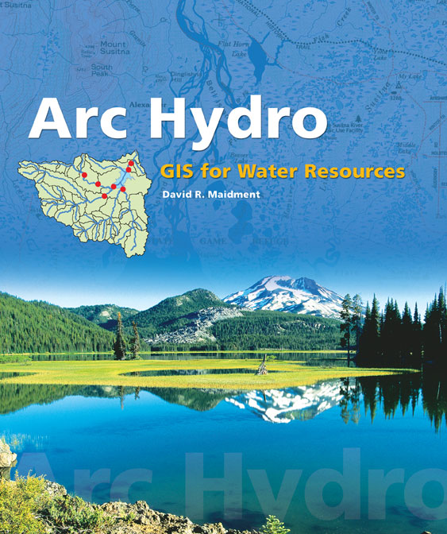
What is Arc Hydro ?
Industry standard data model for hydrologic / hydrographic features
Stores, relates, and describes features including drainage basins, canals, waterbodies, structures, and monitoring points
Arc Hydro Tools Provide watershed delineation and network functions such as tracing water movement, upstream or downstream accumulation, common ancestors, and other analysis
Notes:
Notes:
Arc Hydro: Integrated spatial data layers linked to other types of water measurement data, more info next slide
Industrial partners: ESRI, Danish Hydraulic Institute, Camp,Dresser and McKee, Dodson and Associates
Government partners:
Federal: EPA, USGS, Corps of Engineers (Hydrologic Engineering Center)
State: Texas Natural Resource Conservation Commission, Texas Water Development Board
Local: Lower Colorado River Authority, City of Austin, Dept of Watershed Protection
Academic Partners: University of Texas, Brigham Young University, Utah State University

Slide 5
What is Arc Hydro?
Developed by Center for Research in Water Resources (CRWR) with participation from universities, government agencies, and private business
Adopted by Florida Water Management Districts and Florida Department of Environmental Protection (FDEP)

Slide 6
Notes:
Notes:
Full model with all water resources feature classes represented (basins, canals, cross-sections, etc.)
Data linked through relationships
Backbone– HydroNetwork (HydroEdge, HydroJunction) - click
Connect to related features – click
Model also bundled with ESRI toolbox
Comprehensive set of data for water resource analysis
CRWR provides condensed version of primary system features identified here...

Slide 7
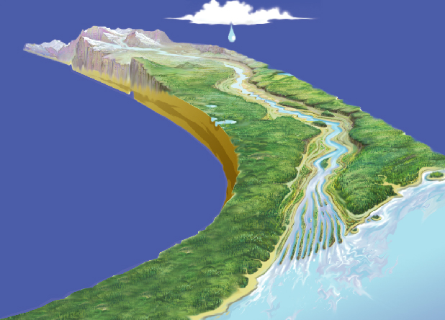
Using A Behavioral Model
Connectivity among features
in different data layers
Notes:
Notes:
Arc Hydro integrates theses layers into a common framework
Relationships allow tracing through a network: rainfall to -- canal network to -- basin outflow

Slide 8
Why SFWMD Needed Arc Hydro?
Need for current and accurate sources of hydrologic and hydrographic data
Historically data from different departments, scales, resolutions
A means for integrating hydrologic data into one common framework and toolset
Central source of data storage and retrieval
Data connectivity: Monitoring points, watersheds, waterbodies, etc connected to the flow network
Part of District Enterprise GIS
Enterprise System of Record for hydrographic feature locations

Slide 9
AHED Project Timeline
FY04
FY05
FY06
FY07
FY08
FY09
FY10
Prototype
Pilot
Population: Phase I
Population: Phase II
Population: Phase III

Slide 10
What is AHED? Arc Hydro Enhanced Database
Hydroperiod
Analysis
Operations
Decision
Support System
Enhanced
Arc Hydro Framework
Existing
Arc Hydro
Framework
Flood
Hydrology &
Hydraulics
Regional
Simulation
Model
AHED
Notes:
For AHED we started with four key projects at the District to identify their common needs and enhance and extend Arc Hydro to meet them.
Share one updated source of GIS hydrologic data
4 projects share common need for timely & accurate data
Have overlapping data needs that can be met through a common data structure
Feeding results into and using results from the common data structure

Slide 11
AHED Enhancements
Includes structures in the database
Establishes data structures to support multiple scales
4 levels of drainage areas
Provides feature-level metadata
Get source information at record level
Incorporates rain areas and rain mesh
Implements components of water control units in geodatabase
Notes:
PBS&J
UT
Describe WCU components

Slide 12
AHED Enhancements
Supports National Hydrography Dataset (NHD)
Maintains NHD-specific schema elements in AHED
Tracks NHD changes made in AHED
Provides opportunities to support Florida’s NHD Data Steward with SFWMD’s work
Establishes common data source for projects
Expands timeseries concepts to support hydroperiod analysis in ArcGIS

Slide 13
AHED Framework
Feature Datasets
Relationship Classes
Domains & Subtypes
Geometric Network (Hydro Network)
Topology Class
Tables and Views
Notes:
More later

Slide 14
Drainage Area Nomenclature Changes
Adopted from USGS for consistency
SFWMD (Legacy) | AHED / USGS SFWMD (Adopted) | HUC Digits
- | Region (not in AHED) | 2
- | SubRegion (not in AHED) | 4
- | Basin | 6
Watershed | SubBasin | 8
Basin (dbasins) | Watershed | 10
Subbasin | SubWatershed | 12

Slide 15
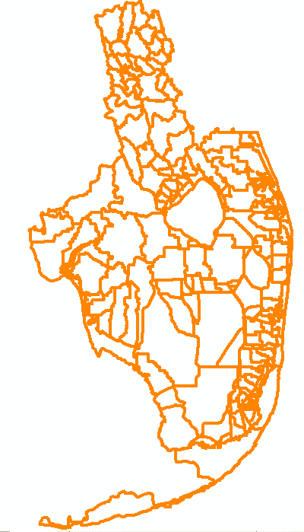
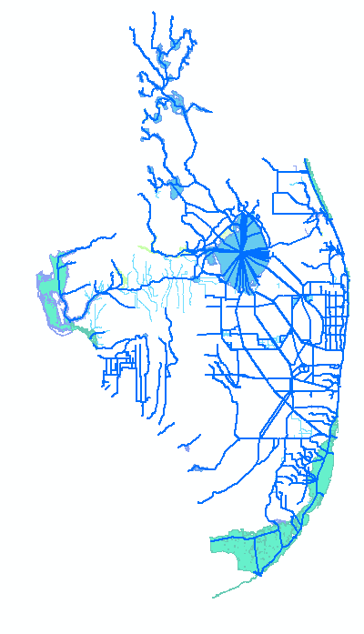
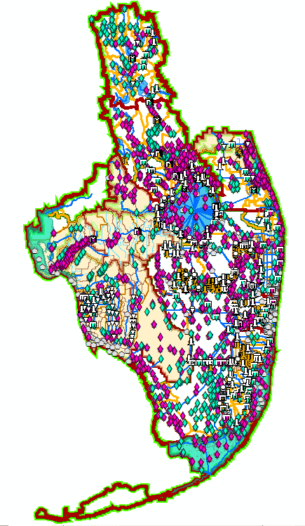
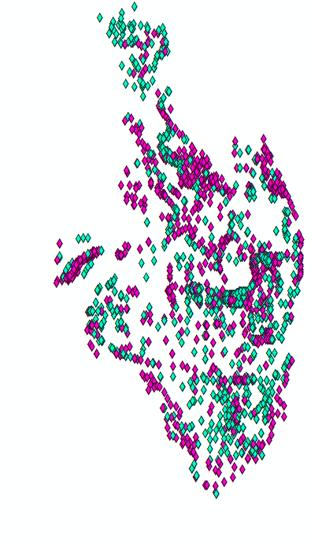
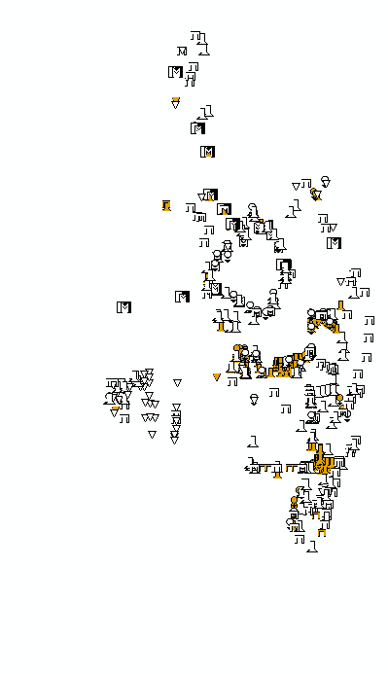
AHED: An Integrated Data Model
Watersheds
Canals / Waterbodies
Monitoring Points
Structures
Notes:
Shape files, coverages still there.Central source for hydrographic data storage as well as data connectivity

Slide 16
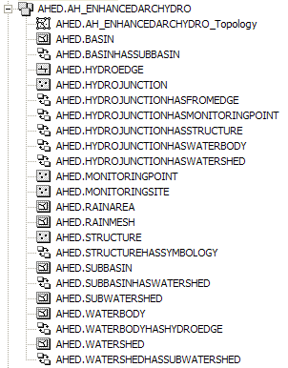
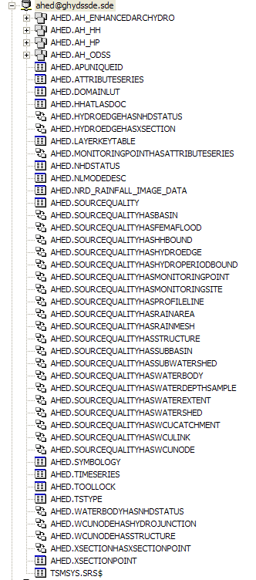
The Database
Feature Datasets
Drainage Areas
Network Features
Tables
Hydrography Features
Relationships
Custom FCs

Slide 17
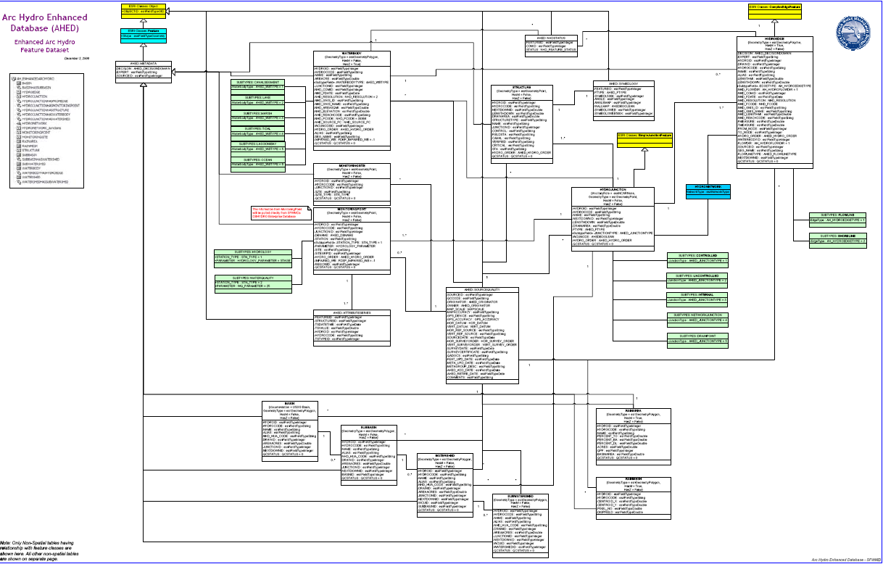
Network
Hydrography
Feature level Metadata
Drainage
Custom Feature Classes
Multiple Scales
Notes:
Custom feature classes, multiple scales, feature level metadata

Slide 18
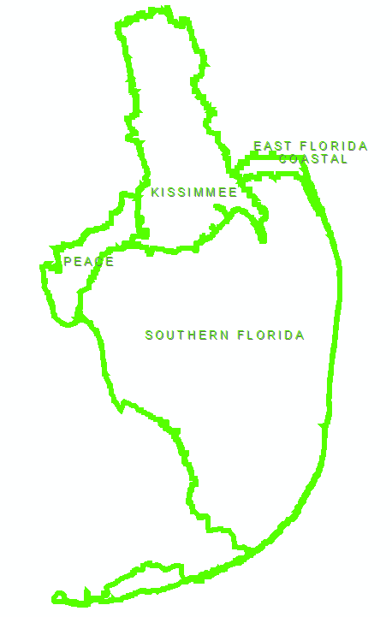
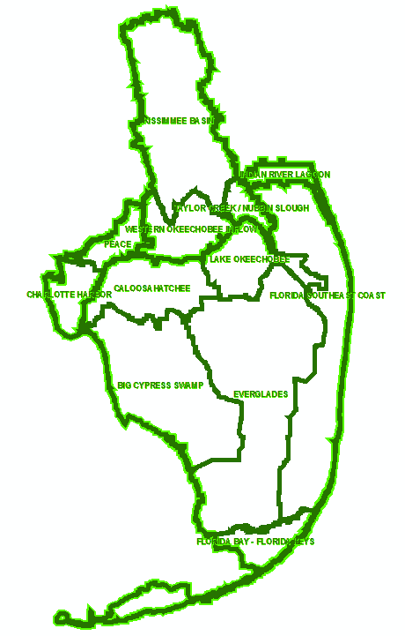
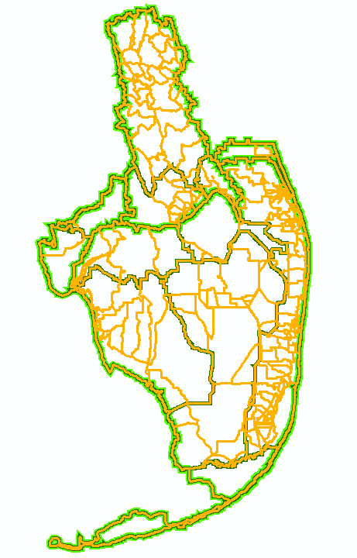
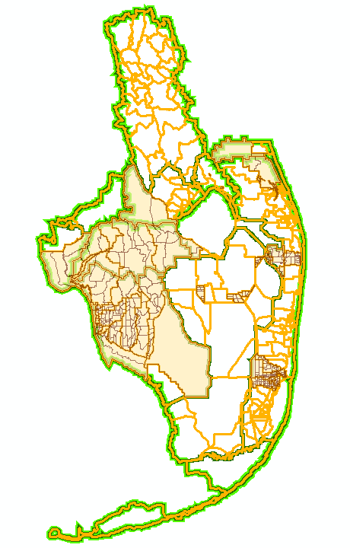
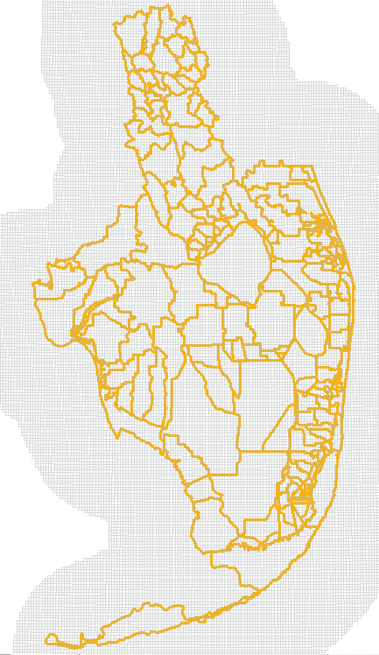
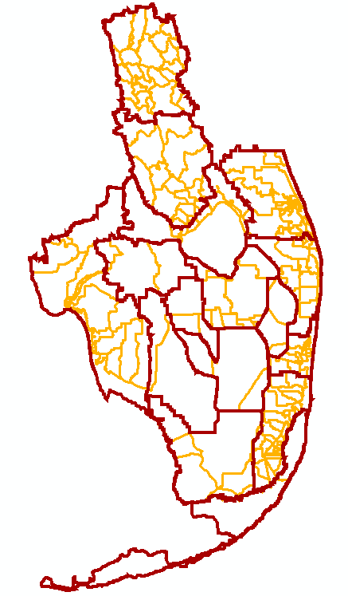
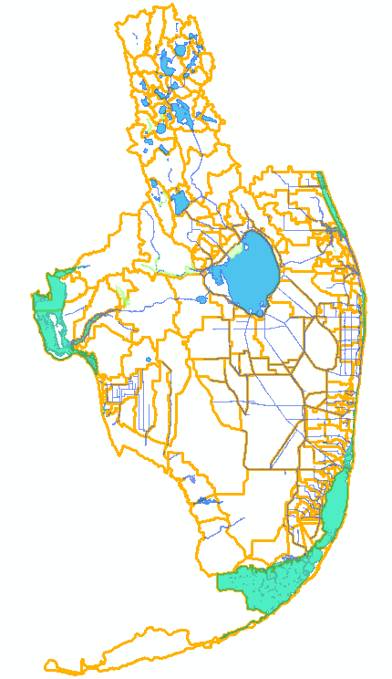
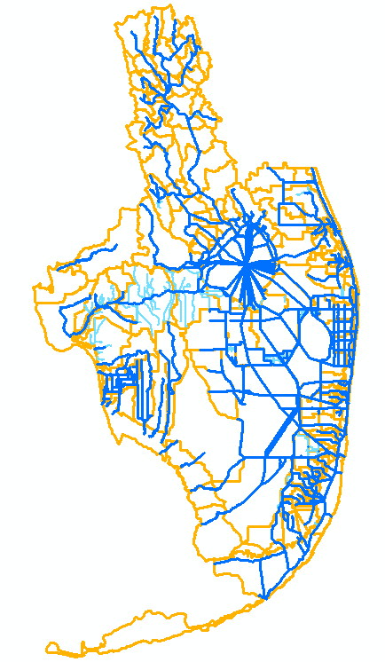
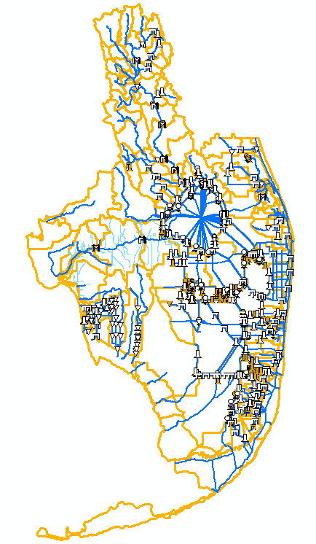
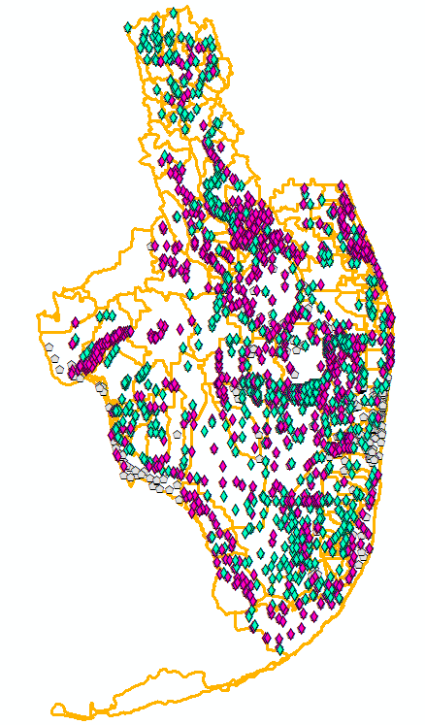
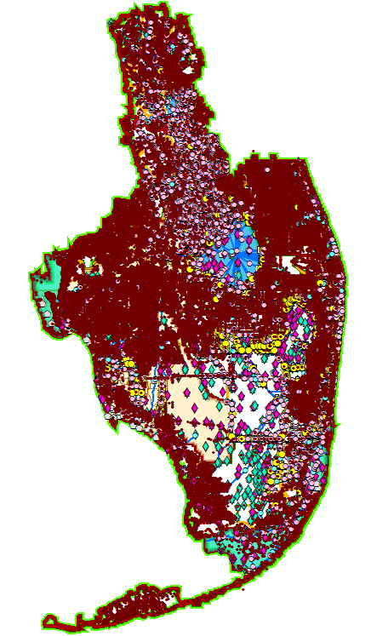

Slide 19
AHED Supporting Elements
Data Dictionary
Quality Assurance Plan & Quality Control Procedures
Compliance Specifications
Data Stewardship User Guide and videos
Database UML & ERD
Data Ingestion Workflow and Methods & Protocols
Governance Process & Operational Support

Slide 20
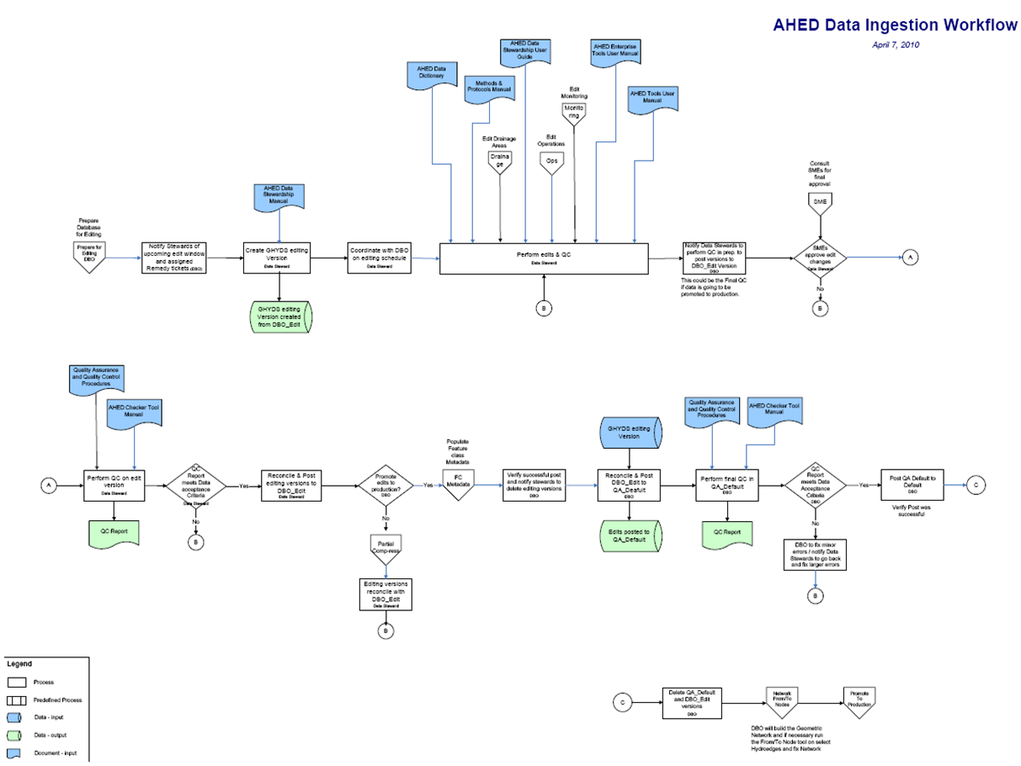
Data Ingestion Workflow
Notes:
Document process and flow. This is significant work

Slide 21
AHED Supporting Elements
Custom Tools
Data population and maintenance tools
AHED Tools
AHED Enterprise Tools
AHED Checker
User Defined Tools
NexRad Rainfall Tool
Hydroperiod Analysis Tool

Slide 22
AHED Supporting Elements
Industry Tools
ESRI Arc Hydro Toolbar
Setting and changing flow directions
ESRI Utility Network Analyst
Tracing Network
Finding related features on the path of trace

Slide 23
AHED Network
Notes:
Connectivity among features

Slide 24
Database Cleanup
Data verified and cleaned up
Subject Matter Expert (SME) consultations
Up-to-date data acquired from business groups or outside agencies
Data corrected and constructed
Primary and Secondary features
Relationships created among features

Slide 25
Data Examples
Before & After

Slide 26
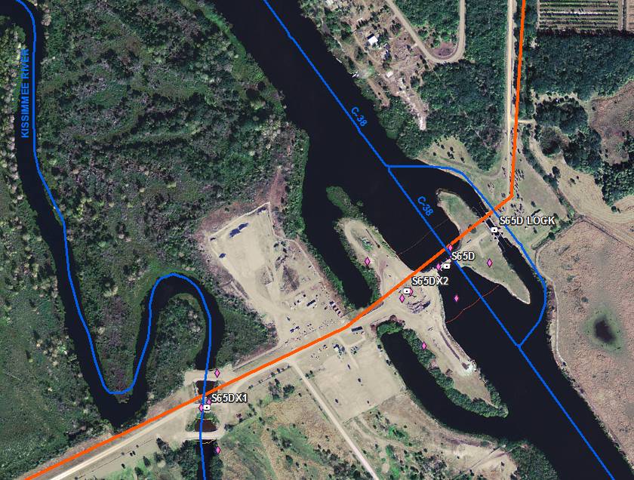
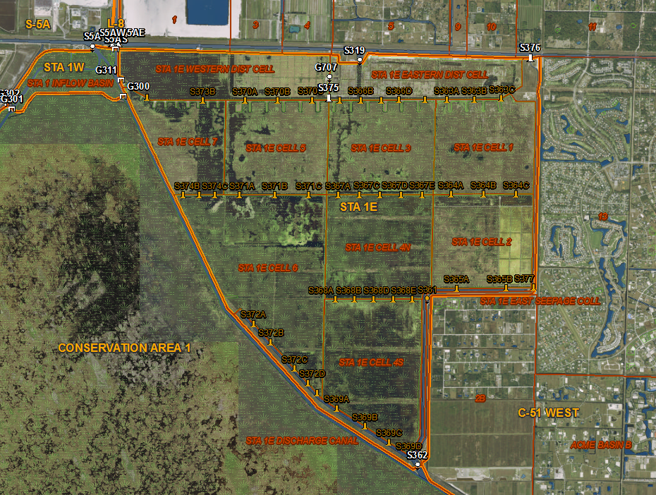
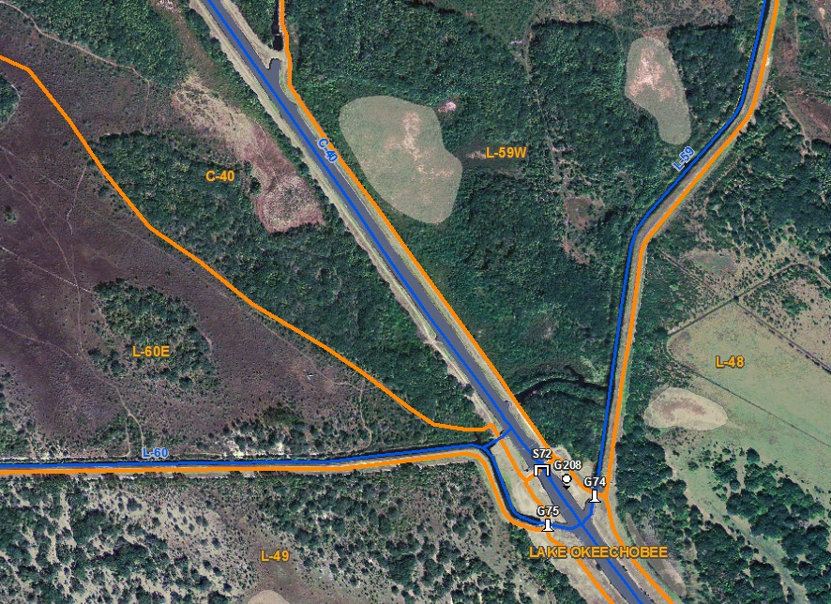
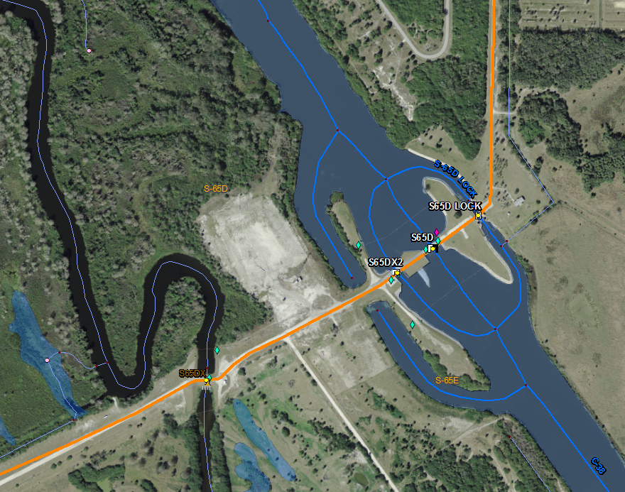
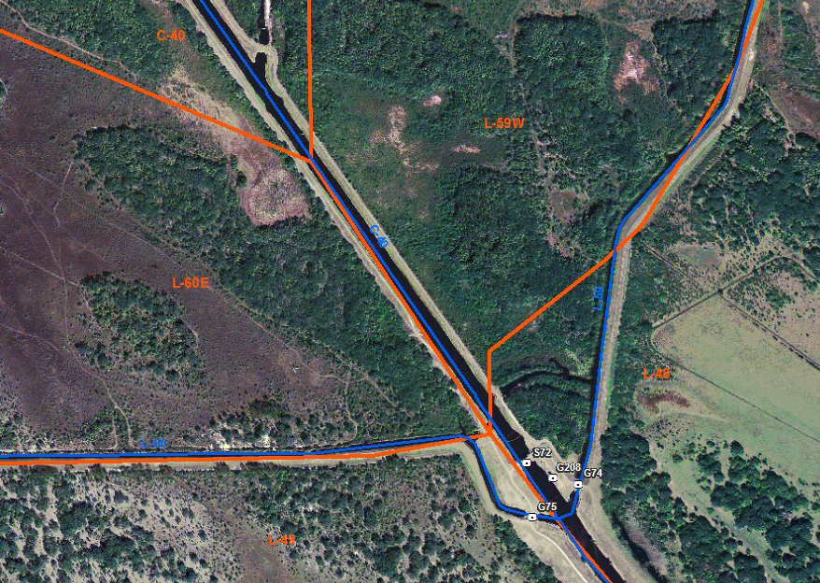
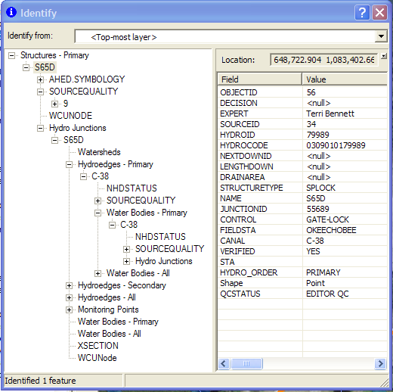
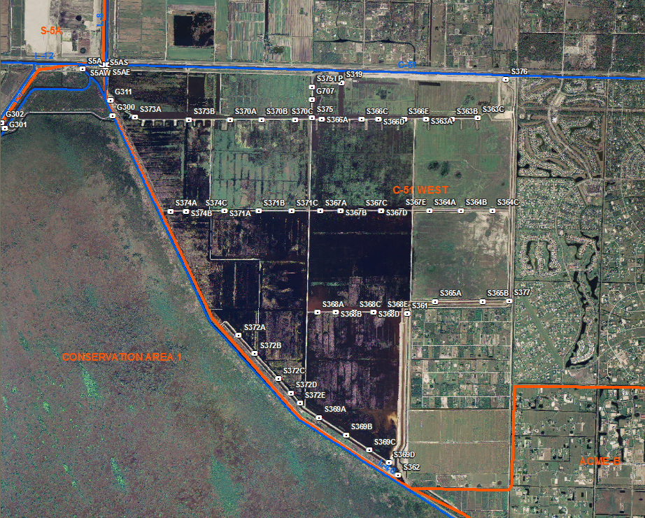
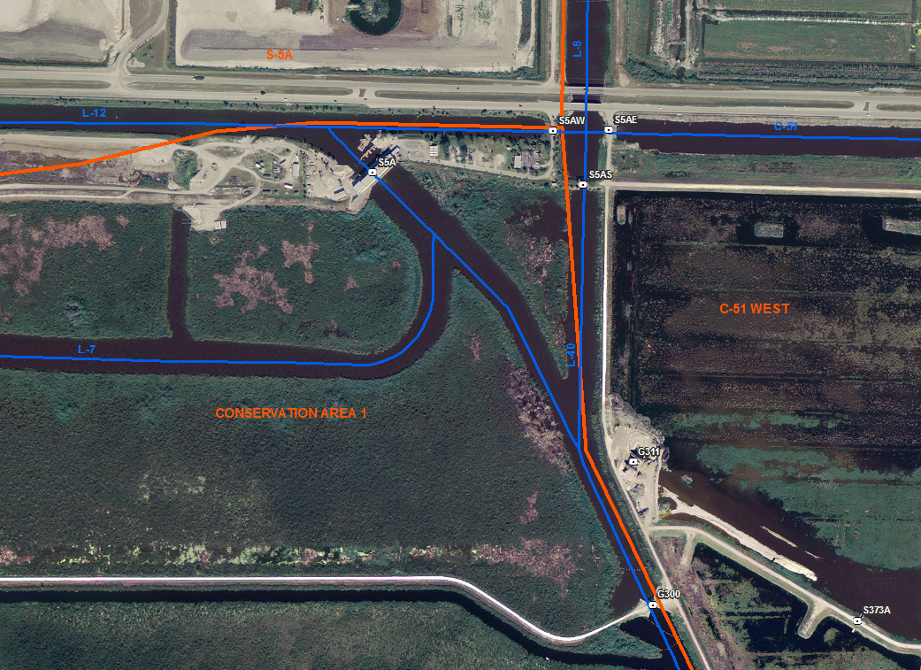
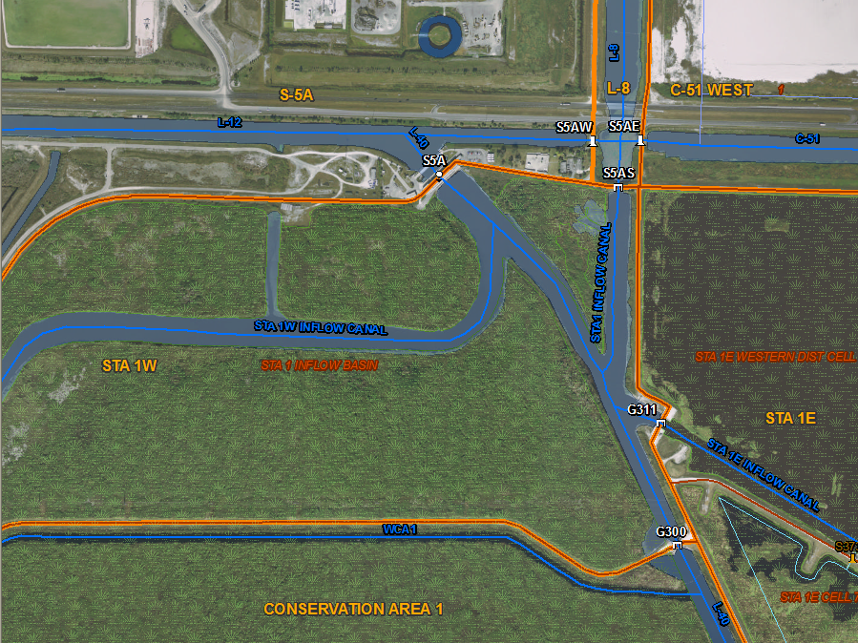

Slide 27
What Does AHED Mean to Me? ☺
Improved data quality
Integrated data model with built in relationships provides application development opportunities
Data consistency
Governance of AHED
System-of-Record for Hydrographic Feature Locations
Notes:
Improved data quality – covered on previous slide. Anything else or use as transition?
Integrated data model – covered in earlier slide. Reinforce here?
Data consistency – Is this discussed earlier and reinforced here?

Slide 28
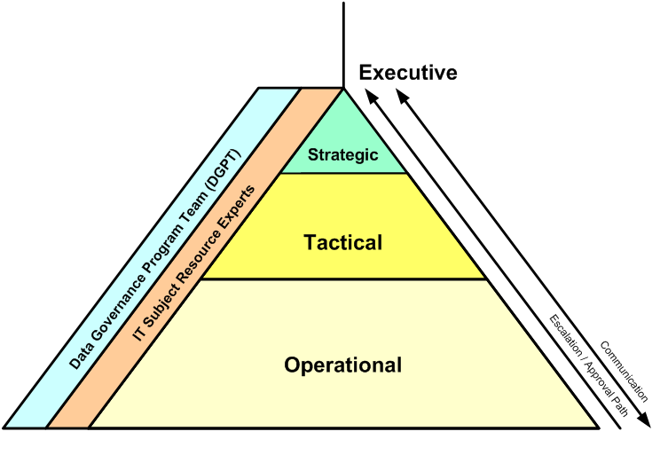
Hydrographic Spatial Data Management
Governance Council
Steering Committee
Technical Review Team
Adapted From: KIK Consulting 2009

Slide 29
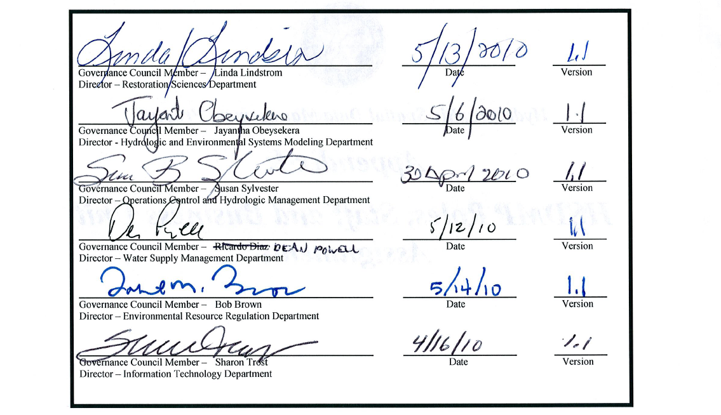
Data Governance Council Members

Slide 30
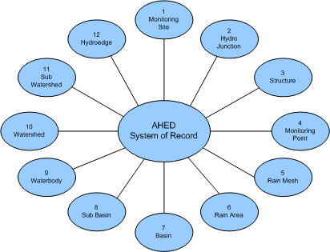
System of Record
The hydrographic spatial locations that comprise AHED are considered the system of record
Notes:
Feature locations and the spatial attributes. SAP stores structures as well. Asset information is stored in SAP.
Single, authoritative source for specific features - figure out how to deal with Monitoring Points
Tie to enterprise data governance and District policy

Slide 31
Hydrographic Spatial Data Management Process
Establishes a formal business process to enable enterprise governance of AHED
Ensures that AHED policies and strategy are implemented
Receives input from stakeholders and provides defined outputs (e.g. completed changes)
Aligned with Enterprise Data Management Governance Framework
Notes:
Other hydrographic data products can be placed under the process as needed

Slide 32
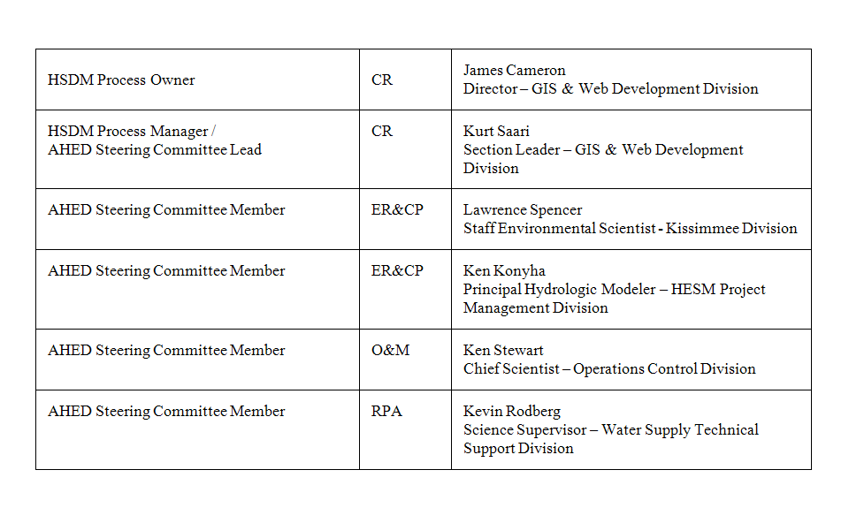
Steering Committee Membership

Slide 33
What Does AHED Mean to Me? ☹
Drainage area nomenclature change
Formal data update cycle
Legacy dataset retirement
Application / .mxd migration
Notes:
Drainage areas – Discussed earlier, reinforce here.

Slide 34
Update Cycle
 | Week 1 | Week 2 | Week 3 | Week 4 | Week 5 | Week 6 | Week 7 | Week 8
Submit Change Requests | Steering Meeting |  |  |  | Steering Meeting
Classify Change Type
Perform LOE Assessment
Steering Committee Review and approval
Edit Window open
Publish to Production
Notes:
Requests requiring LOE assessments must be submitted prior to or during Week 1 in order to be reviewed during the current cycle. Requests submitted after week 1 that require an LOE will be evaluated during the next cycle.
Last chance to get requests that do not require LOE classified for review at next Steering Committee meeting.
Requests can be submitted after week 4 but will not be authorized by Steering Committee until next cycle.
Requests requiring Governance Council review will follow Governance Council schedule and will not be addressed in the next available edit window.

Slide 35
Spatial Data Lifecycle Phases
Released - the data collection has been tested and is released for review and comment
Operational - the data collection is available for production usage
Active – GIS Data Steward provides data content, schema, and metadata updates
Passive –There are no content/schema changes or metadata updates. The data is in a static state and is renamed.
Retired - the data collection is no longer needed to support business processes has been archived in a less readily accessible state

Slide 36
Retirement Timeline
6/25/2010
Operational/
Active
Released
AHED
Operational/
Active
Operational/
Passive
Retired
Legacy
7/26/2010
12/31/2010 Est.
Notes:
Operational Passive Data is in DROP

Slide 37
Legacy Layers to be Retired
Legacy Layer | AHED Equivalent
Structures SFWMD | structures
Hydrography Canals SFWMD (and Anno) | hydroedges
Drainage Basins SFWMD | basins, subbasins, watersheds, subwatersheds
Hydrography USGS 24k (Lines and Polys) | hydroedges, waterbodies
Hydrography Lakes SFWMD (and General) | waterbodies
Rain Areas | rainareas
NexRad Rainfall Grid | nexrad grid

Slide 38
How to access AHED?
AHED layer file on \\gisdata1\layers\
Google Earth
EGDL (GHYDP database)

Slide 39
Information and Support
AHED website
Link to project documentation and external Arc Hydro sources
AHED website

Slide 40
Questions & Discussion

Slide 41
Update Cycle
Request Submission
Classify Change Requests
Perform LOC Assessments
Steering Committee Review and Approve
Edit Window Open
Publish to Production
8 Week Cycle
Notes:
Requests requiring LOE assessments must be submitted prior to or during Week 1 in order to be reviewed during the current cycle. Requests submitted after week 1 that require an LOE will be evaluated during the next cycle.
Last chance to get requests that do not require LOE classified for review at next Steering Committee meeting.
Requests can be submitted after week 4 but will not be authorized by Steering Committee until next cycle.
Requests requiring Governance Council review will follow Governance Council schedule and will not be addressed in the next available edit window.

