Slide 1
Recommendations to the TOC Concerning Monitoring for the Settlement Agreement
Pete Rawlik
For the Water Quality Monitoring Subteam
April 26, 2016

Slide 2
Water Quality Subteam Met to Address Multiple Issues
Rules for monitoring G300 and G301 (diversion structures)
Ions monitoring at G311 and G302
Pesticides Monitoring
Metals monitoring
Copper
Iron

Slide 3
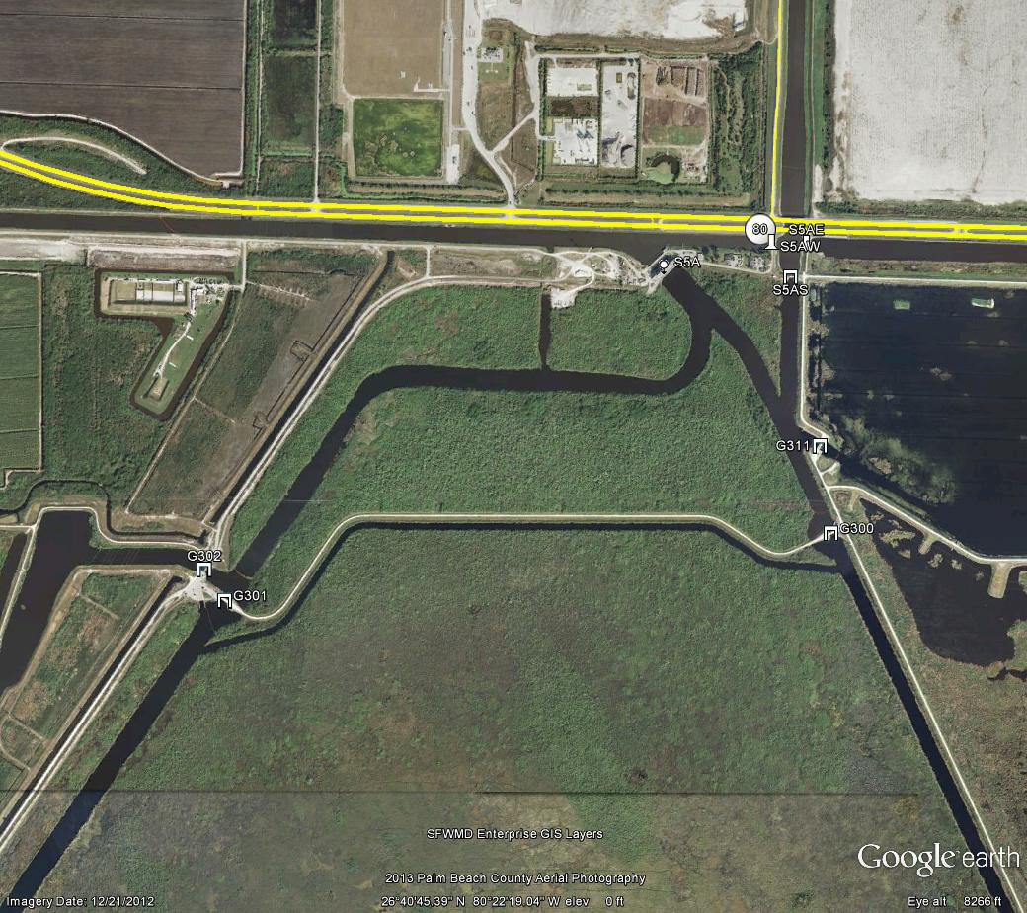
S5A and Associated Structures Showing G300 and G301
S5AW
S5AE
S5A
S5AS
STA1E
Distribution Basin
G311
G302
G300
STA1W
G301
WCA1

Slide 4
Monitoring at G300 and G301
At the last meeting, the TOC agreed to monitoring at these structures to do the following:
Response monitoring, weekly when in use
Physical parameters (DO, pH, specific conductivity, temperature)
TPO_{4,} OPO_{4,} TDPO₄, alkalinity, Ca,Cl, Na, K, Mg, SO₄, TN, NO_{x}, NH₄, TSS
The following clarifications are suggested:
This includes reverse flow events
Prior to a diversion event District staff will collect a pre-discharge sample for the above parameters initiated either by the following:
Falling into the 5-day impact cone of a storm
The initiation of interagency diversion discussions

Slide 5
Ions at G311 and G302
It is suggested that the parameter list at G311 and G302 be adjusted by adding Mg, Na, K, and SiO₂ to the weekly recorded flow grab samples
Weekly Grab Samples
TP
Weekly Recorded Flow Grab Samples
TDP, OPO₄
TKN, NO_{X}, NH₄
Alkalinity, Ca, Cl, SO₄, Mg, Na, K, SiO₂
TSS
Quarterly
DOC

Slide 6
Pesticides
“Water quality monitoring shall include timely data on . . . pesticides/herbicides . . .”
Quarterly monitoring of 17 stations, 9 overlap with the NECP permit required pesticide monitoring meaning 8 are strictly Settlement Agreement
Team reviewed the last ten years of data

Slide 7
Pesticides
Consideration
Reduce frequency of pesticide monitoring
However, TOC action will have no impact on 9 overlapping NECP permit stations
Stakeholder concerns in western WCA-3A
Recommendation
All 9 NECP stations to remain quarterly
L3BRS, S8, and S12A to remain quarterly pending coordination with stakeholders
5 Stations (S5A, S6, S7, US41-25 and Tambr105) to change from quarterly to semi-annually

Slide 8
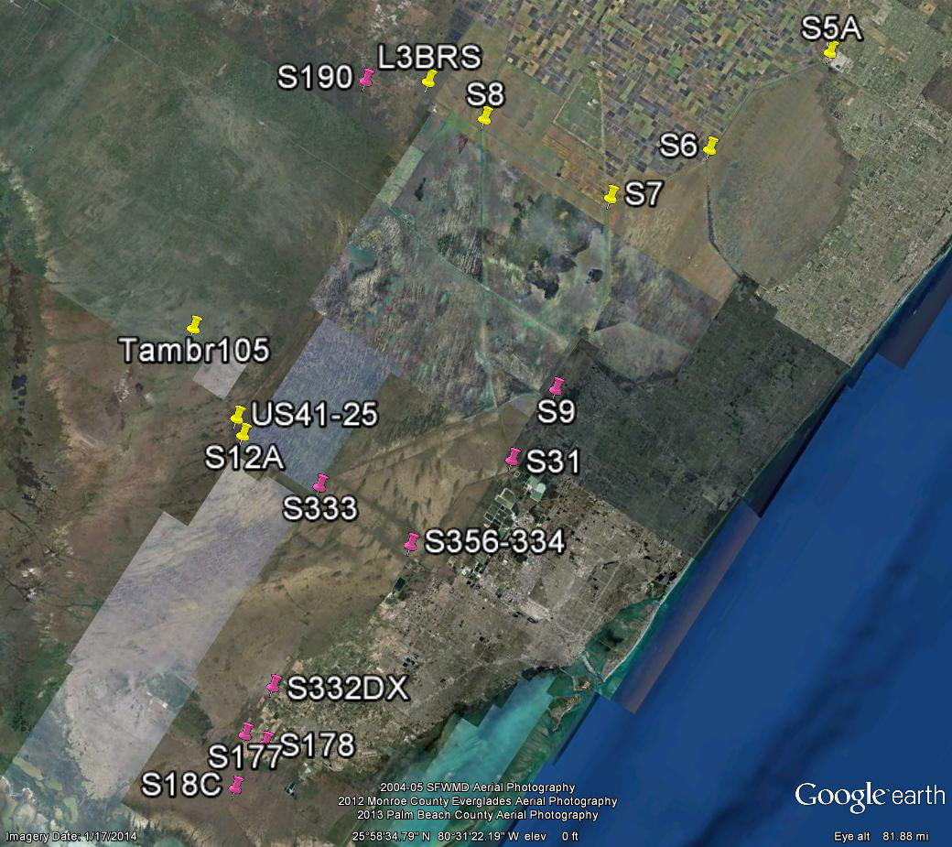
Pesticides Monitoring
Settlement Agreement
Settlement Agreement and NECP Permit
Recommended for Reduction
North

Slide 9
Copper Monitoring at S5A
Since 2009, 20 samples collected ( 2 to 4 samples per year)
16 samples were below the detection limit of 2.00 µg/L
4 samples from 2011 and 2012 detected copper
All values far below variable standard
Recommend to implement the previously agreed to frequency of annually during the wet season
Date | Hardness | Standard (µg/L) | Cu (µg/L) | Status
12/12/2011 | 269 | 22 | 10.3 | Acceptable
3/19/2012 | 247 | 20 | 2.1 | Acceptable
6/11/2012 | 311 | 25 | 2.8 | Acceptable
9/10/2012 | 364 | 28 | 3.4 | Acceptable

Slide 10
Iron Monitoring at S5A
Since 2010, 609 samples collected at 44 Settlement Agreement stations (primarily inflows and marsh)
95% of samples below half of the state standard of 1,000 µg/L
Only 2 samples above the standard
Data was provided to partners for potential optimization
This will be a subject for discussion at the next subteam meeting

Slide 11
Recommendations to the TOC for Approval
Clarifications of G300 and G301
Supplemental monitoring of ions at G311 and G302
Reduced monitoring for pesticides at 5 stations (quarterly to semi-annually)
Maintain Cu monitoring at S5A annually during the wet season

Slide 12
Future Discussions
Iron
A surrogate station for S5AE, S5AW, and S5AS

Slide 13
Discussion

