Slide 1
Everglades Depth Estimation Network (EDEN)
Gap-fill Method for Estimating Missing data
and Review Process
** Agenda Item #5, Update on Sub-Committee for Dealing with Refuge Stage Data Gaps **
Eduardo Patino
April 26, 2016
http://sofia.usgs.gov/eden/
U.S. Department of The Interior
U.S. Geological Survey

Slide 2
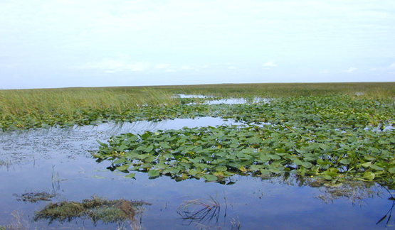
OUTLINE
Use of data filters to flag possible erroneous or missing data
Use of gap-fill empirical models to estimate missing or erroneous data
EDEN Gap-Fill method compared to the Water-Balance method
USGS & EDEN review process – real-time, provisional, final
Missing data periods for Sites 1-7, 1-8C, & 1-9 (1990 – present)
Alternatives moving forward

Slide 3
DATA FILTERS
Filters are used to scan and flag potentially erroneous or missing data.
Filters include several combinations of the following criteria:
Missing values
Exceedance of maximum and minimum value thresholds
Rate of change
As data for any given station is flagged by any of the filters used, it is manually reviewed to determine if in error and if it requires estimation.
Matthew D. Petkewich and others – in review, Using Inferential Sensors for Quality Control of the Everglades Depth Estimation Network Water Level Data.

Slide 4
GAP-FILL EMPIRICAL MODELS
Gap-fill empirical models were developed using data for the period between 2006 and 2011 and include the following:
Simple linear regression models
Multivariate linear regression models
Petkewich, M.D., and Conrads, P.A., 2013, Estimation of missing water-level data for the Everglades Depth Estimation Network (EDEN), 2013 update: U.S. Geological Survey Open-File Report 2013–1251, 45 p.

Slide 5
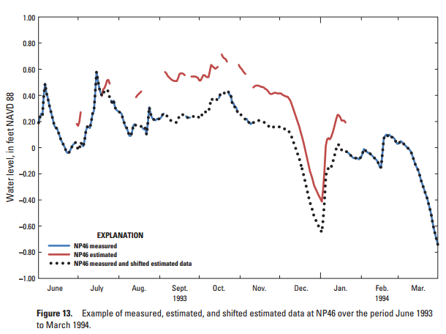
GAP-FILL EMPIRICAL MODELS
Graph below shows observed data, gap-fill estimates, and shifted final estimated data for NP-46 monitoring station during the period of June 1993 to March 1994.
Gap-fill models capture the general data signature (trend) and shifts applied to the data bring estimates to match observed data prior and after each period of missing data.
From “Hydrologic Record Extension of Water-Level Data in the Everglades Depth Estimation Network (EDEN), 1991-99. Paul Conrads and others, 2014.
http://pubs.usgs.gov/sir/2014/5226/pdf/sir2014-5226.pdf

Slide 6
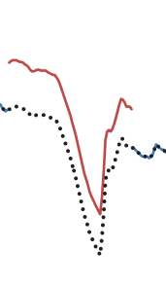
GAP-FILL EMPIRICAL MODELS
Shifts are calculated from differences between observed data and gap-fill estimates for dates A and B, and prorated in time and magnitude.
Gap-fill estimate
A
B
Shifted estimate

Slide 7
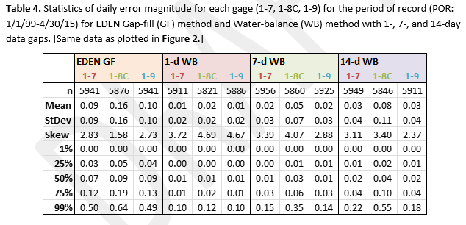
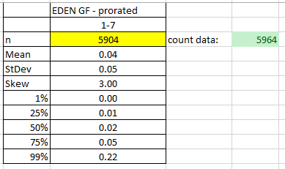
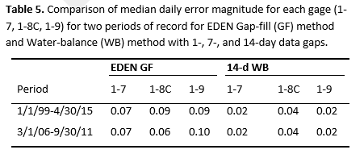
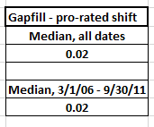
GAP-FILL vs WATER-BALANCE, Site 1-7
14-d comparison
Shifted

Slide 8
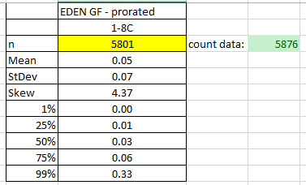
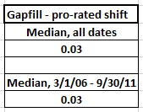
GAP-FILL vs WATER-BALANCE, Site 1-8C
14-d comparison
Shifted

Slide 9
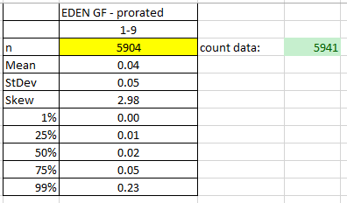
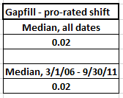
GAP-FILL vs WATER-BALANCE, Site 1-9
14-d comparison
Shifted

Slide 10
USGS & EDEN REVIEW PROCESS
USGS data review process:
Real-time – raw data as received through satellite transmissions (hourly)
Provisional – not to exceed 90 days after every field visit – corrections may be applied.
Final – Water-year data (Oct. – Sept.) is finalized by April 1 of the following year, but current efforts are moving towards Continuous Records Processing (CRP) and not to exceed 150 days after every field visit – final corrections applied.
** No estimated daily water-levels other than for days with partial record **

Slide 11
USGS & EDEN REVIEW PROCESS… continued
EDEN data review process:
Real-time – raw data as received daily from SFWMD, NPS, and USGS, and is posted on EDENWeb.
Provisional – quarterly, posted about 45 days after the end of each quarter – replaces real-time data on EDENWeb.
Final – yearly, Oct. to Sept. of previous year, posted in October of the following year – replaces provisional data on EDENWeb.
** Estimated water-levels using gap-fill equations and shifts **

Slide 12
USGS & EDEN REVIEW PROCESS… continued
It is USGS policy not to approve (finalize) data until after a field inspection has been made at the monitoring station of interest and the data reviewed.
Currently field visits at Site 1-7, Site 1-8C, and Site 1-9 are scheduled for twice per year (6 months), with emergency visits as problems arise at stations.

Slide 13
Missing data periods for Site 1-7, 1-8C, & 1-9
1990 - present
Site 1-7
1-5 days = 16
5-10 days = 2
10-15 days = 4
15-30 days = 3
Over 30 days = 1
- - 2006 - -
Site 1-8C
1-5 days = 20
5-10 days = 1
10-15 days = 0
15-30 days = 0
Over 30 days = 1
- - 2005 - -
Site 1-9
1-5 days = 22
5-10 days = 6
10-15 days = 3
15-30 days = 4
Over 30 days = 0

Slide 14
ALTERNATIVES MOVING FORWARD
Reduce the time-frame for approved final data – would require more frequent field visits to sites of interest
Reduce the amount of missing data – could install back-up sensors at sites of interest
Other alternatives?

Slide 15
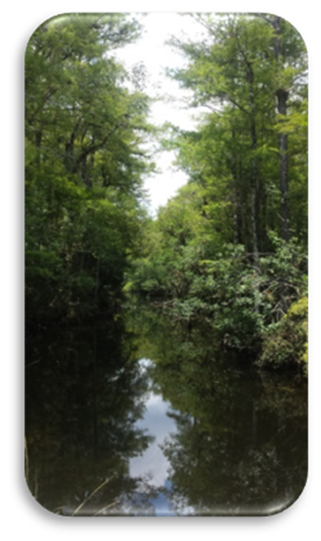
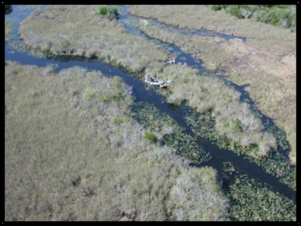
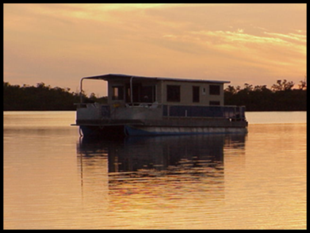
QUESTIONS?

