Slide 1
The Legacy Program
Nature’s Classroom: Learning on Public Lands

Slide 2
What is Legacy?
Legacy is a hands-on environmental stewardship program promoting environmental education on public lands
Partners local schools with nearby public lands owned by the SFWMD
Shares our expertise in land management, water resource and environmental science
Provides outdoor learning activities for students and instills a sense of stewardship for the environment

Slide 3
Legacy Goals
Utilize Legacy Program to assist in meeting land management needs
Provide communities with new opportunities on public lands
Enhance environmental stewardship in youth
Encourage recreational use of public lands

Slide 4
Legacy Program Activities
Classroom-specific curriculum in an outdoor experience with hands-on activities that may include:
Bird surveys
GPS and photo monitoring of plant communities and wildlife
Aquatic invertebrate studies with water quality testing and analysis
Wildlife surveys and habitat mapping

Slide 5
Legacy Key Features
Multiple visits by the same group of students
Involvement of technical specialists (land managers, scientists, engineers)
Activities that leave a “legacy” on the property
Bird counts, wildlife surveys, water & soil analysis
Cascade teaching to younger students

Slide 6
How We Help You Participate
Proximity of school to District property
Appropriate on-site facilities (shelters, restrooms)
Assistance with logistical support (transportation, substitute teachers)
Flexibility to accommodate teacher interests/ classroom needs
Site-specific activities developed and finalized in collaboration with local schools

Slide 7
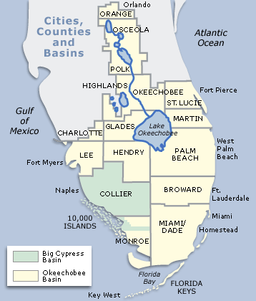
Pilot Legacy Program Site Locations
CREW Management Area (Corkscrew Regional Ecosystem Watershed) Lee and Collier Counties
DuPuis Management Area Martin County
LILA (Loxahatchee Impoundment Landscape Assessment) Palm Beach County
Osceola Environmental Study Center Osceola County

Slide 8
CREW Management Area LEE AND COLLIER COUNTIES
26,400 acres that provide flood control, improved water quality, aquifer recharge and resource protection
Habitat for wildlife such as Florida panther, snail kite, wood stork, black bear and red-shouldered hawks
Legacy activities:
Bird surveys for annual data reports
Data result presentations

Slide 9
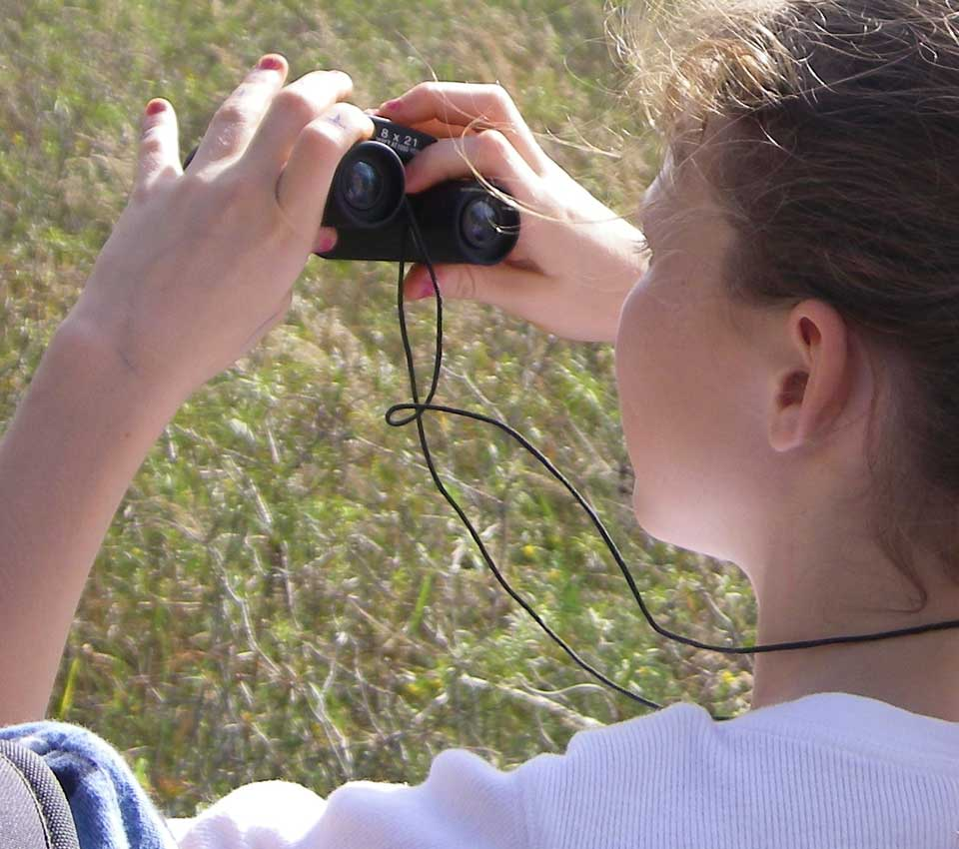
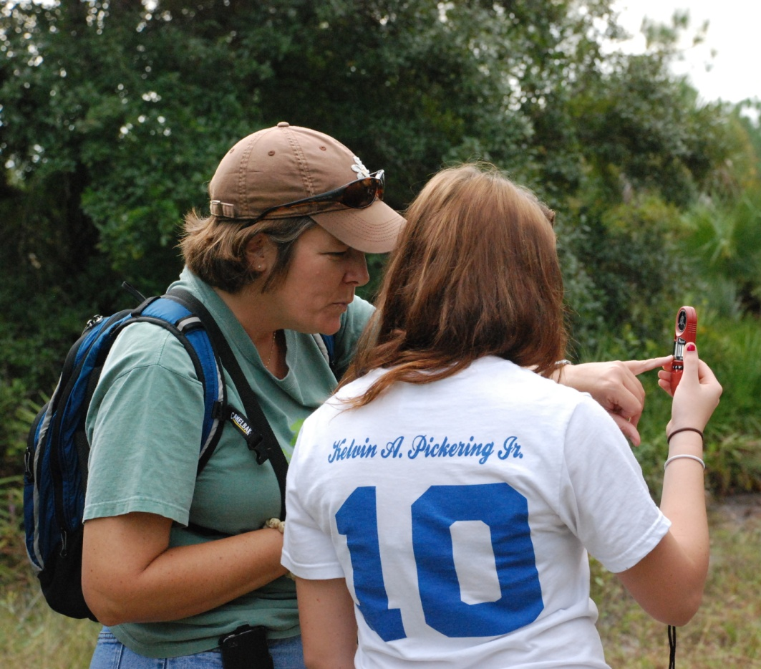
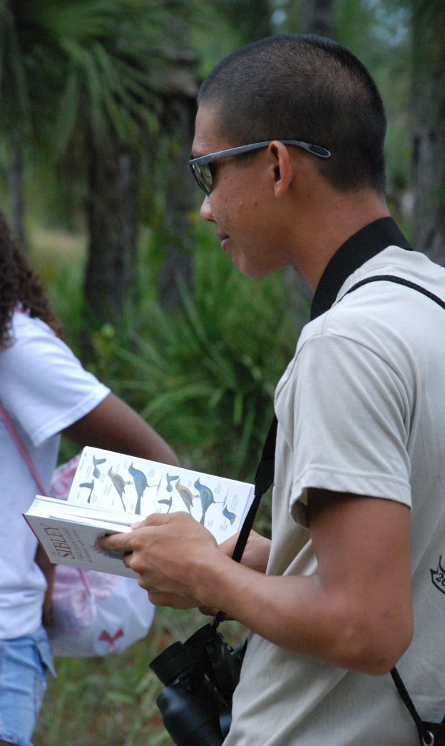
CREW Legacy in Action

Slide 10
DuPuis Management Area MARTIN COUNTY
21,875 acres of natural area with ponds, wet prairies, cypress domes, pine flatwoods and remnant Everglades marsh
400-foot boardwalk trail provides a path through a cypress swamp
22 miles of hiking trails and 40 miles of horseback trails
Legacy activities:
GPS and photo documentation of pine flatwoods understory restoration
PowerPoint presentations developed for younger students

Slide 11
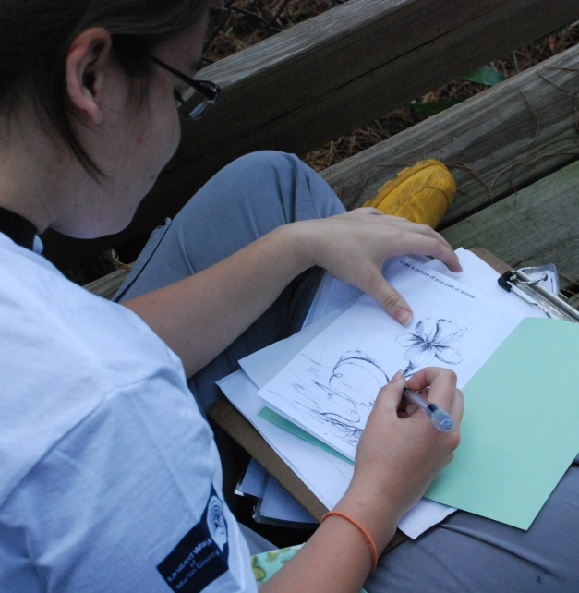
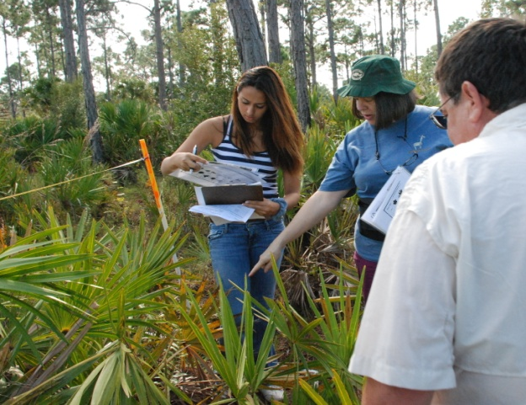
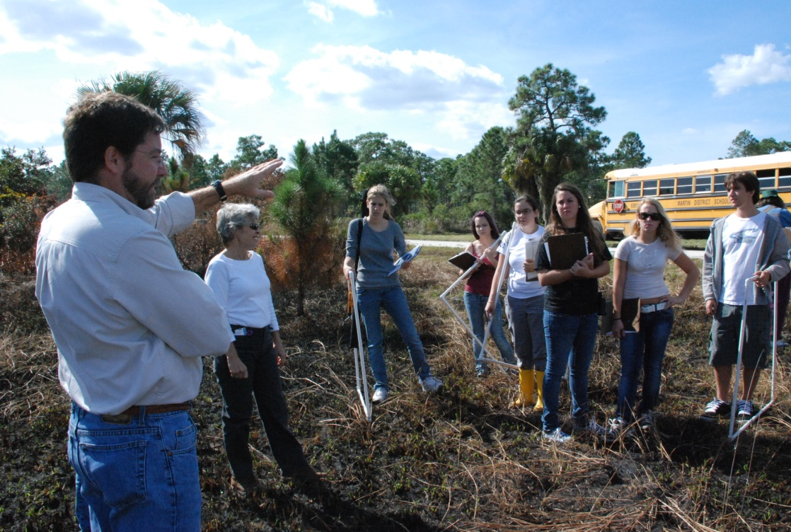
DuPuis Legacy in Action

Slide 12
LILA (Loxahatchee Impoundment Landscape Assessment) PALM BEACH COUNTY
Located on the grounds of the Arthur R. Marshall Loxahatchee National Wildlife Refuge
80-acre living laboratory that mimics (on a smaller scale) how the 1.7 million-acre Everglades functions
Legacy activities:
Water quality monitoring and aquatic invertebrate surveys
Test for critical water quality parameters, collect data and analyze results

Slide 13
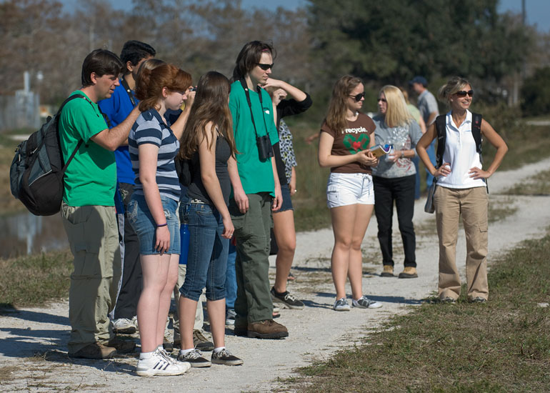
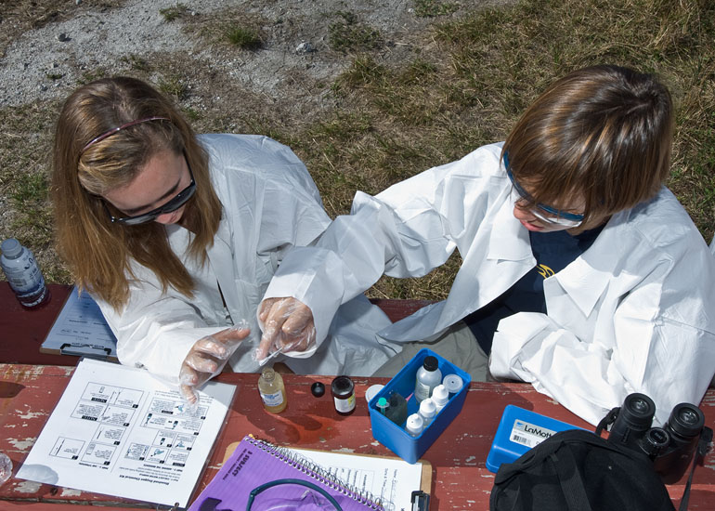
LILA Legacy in Action

Slide 14
Osceola Environmental Studies Center OSCEOLA COUNTY
Environmental Center sits on 850 acres at Lake Russell
Prominent floodplain swamp with other natural communities including rare dry prairie, flatwoods and scrub habitat
Legacy activities:
Conduct wildlife surveys and map locations using GPS
Implement procedures to enhance wildlife habitat

Slide 15
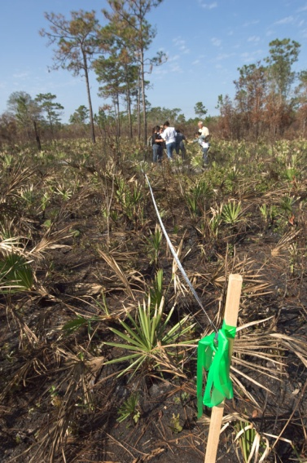
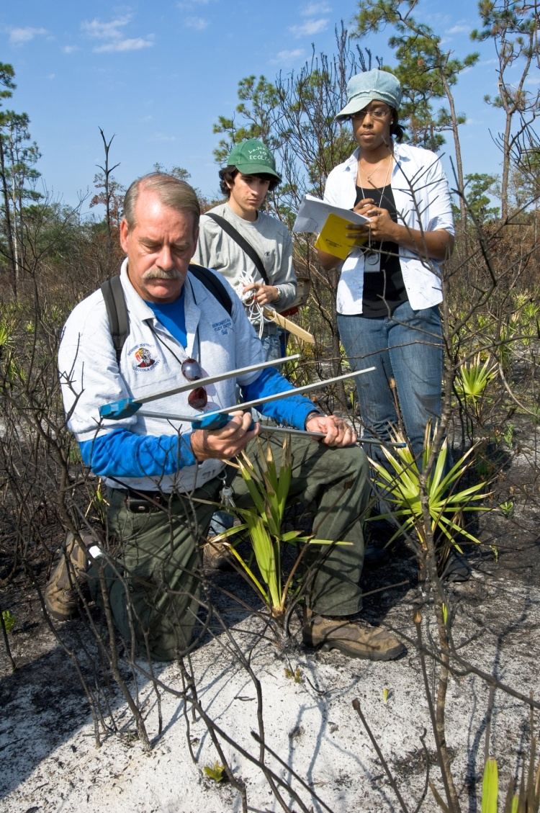
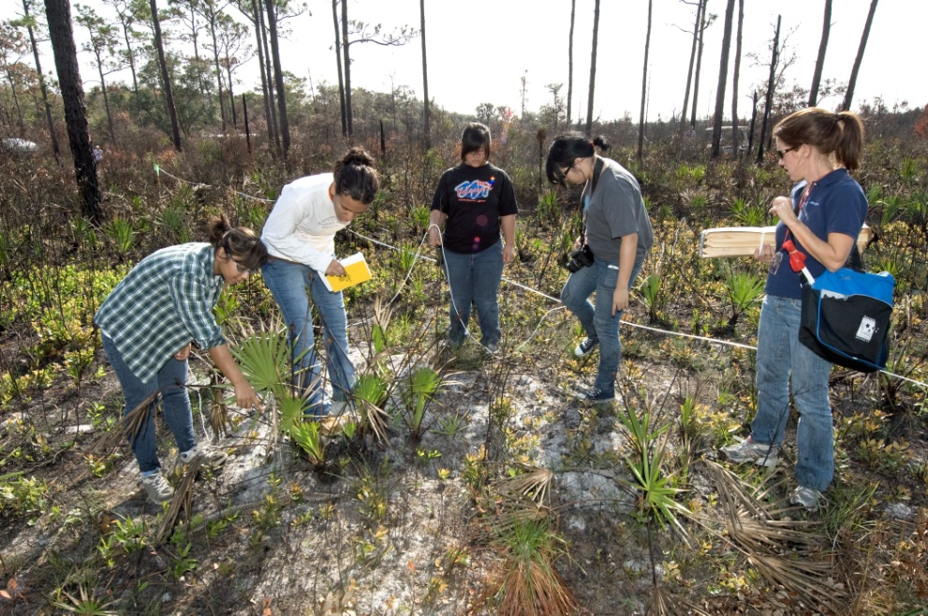
Osceola Environmental Center Legacy in Action

Slide 16
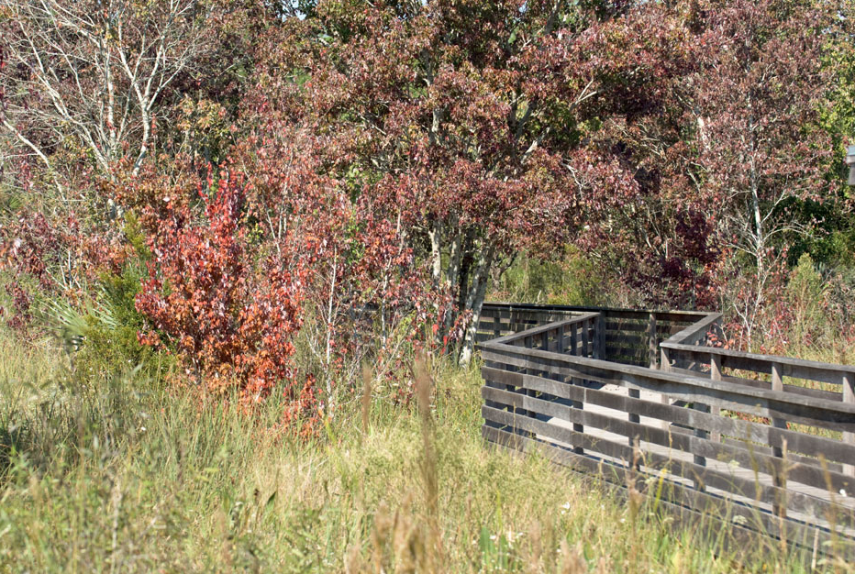
Students Recall What They Liked Best
“The swamp because I've never been anywhere like this.”
“All the outside activities. I love the environment!”
“The boardwalk that puts us in the middle of the marsh.”
“Setting the stakes and stomping through the woods.”
“Finding the Geocach after searching so hard.”
“Experiencing the beautiful boardwalk.”

Slide 17
Students Recall What They Liked Best (cont.)
“Talking with the SFWMD scientists.”
“The nature center. Learning about the animals was exciting.”
“Walking through the palmettos and connecting with nature.”
“Holding the lubber (grasshopper). I didn't know they were so tame.”
“Marking the transects, then looking up to see 3 bald eagles flying overhead. This wouldn't happen just any place!”

Slide 18
Legacy Program Contact
Visit our website
http://www.sfwmd.gov/legacy
Teach the children well
and they become life-long
ambassadors for the environment!

Slide 19
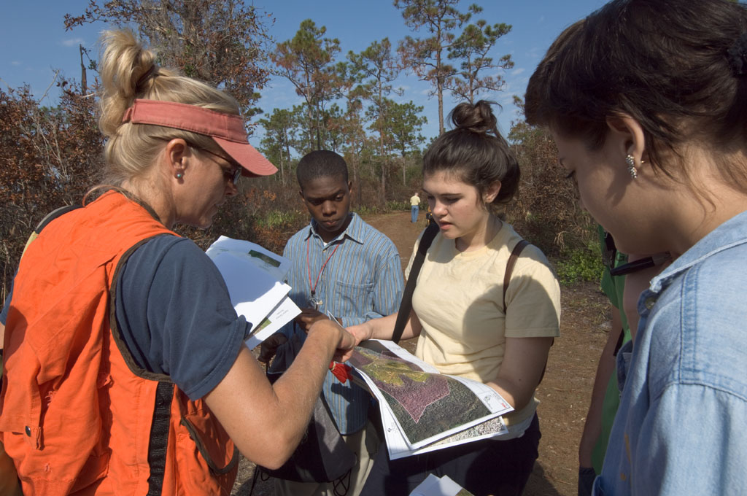
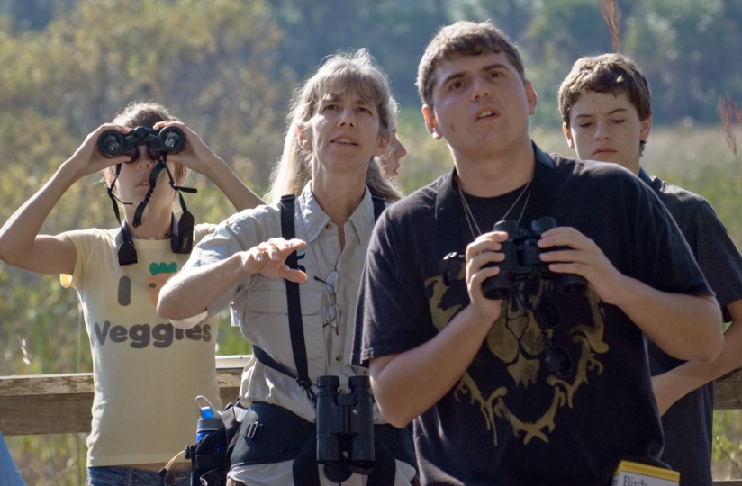
Thank you. Questions?

