Slide 1
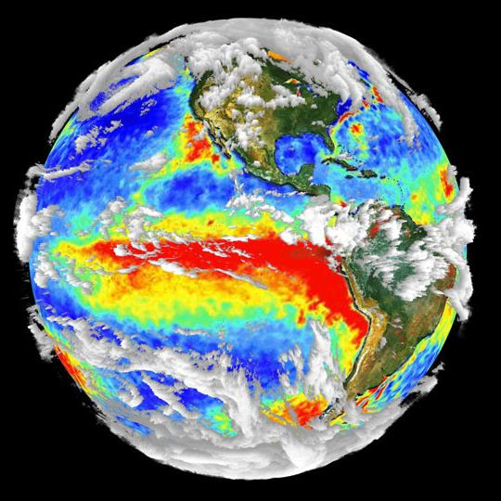
Extended Lake Okeechobee Hydrologic Outlook
June 23rd, 2015

Slide 2
Summary
EL NINO CONDITIONS CONTINUE TO STRENGTHEN as indicated by recent observations of Equatorial water temperatures in the equatorial Pacific ocean. Atmospheric observations above the tropical Pacific also are in good agreement with those normally associated with El Nino. A moderate to strong El Nino is likely to persists into early 2016.
The latter half of the wet season will tend towards normal rainfall probabilities. There are increased chances of above normal rainfall for the 2015-2016 dry season
The Atlantic Multidecadal Oscillation (AMO) is showing signs that it is weakening and possibly entering the cold (negative) phase, which if it is the case, creates the potential for drier conditions in south Florida during the wet season. It also decreases the tropical activity in the Atlantic.

Slide 3
Precipitation Outlook
May Anomaly Outlook
May – June –July Anomaly Outlook

Slide 4
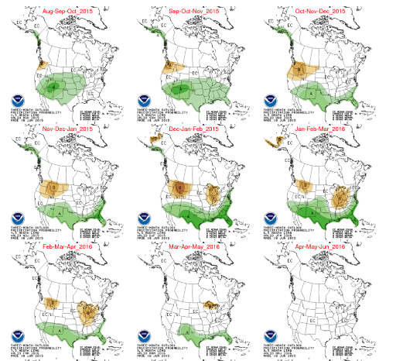
U.S. Multi- Seasonal Outlook
PROGNOSTIC DISCUSSION FOR LONG-LEAD SEASONAL OUTLOOKS

Slide 5
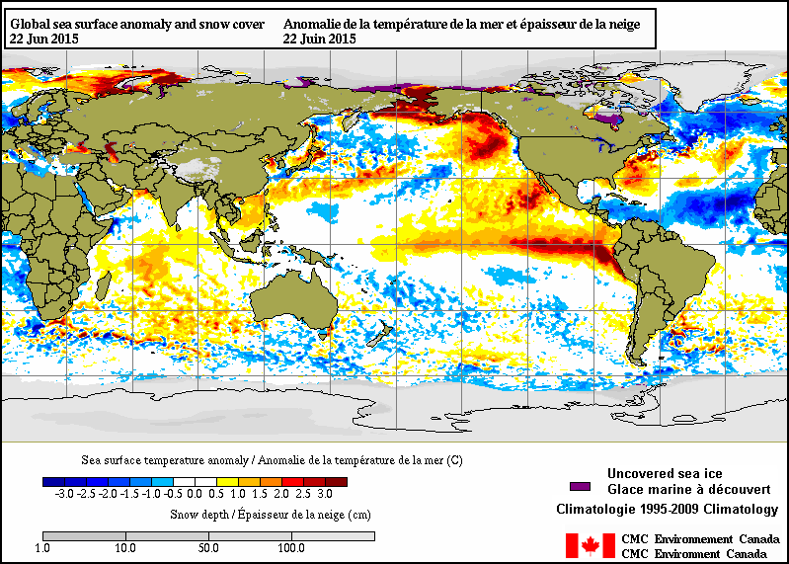
Current Global Sea Surface Temperature Anomalies
PDO
Positive
Phase
Below average SSTA in tropical Atlantic
Strengthening El Nino
animation

Slide 6
Rapid Development Occurring
El Nino continues to strengthen
Notes:
http://www.cpc.ncep.noaa.gov/products/expert_assessment/

Slide 7
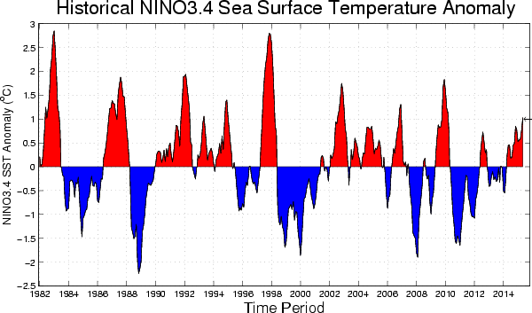

Slide 10
Pacific Decadal Oscillation
Notes:
http://www.cpc.ncep.noaa.gov/products/GODAS/

Slide 11
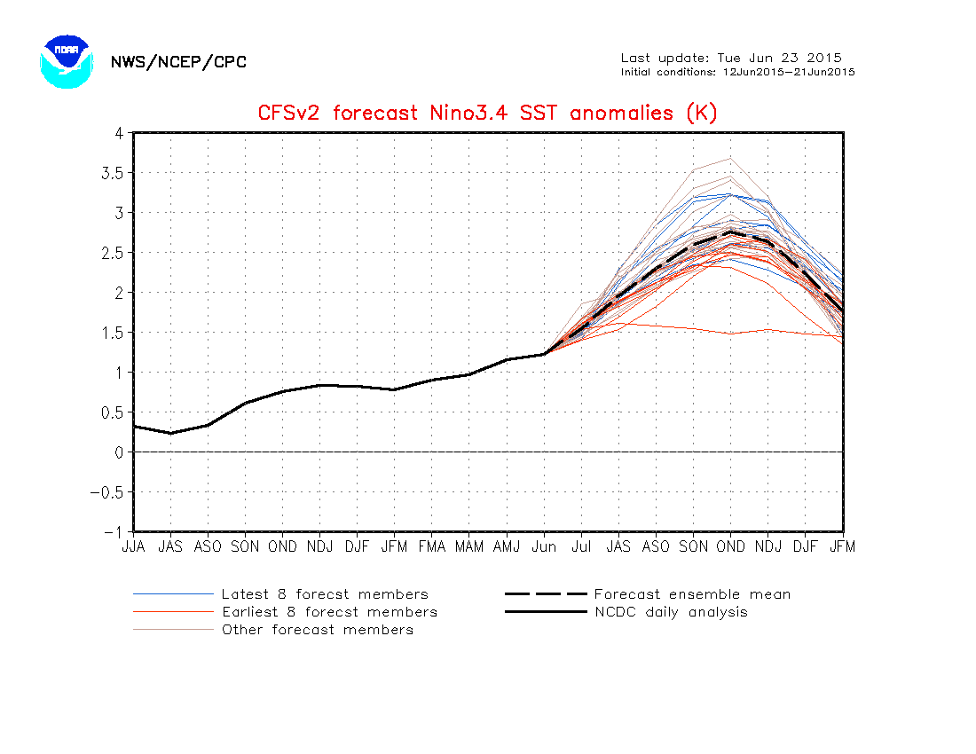

Slide 12
Degree Celsius
Notes:
http://www.cpc.ncep.noaa.gov/products/CFSv2/imagesInd3/nino34Sea.gif

Slide 13
This graphic is late in being updated by IRI. The chances of El Nino have likely increased.

Slide 14
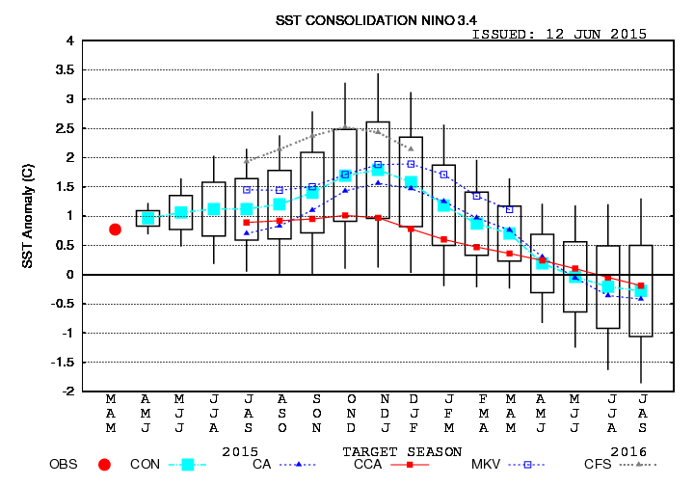

Slide 15
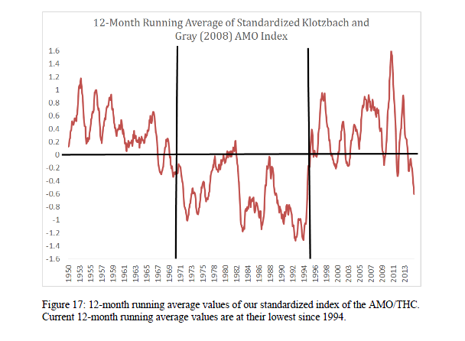
Philip J. Klotzbach and William M. Gray

Slide 16
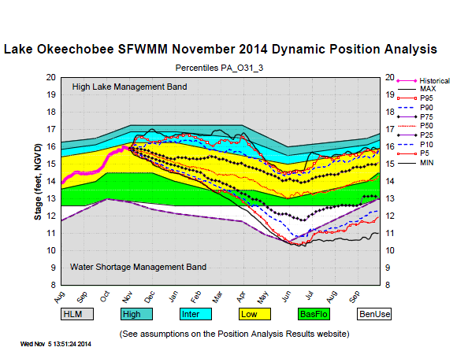
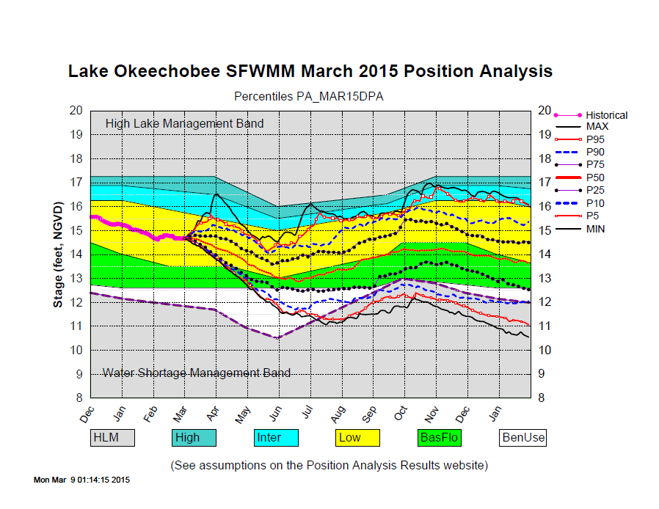
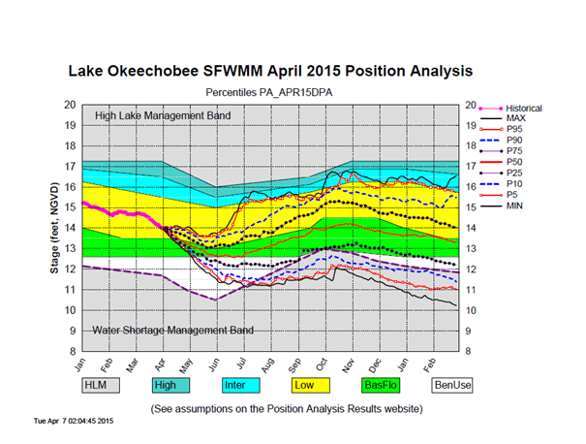

Slide 17
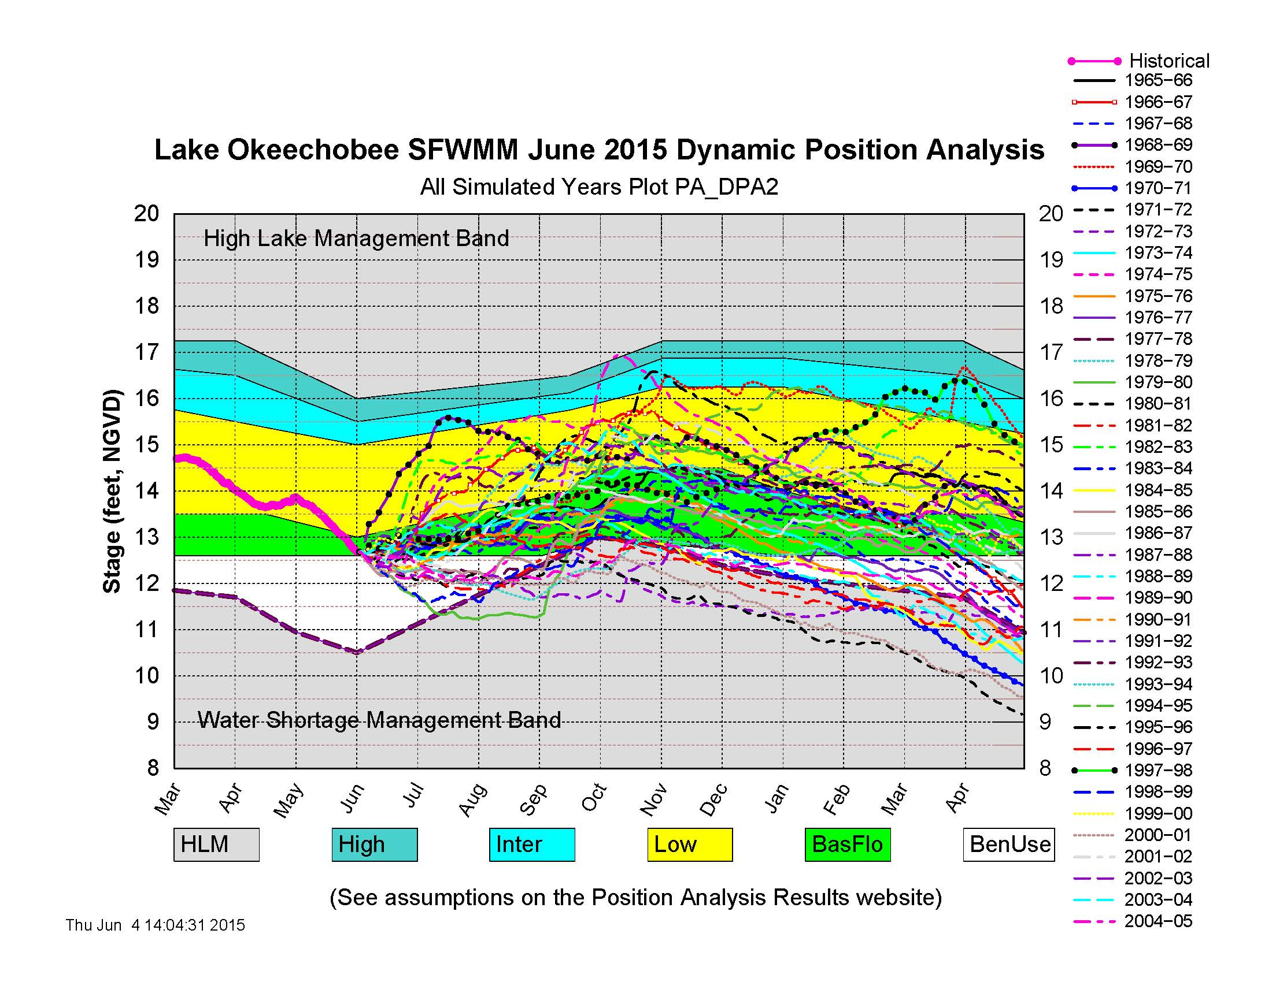

Slide 19
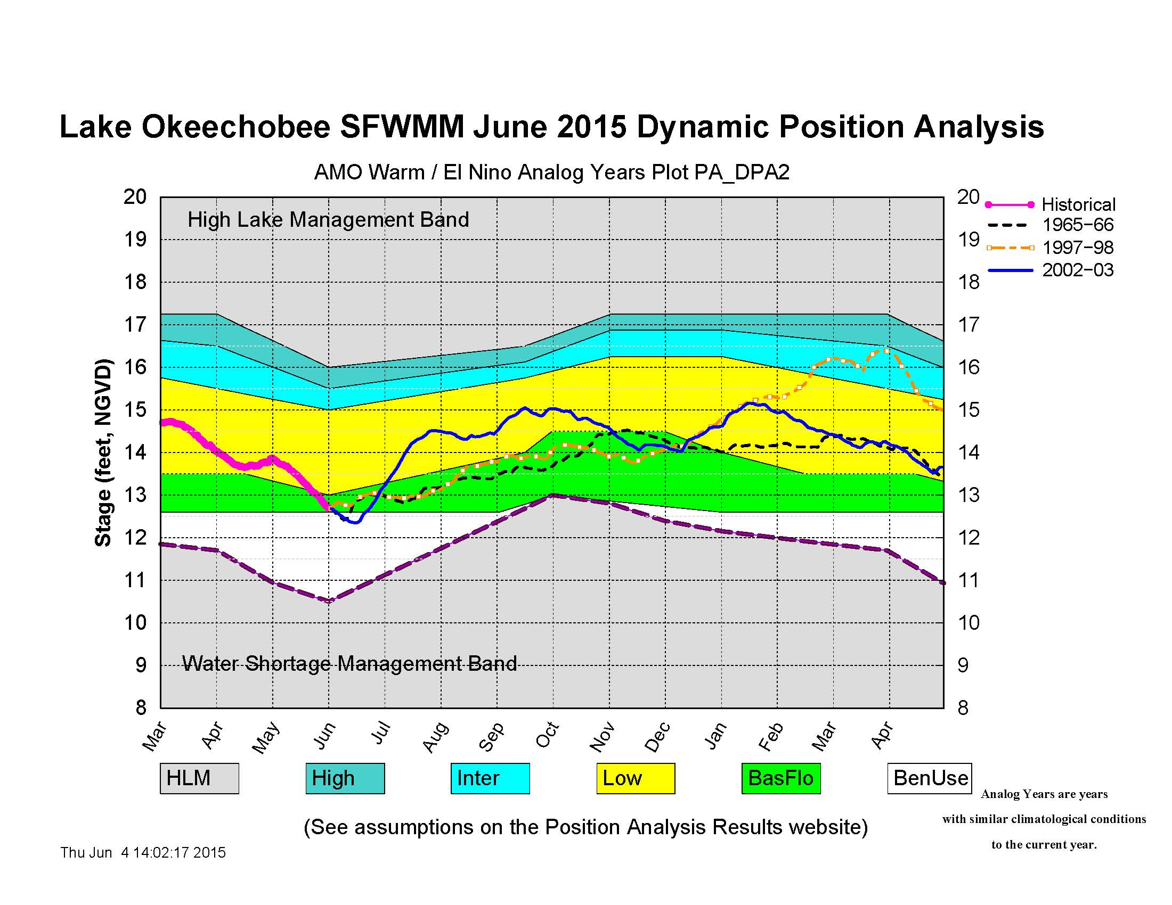

Slide 20
Backup Slides

Slide 21
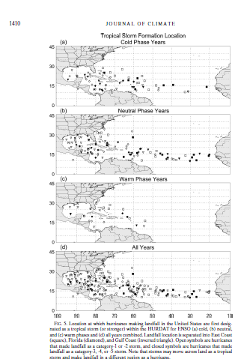
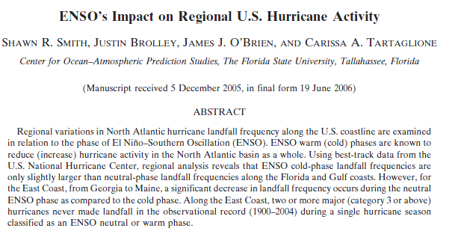
ENSO Impacts on U.S. regional Hurricane Activity
Journal of Climate

Slide 22
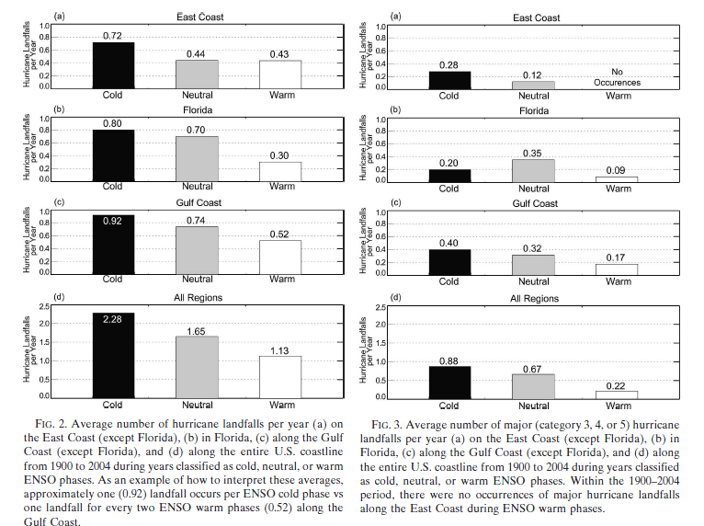
Total Number of Hurricanes
El Niño is listed here as “Warm”
Total Number of Major Hurricanes
El Niño is listed here as “Warm”

Slide 23
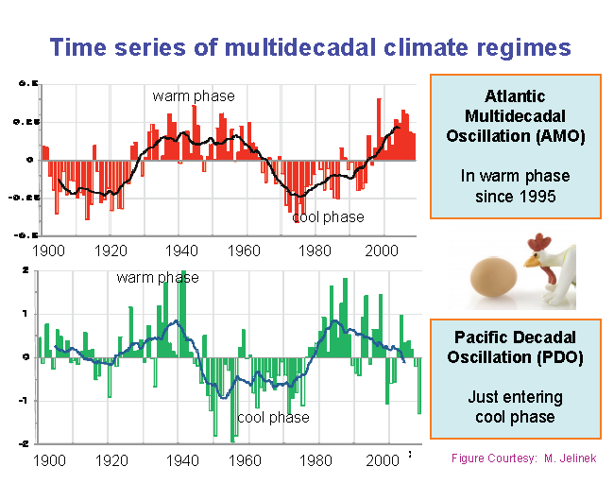

Slide 24
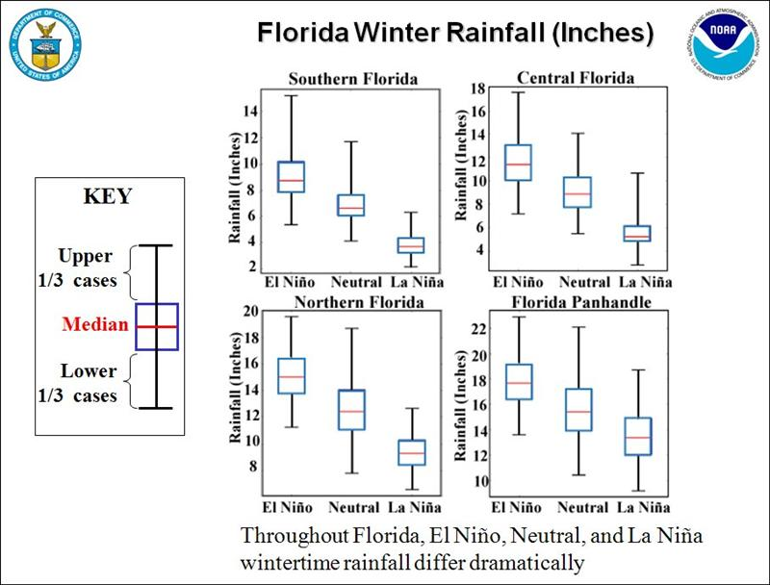

Slide 25
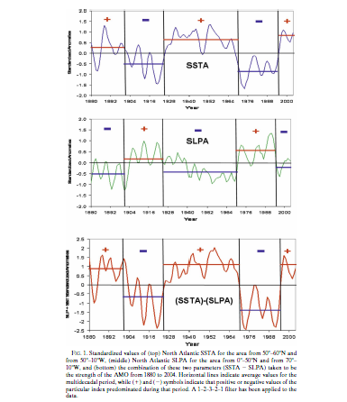
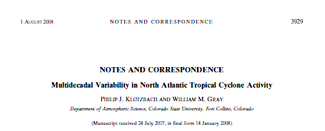
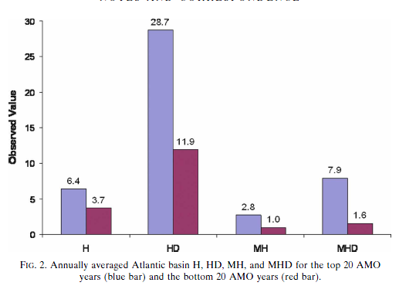
Atlantic Multidecadal Warm and Cold Phases
JOURNAL OF CLIMATE

Slide 26
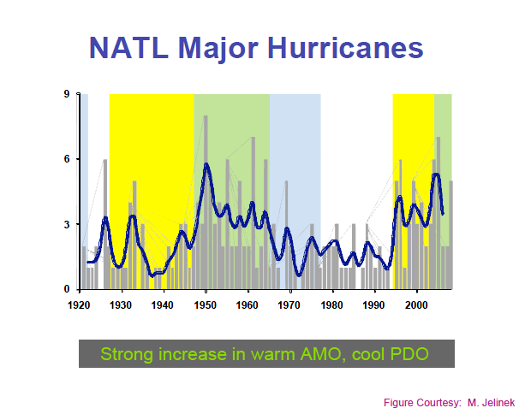

Slide 27
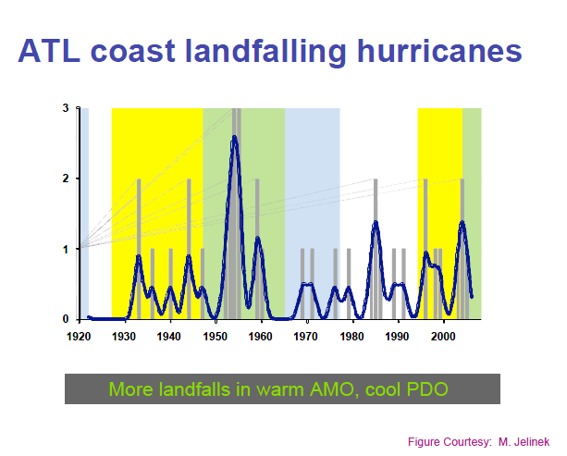
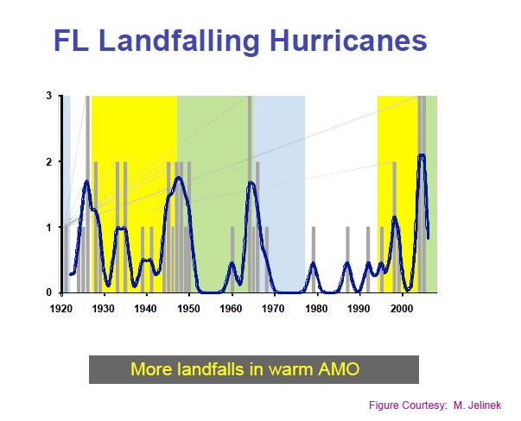

Slide 28
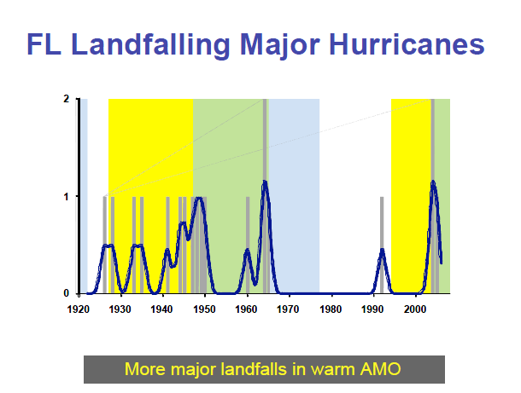

Slide 29
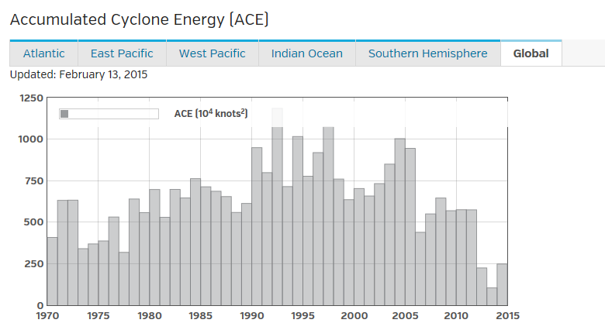
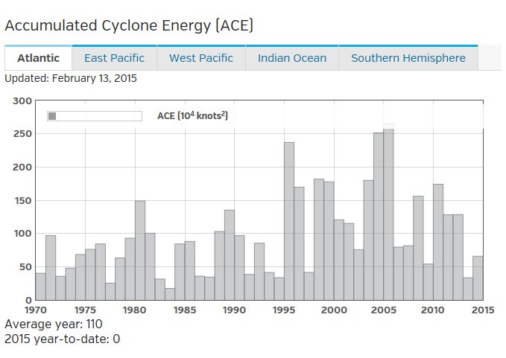

Slide 30
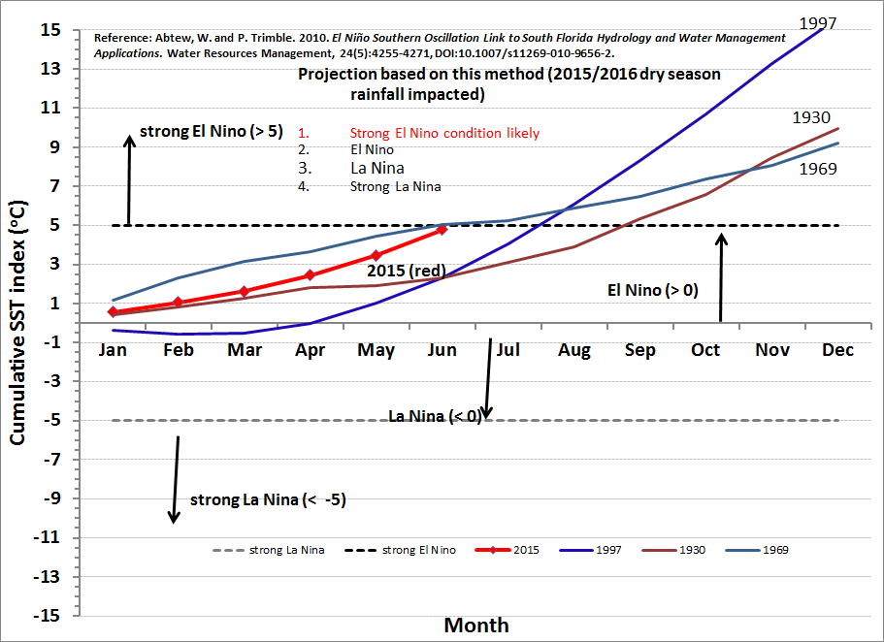
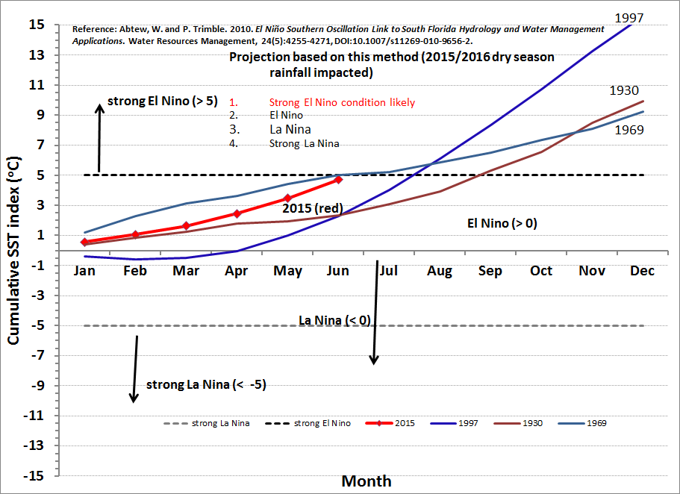

Slide 31
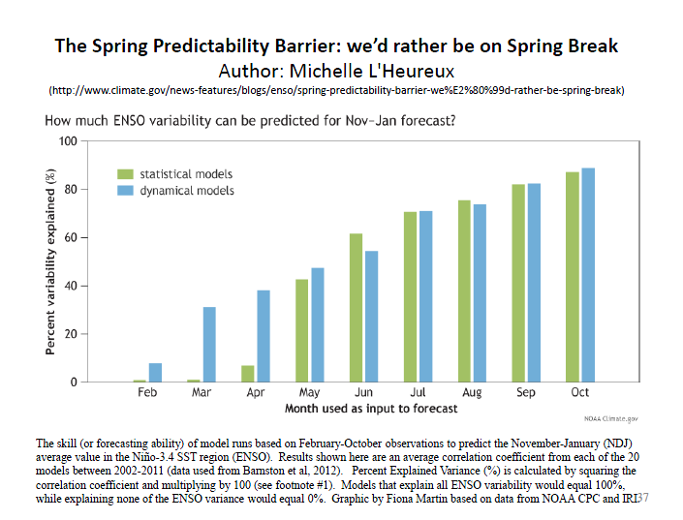
Dynamic models tend to do better through the spring barrier.

Slide 32
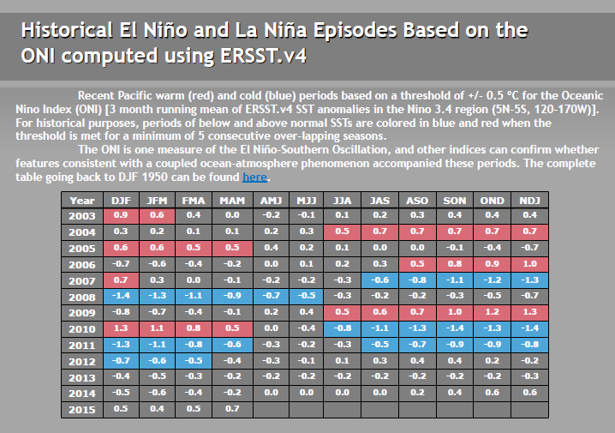
2014-15 marked as an official El Nino event by CPC.

Slide 33
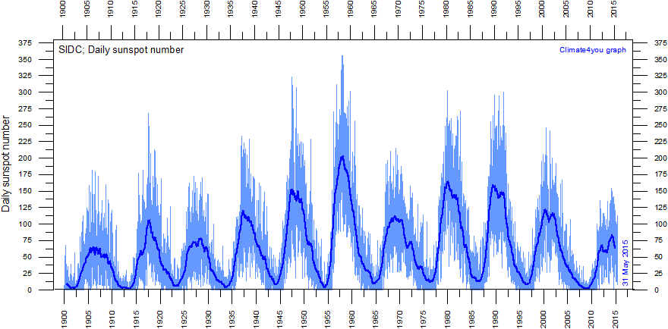
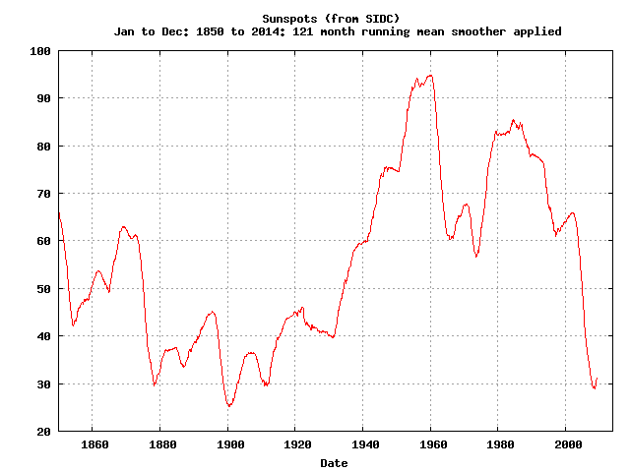
Sunspot Number

Slide 34
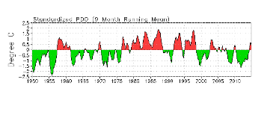
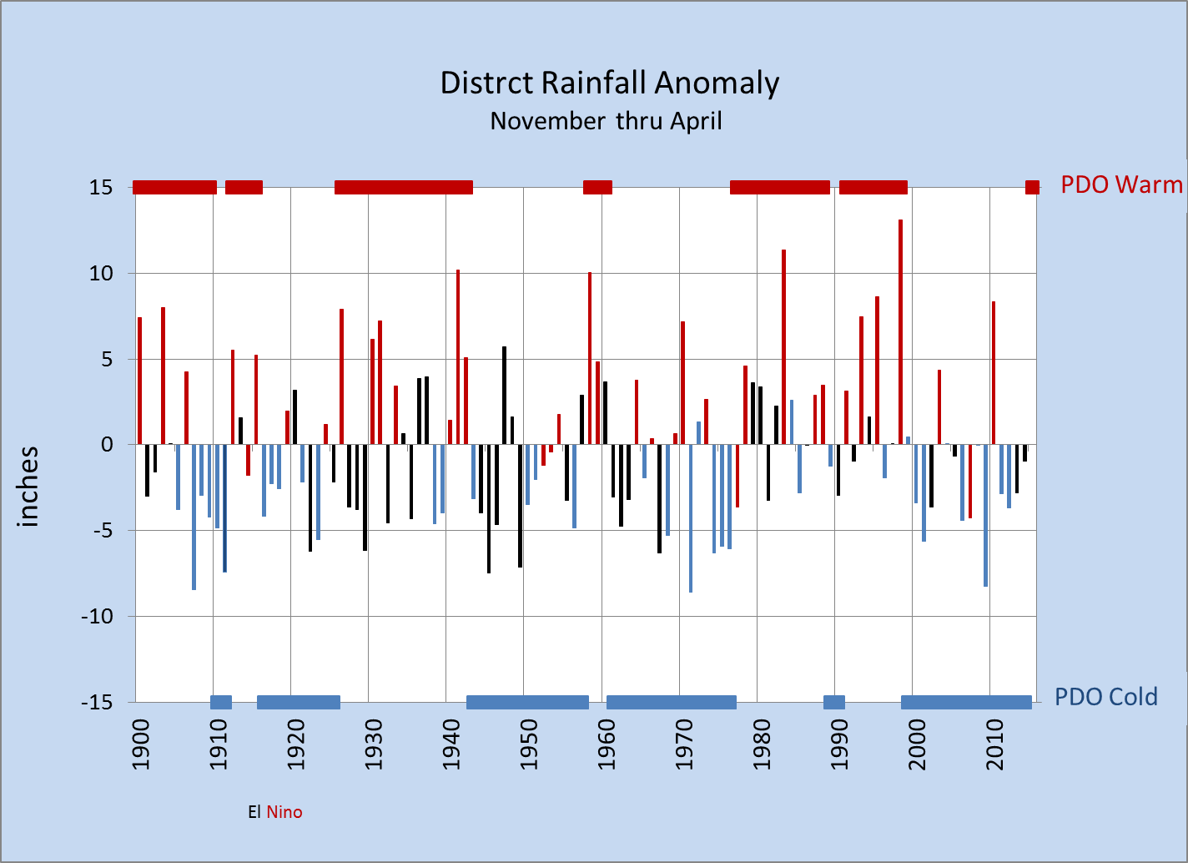
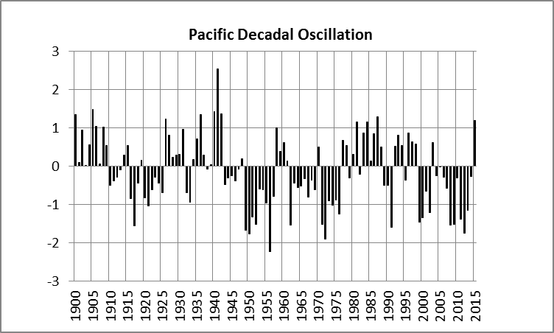
The PDO has transitioned to the positive phase after an extended period of being negative

Slide 35
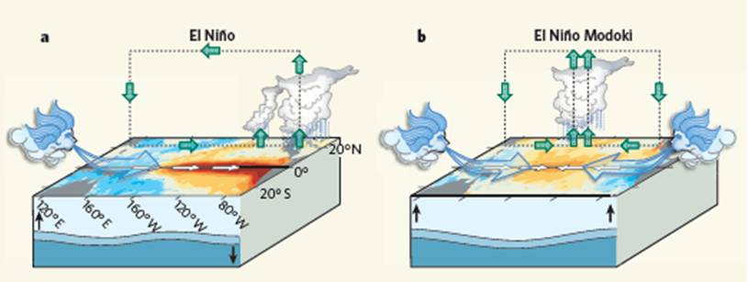

Slide 36
