Slide 1
July 15, 2026: Conditional Position Analysis (CPA) Implementation – LOSOM
Water Resources & Systems Modeling Bureau, Systems Modeling Unit
SFWMD

Slide 2
CPA Overview
CPA is a stochastic framework (CPA Overview) that transforms stages obtained from Dynamic Position Analysis (DPA) based on forecasted rainfall conditions over the next twelve months (Ali, 2016).
CPA depends on DPA - DPA stage outputs are used as inputs to CPA (DPA). DPA uses a physically based model (SFWMM) to forecast stages from the currently observed stages using 52-years of historical rainfall.
3 rainfall outlook scenarios (climatological, CPC, and Preferred Scenario) are used to compare potential stage outlooks.
CPA is implemented for 200 locations in the Everglades including Lake Okeechobee. Additionally, CPA is implemented for WCA1Avg (avg of Site 7, Site 8T, and Site 9) and WCA3AAvg (avg of Site 63, Site 64, and Site 65) stages (Khare et al., 2024) in the Everglades.

Slide 3
CPA Overview
CPA Outputs
  CPA forecasted stage percentiles from ‘Climatologic’ scenario are first collapsed on DPA stage percentiles. Corresponding adjustments are then applied to stage percentile lines for all other rainfall scenarios.

Slide 4
CPA: Rainfall Scenarios for July 15, 2026
Climatological
  Climatological scenario assumes equal chances of below-normal/dry, normal, and above-normal/wet rainfall conditions over next twelve 3 monthly seasons (slide 5).
  This scenario is the connecting link between DPA and all other scenarios simulated under CPA.
CPC
  This is based on official rainfall forecasts published by NOAA’s Climate Prediction Center (CPC) every month (Climate Prediction Center - Forecasts & Outlook Maps, Graphs and tables (noaa.gov)).
  The July 15, 2026, CPC rainfall scenario reflects the latest rainfall outlook released by CPC.
  It is also used by JEM’s EverForecast tool for stage prediction.
Preferred Scenario (PrefSce)
  Seasonal rainfall probabilities are calculated based on historical data and projected Relative Oceanic Nino-3.4 Index (RONI) published by the CPC.
  This scenario developed by System Modeling Unit (PrefSce Overview) represents a best professional judgement rainfall outlook.
  July 15, 2026, PrefSce rainfall scenario includes latest release of seasonal rainfall outlook from NOAA.
  Seasonal tercile probabilities of the remaining days of the current JAS season are estimated from the average of RONI published by the CPC and QPF produced by WMD, WPC, ECMWF HRES, and 100 ECMWF ensembles, in combination with historical rainfall data during 1991–2020.
  The monthly probability for the remaining days of July is derived from the QPF estimates generated from WMD, WPC, ECMWF HRES, and 100 ECMWF ensembles, in combination with historical rainfall data during 1991–2020.

Slide 5
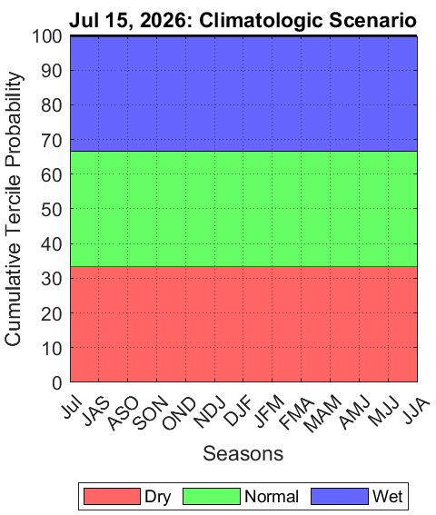
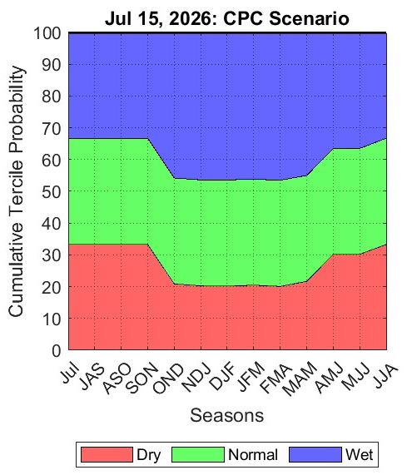
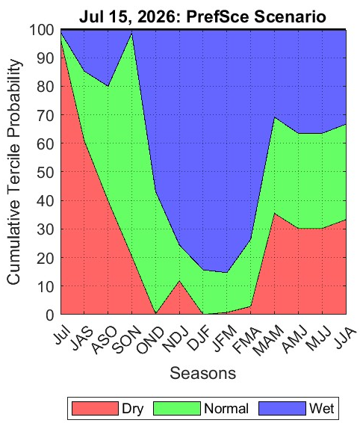
July 15, 2026 CPA: Rainfall Scenarios

Slide 6
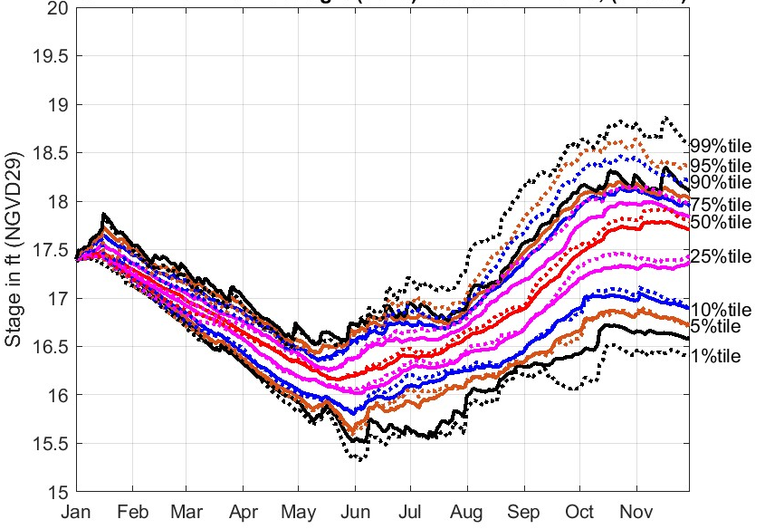
CPA: Key to Reading Results
Solid lines → Climatological Scenario/DPA
Dotted lines → Alternative Rainfall Scenario
Black lines → 1% and 99%
Brown lines → 5% and 95%
Blue lines → 10% and 90%
Pink lines → 25% and 75%
Red lines → 50%
Need to focus on how DPA percentile lines shift under Alternate Rainfall Scenario

Slide 7
LOSOM

Slide 8
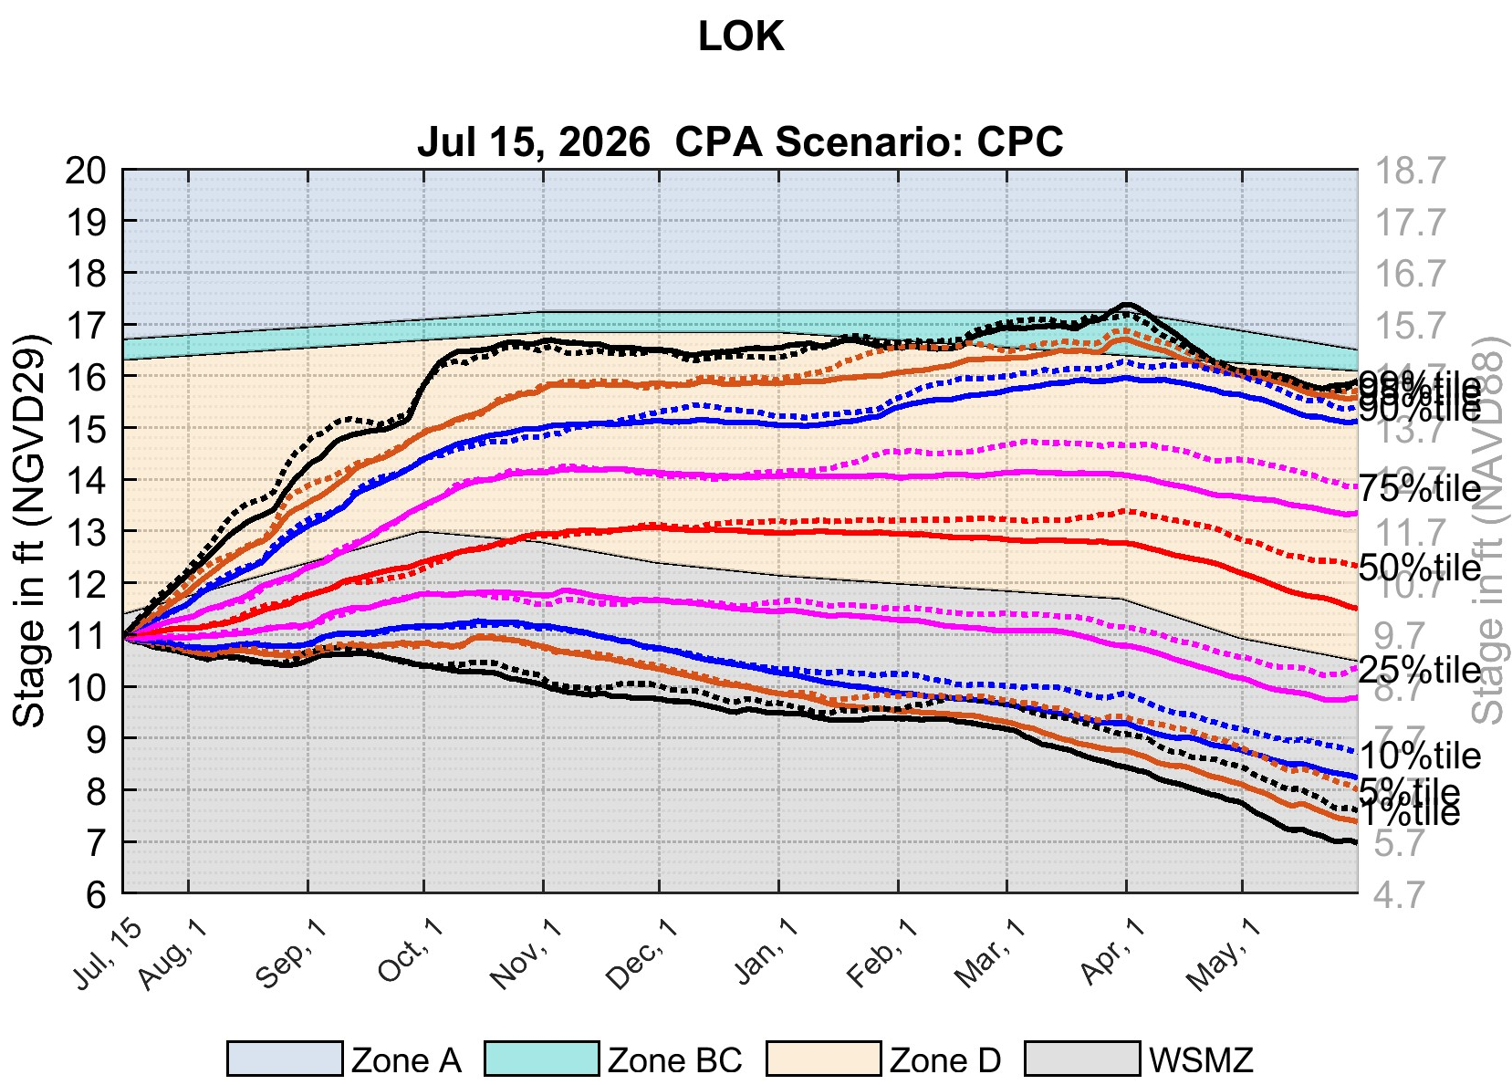
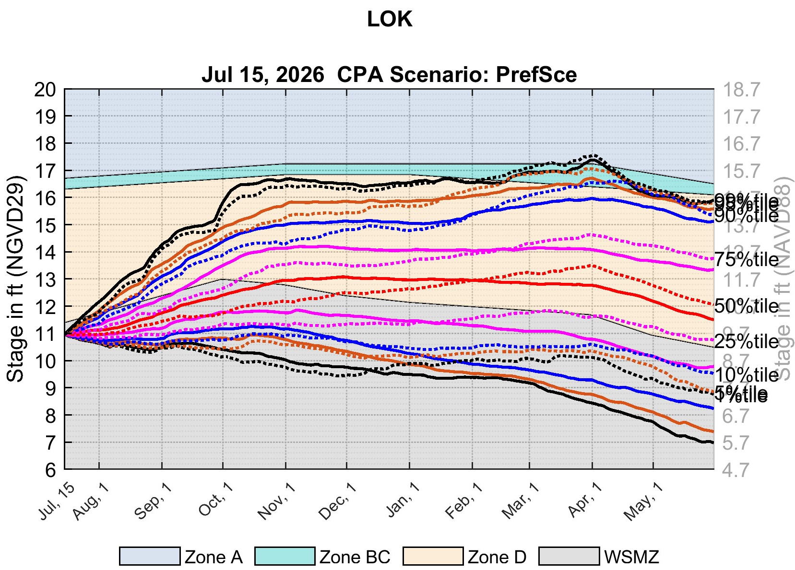
July 15, 2026 CPA: Lake Okeechobee
CPC
PrefSce
Secondary vertical axis shows stages in NAVD88. These stages are based on agreed upon regulation schedule conversion offsets between NGVD29 and NAVD88 (1.30 ft for Lake Okeechobee).

Slide 9
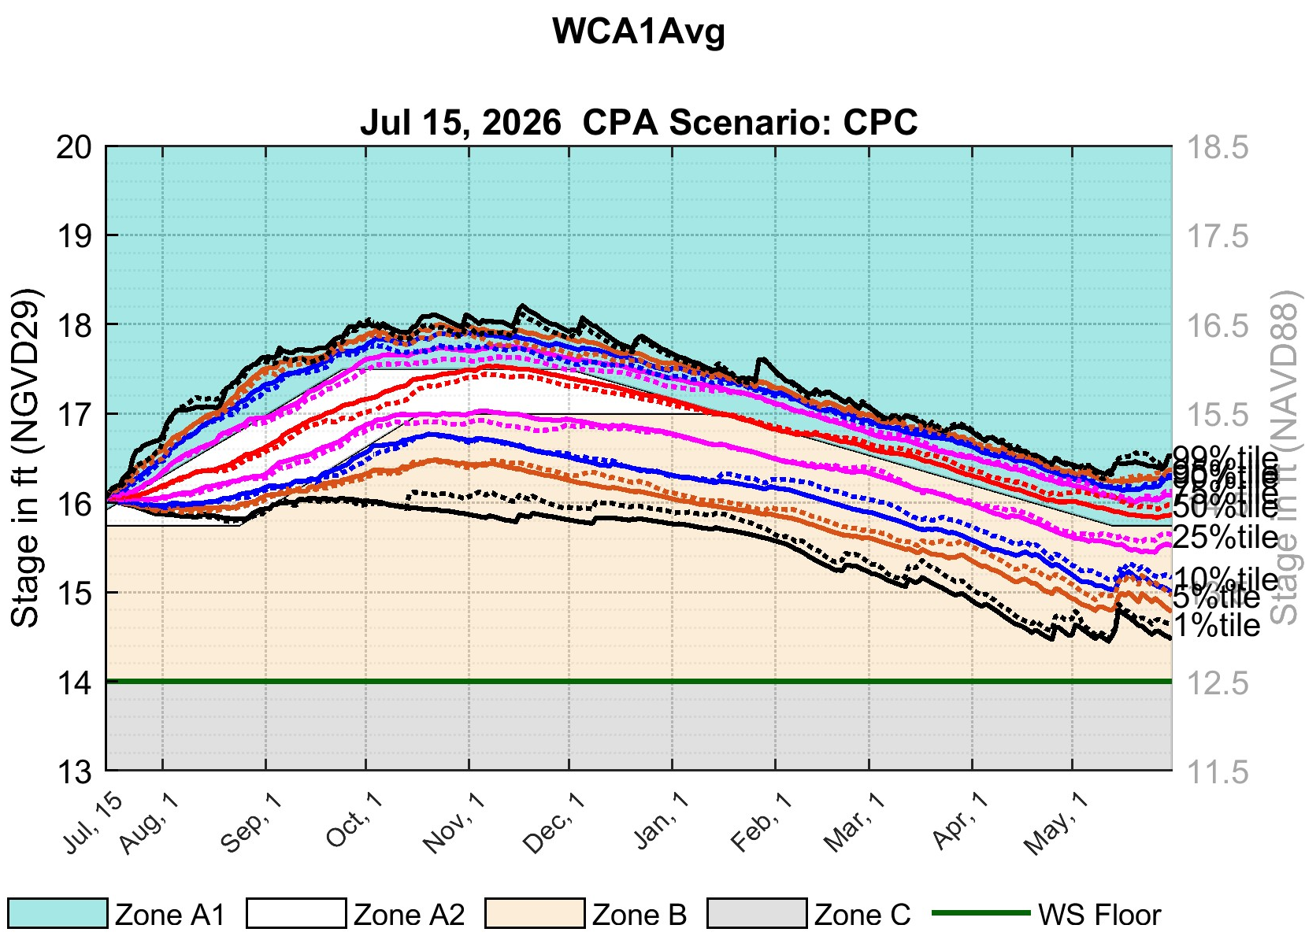
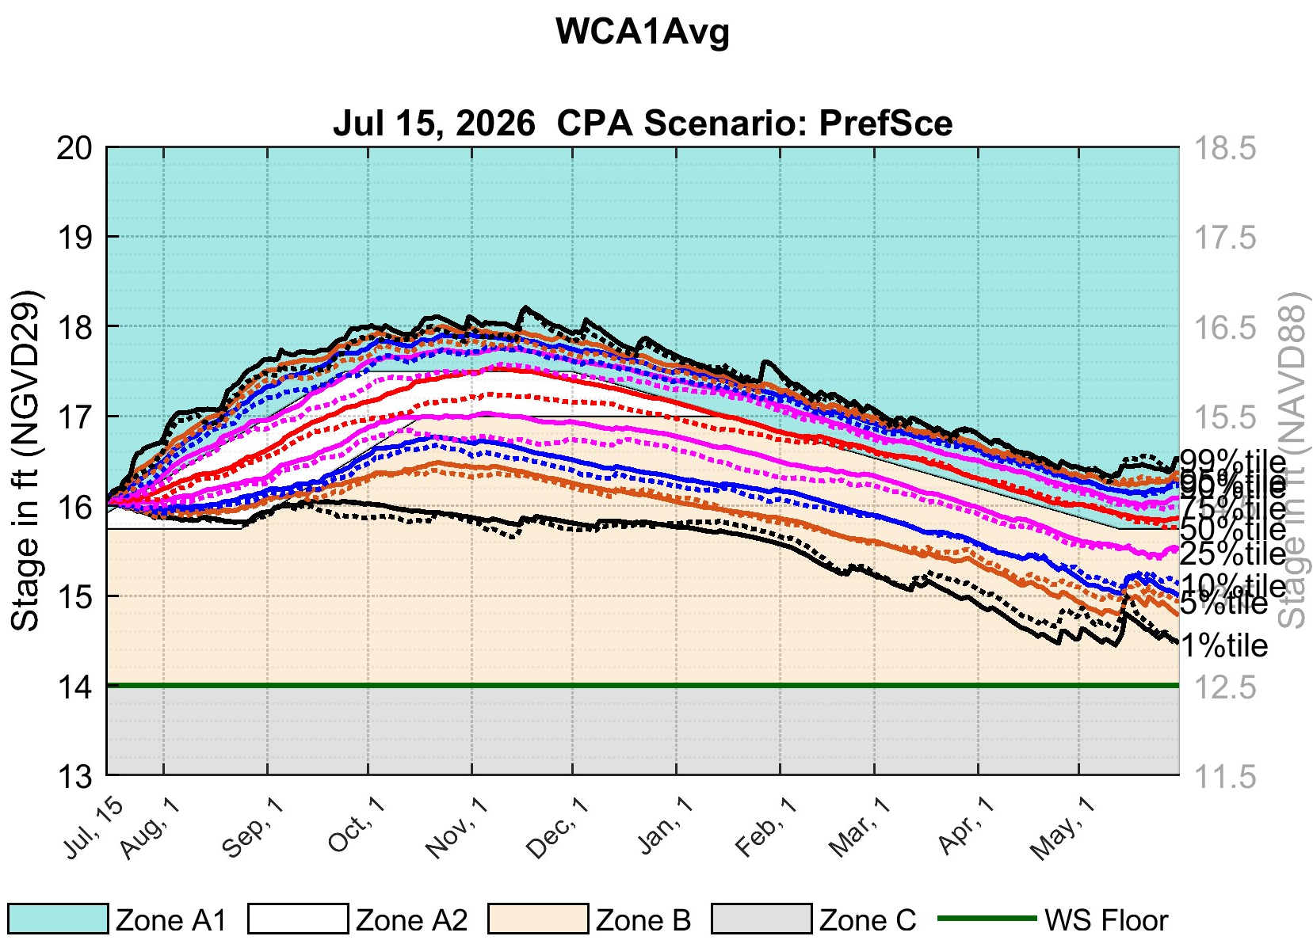
July 15, 2026 CPA: WCA-1 3-Gage Avg.
CPC
PrefSce
WCA-1 3-Gage Avg.
WCA-1 3-Gage Avg.
Secondary vertical axis shows stages in NAVD88. These stages are based on agreed upon regulation schedule conversion offsets between NGVD29 and NAVD88 (1.5 ft for WCA-1).

Slide 10
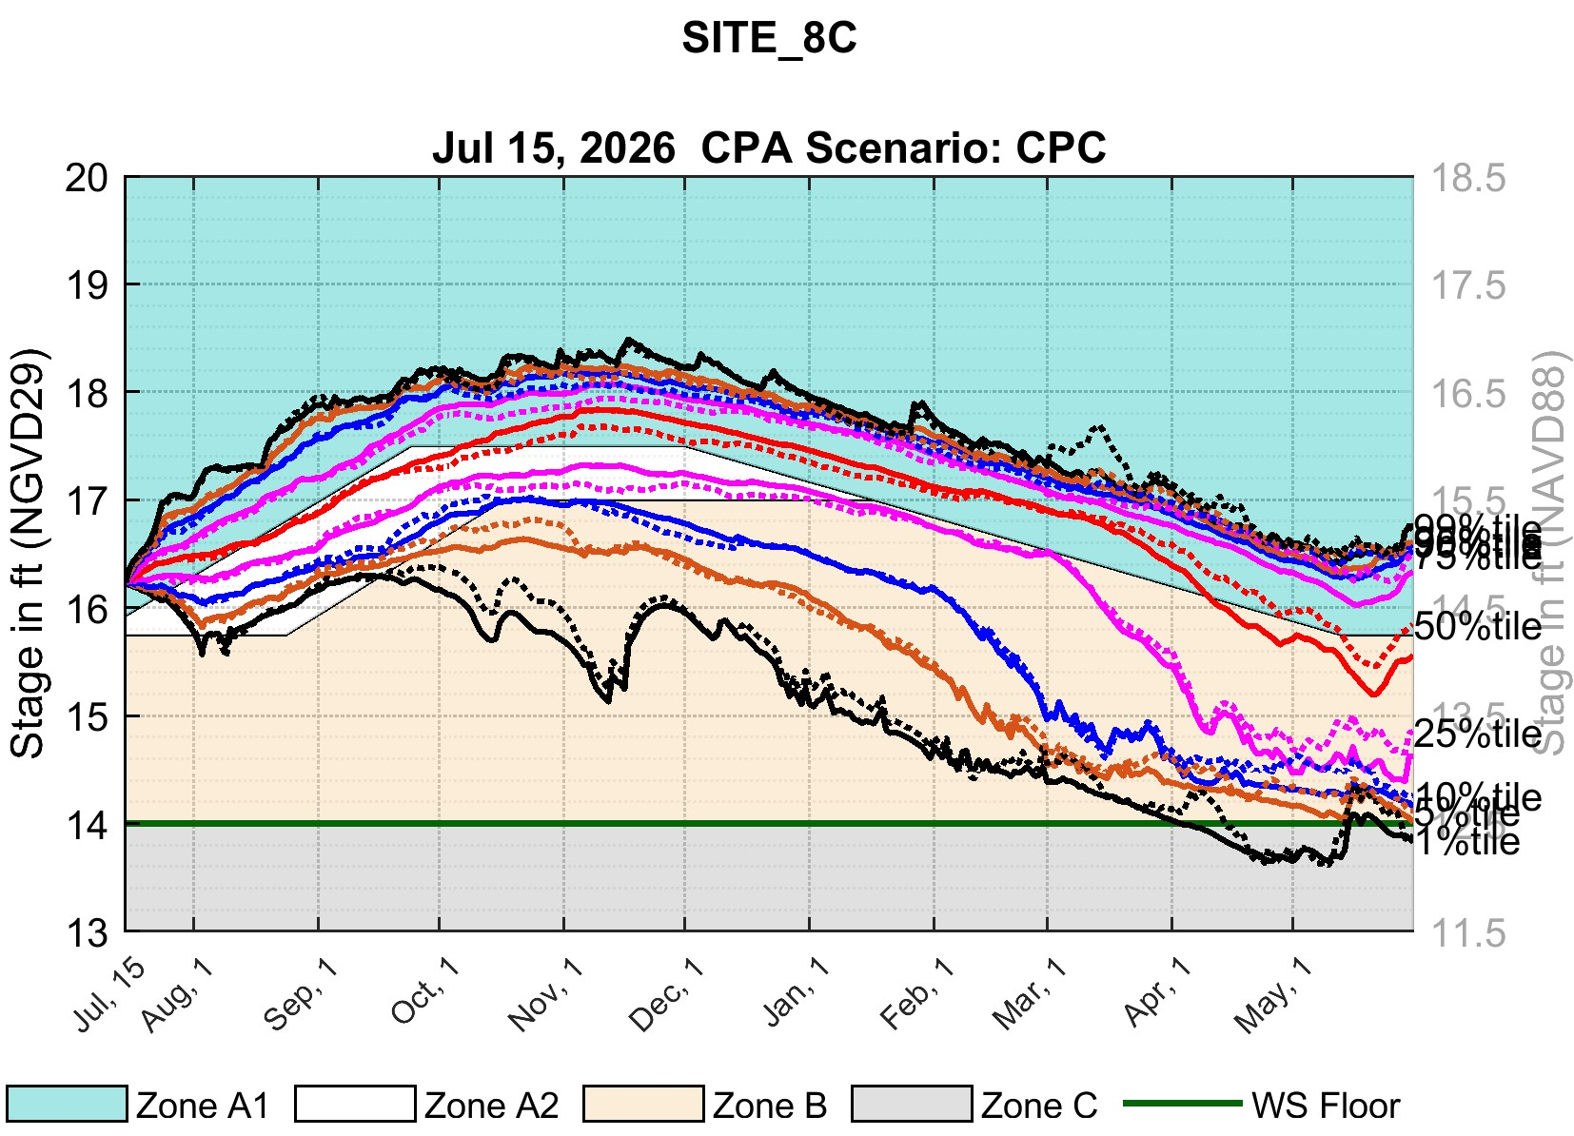
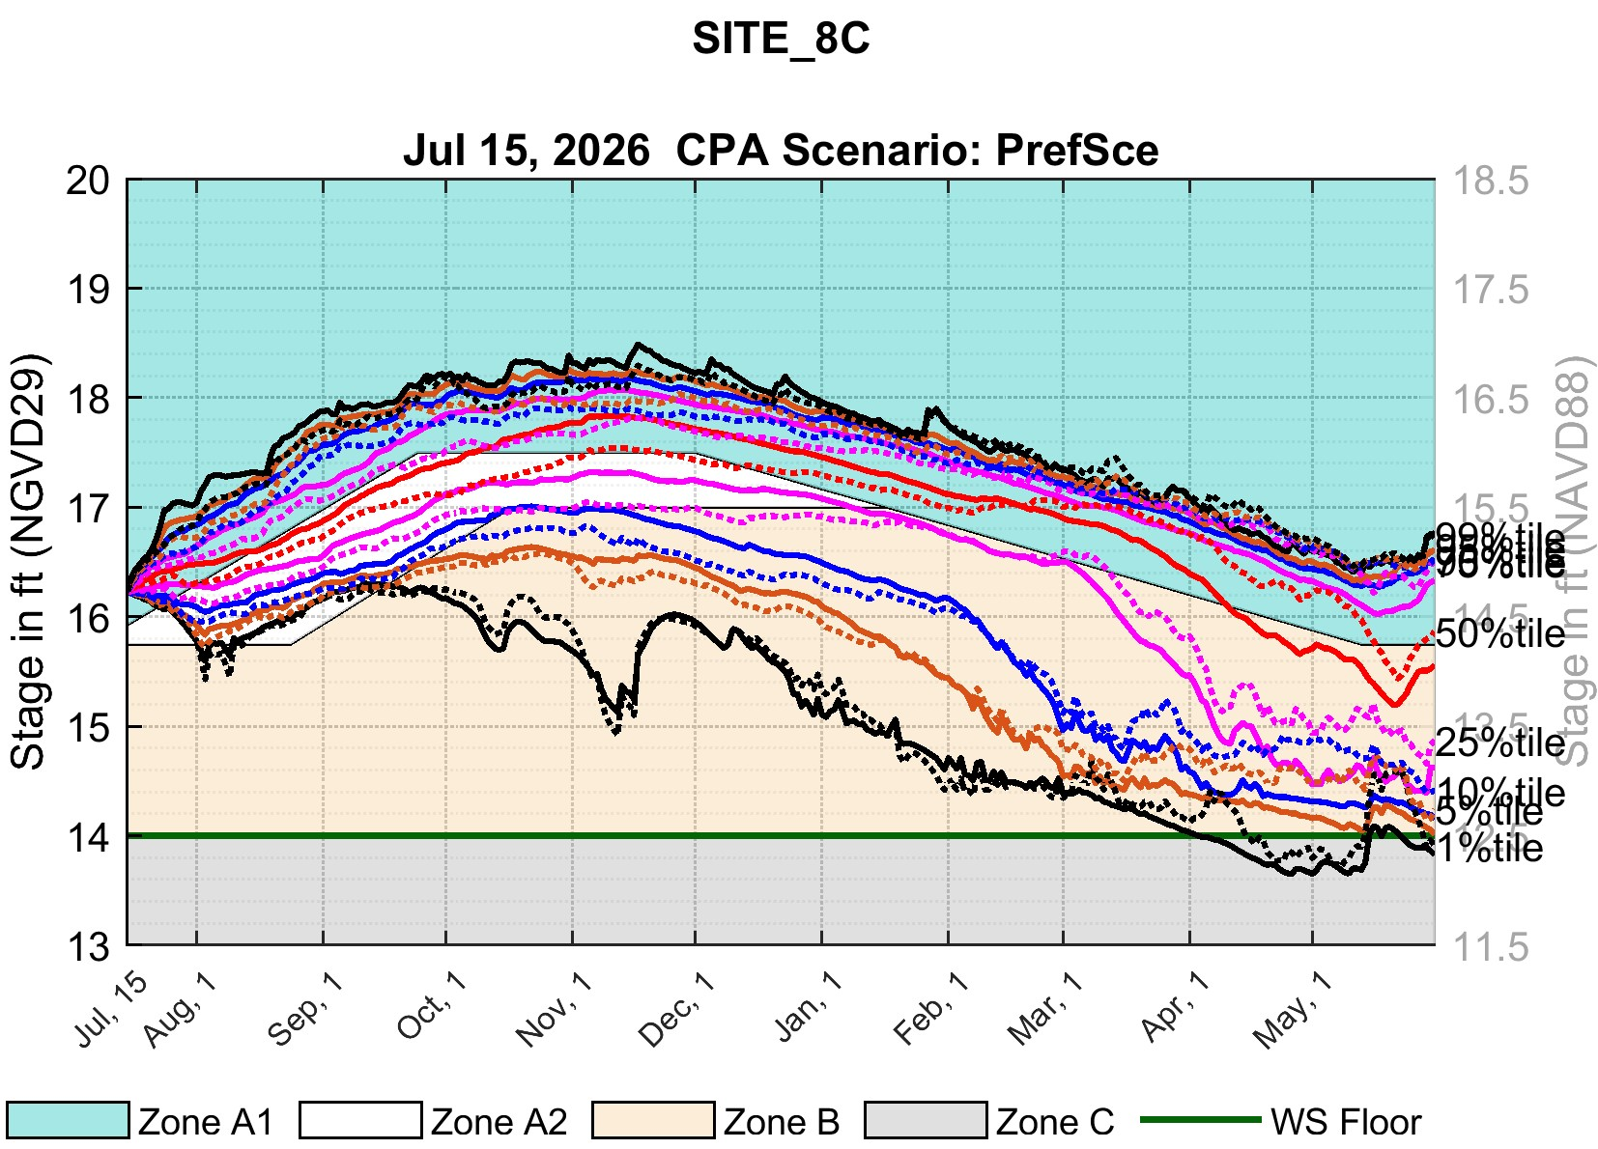
July 15, 2026 CPA: WCA-1 Site-8C
CPC
PrefSce
WCA-1 Site-8C
WCA-1 Site-8C
Secondary vertical axis shows stages in NAVD88. These stages are based on agreed upon regulation schedule conversion offsets between NGVD29 and NAVD88 (1.5 ft for WCA-1).

Slide 11
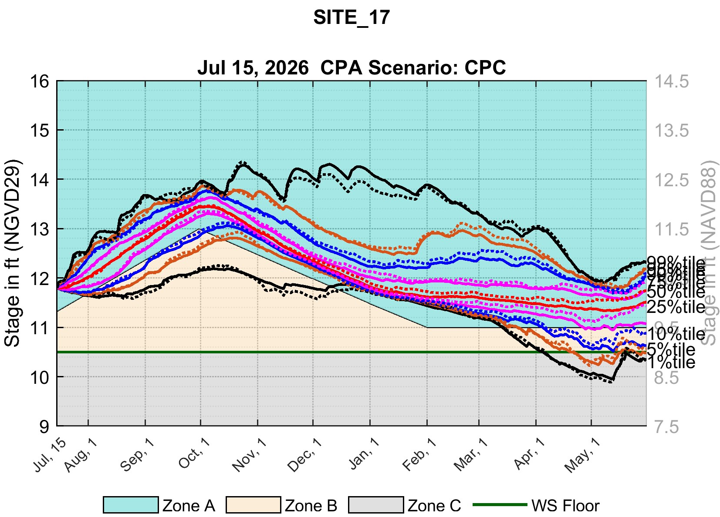

July 15, 2026 CPA: WCA-2A Site-17
CPC
PrefSce
WCA-2A Site-17
WCA-2A Site-17
Secondary vertical axis shows stages in NAVD88. These stages are based on agreed upon regulation schedule conversion offsets between NGVD29 and NAVD88 (1.5 ft for WCA-2A).

Slide 12
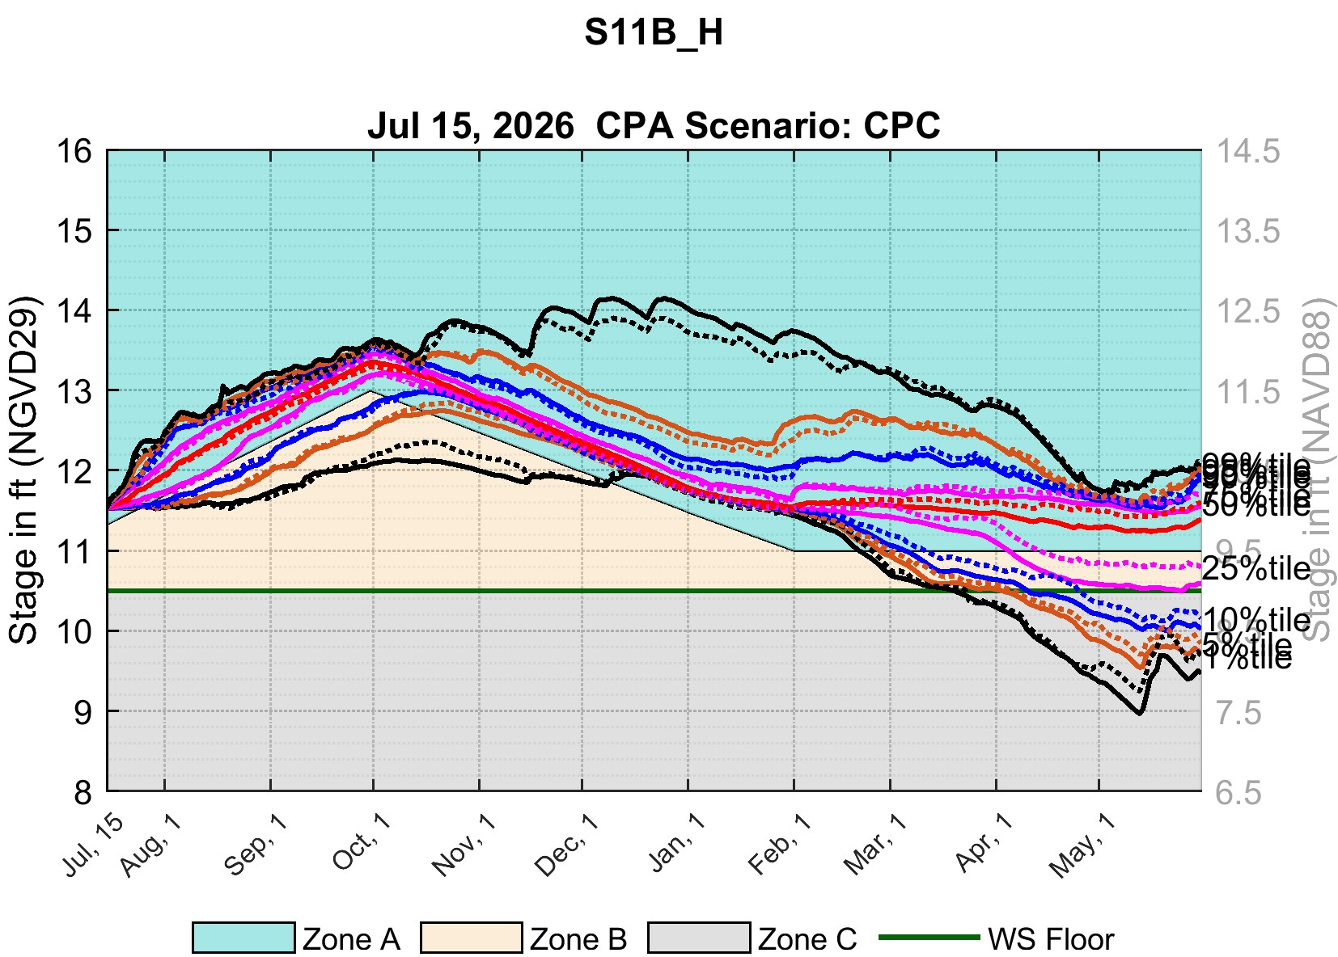
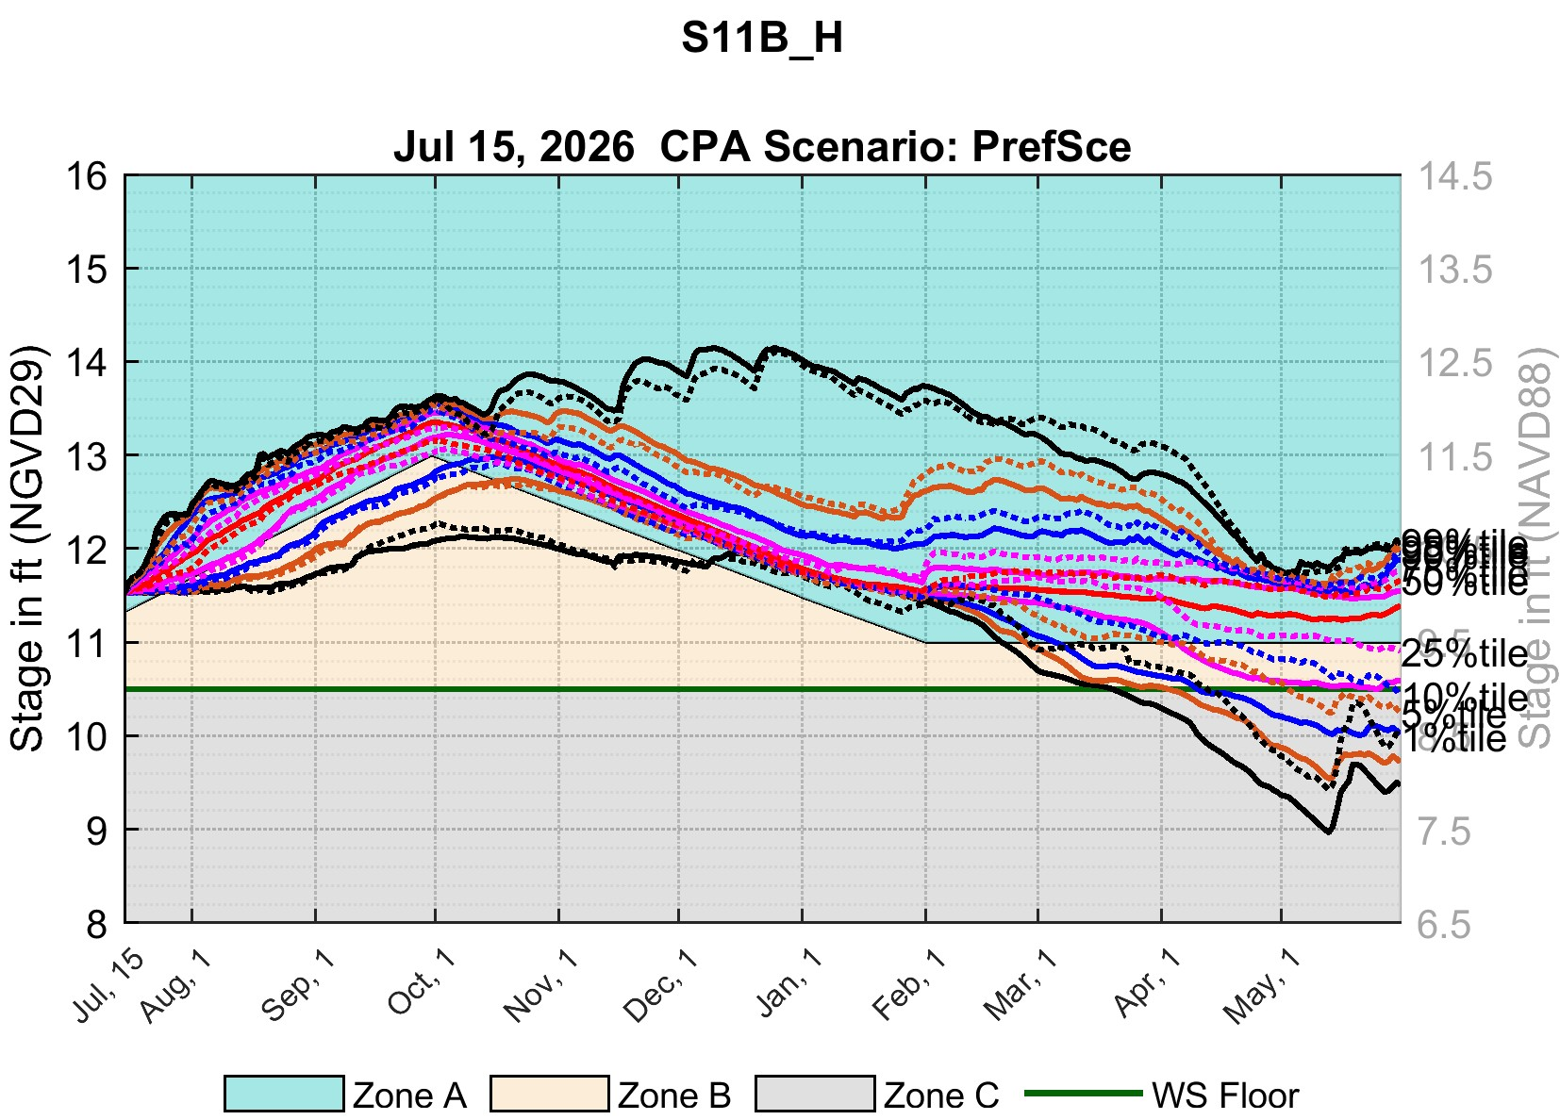
July 15, 2026 CPA: WCA-2A S-11B_H
CPC
PrefSce
WCA2Avg
WCA2Avg
WCA-2A S-11B_H
WCA-2A S-11B_H
Secondary vertical axis shows stages in NAVD88. These stages are based on agreed upon regulation schedule conversion offsets between NGVD29 and NAVD88 (1.5 ft for WCA-2A).

Slide 13
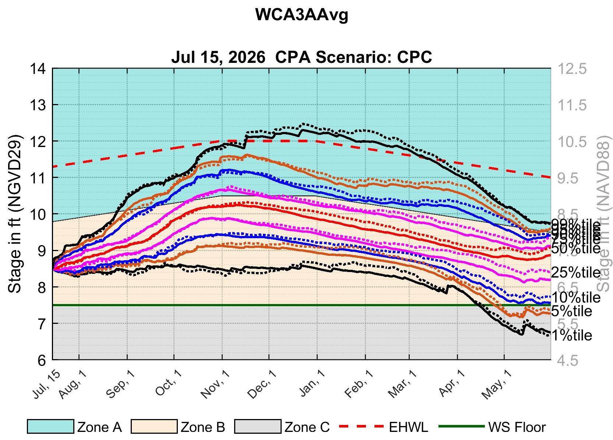
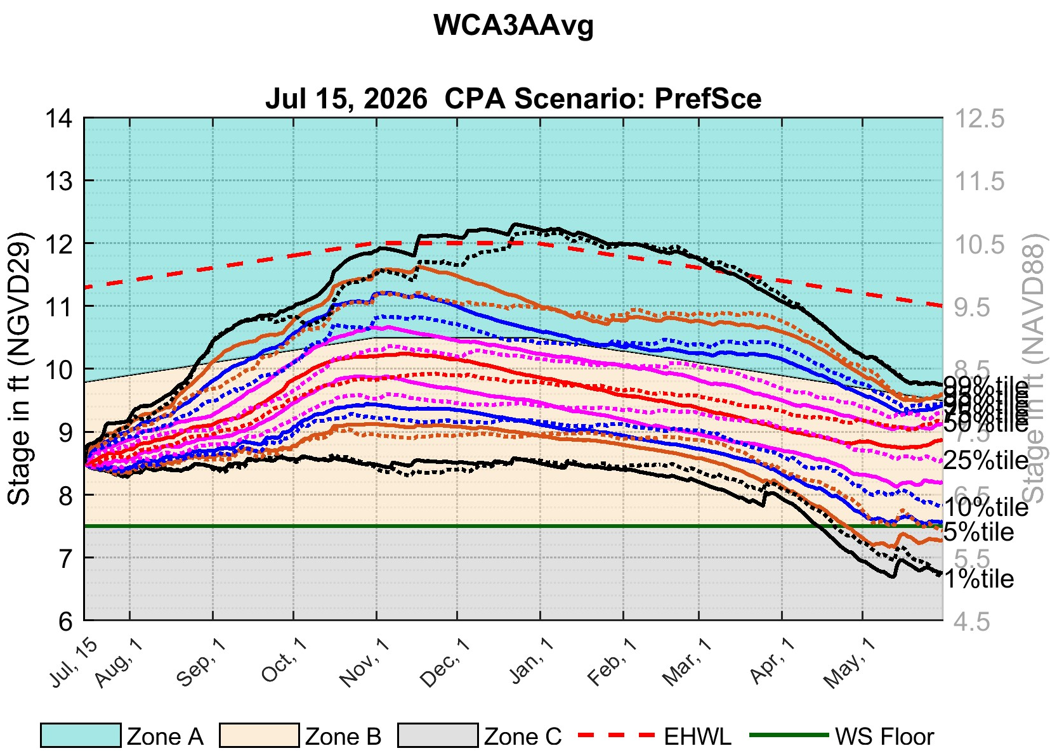
July 15, 2026 CPA: WCA-3A 3-Gage Avg.
CPC
PrefSce
WCA-3A 3-Gage Avg.
WCA-3A 3-Gage Avg.
Secondary vertical axis shows stages in NAVD88. These stages are based on agreed upon regulation schedule conversion offsets between NGVD29 and NAVD88 (1.5 ft for WCA-3A).

Slide 14
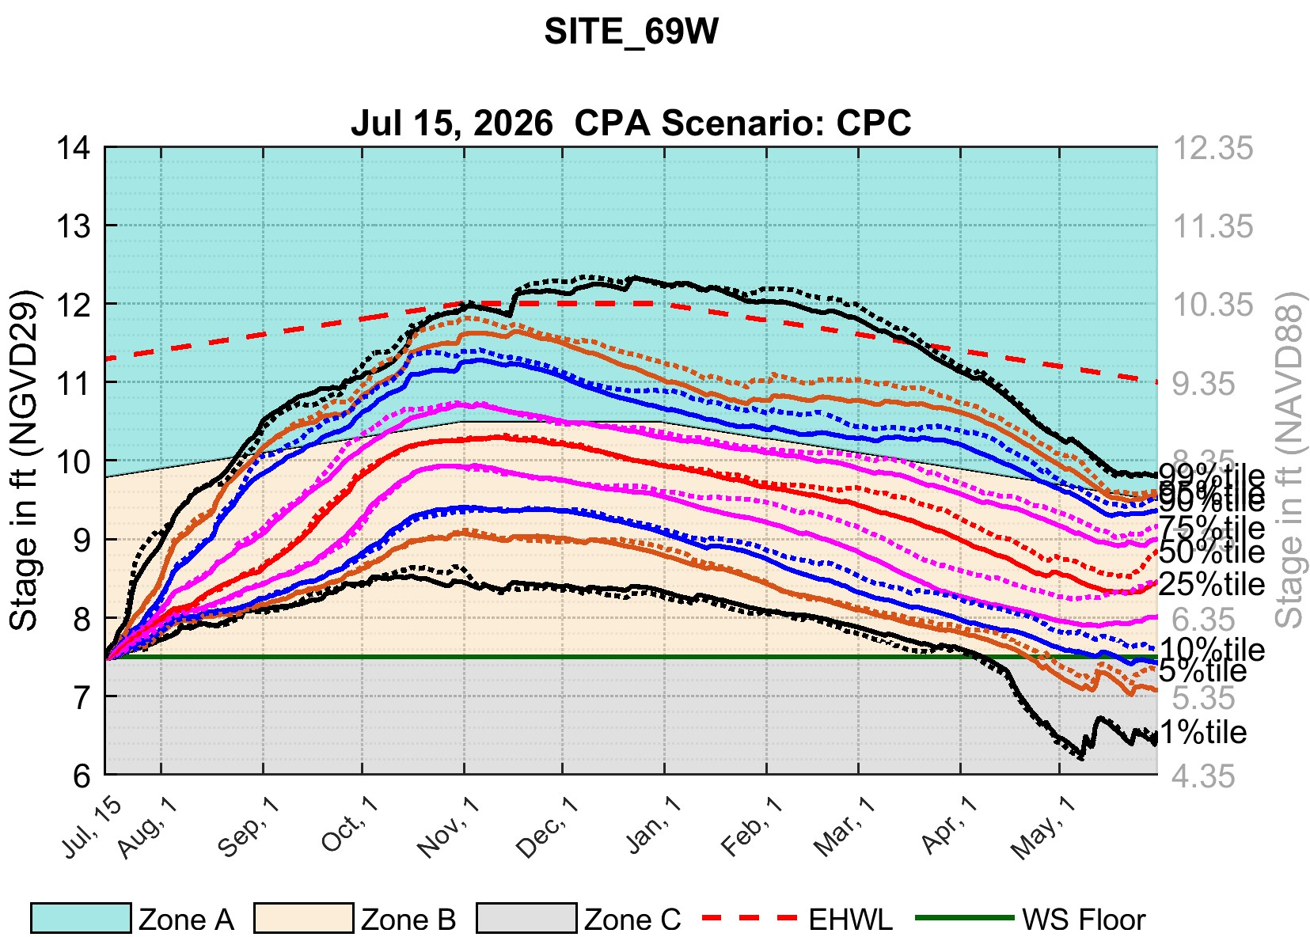
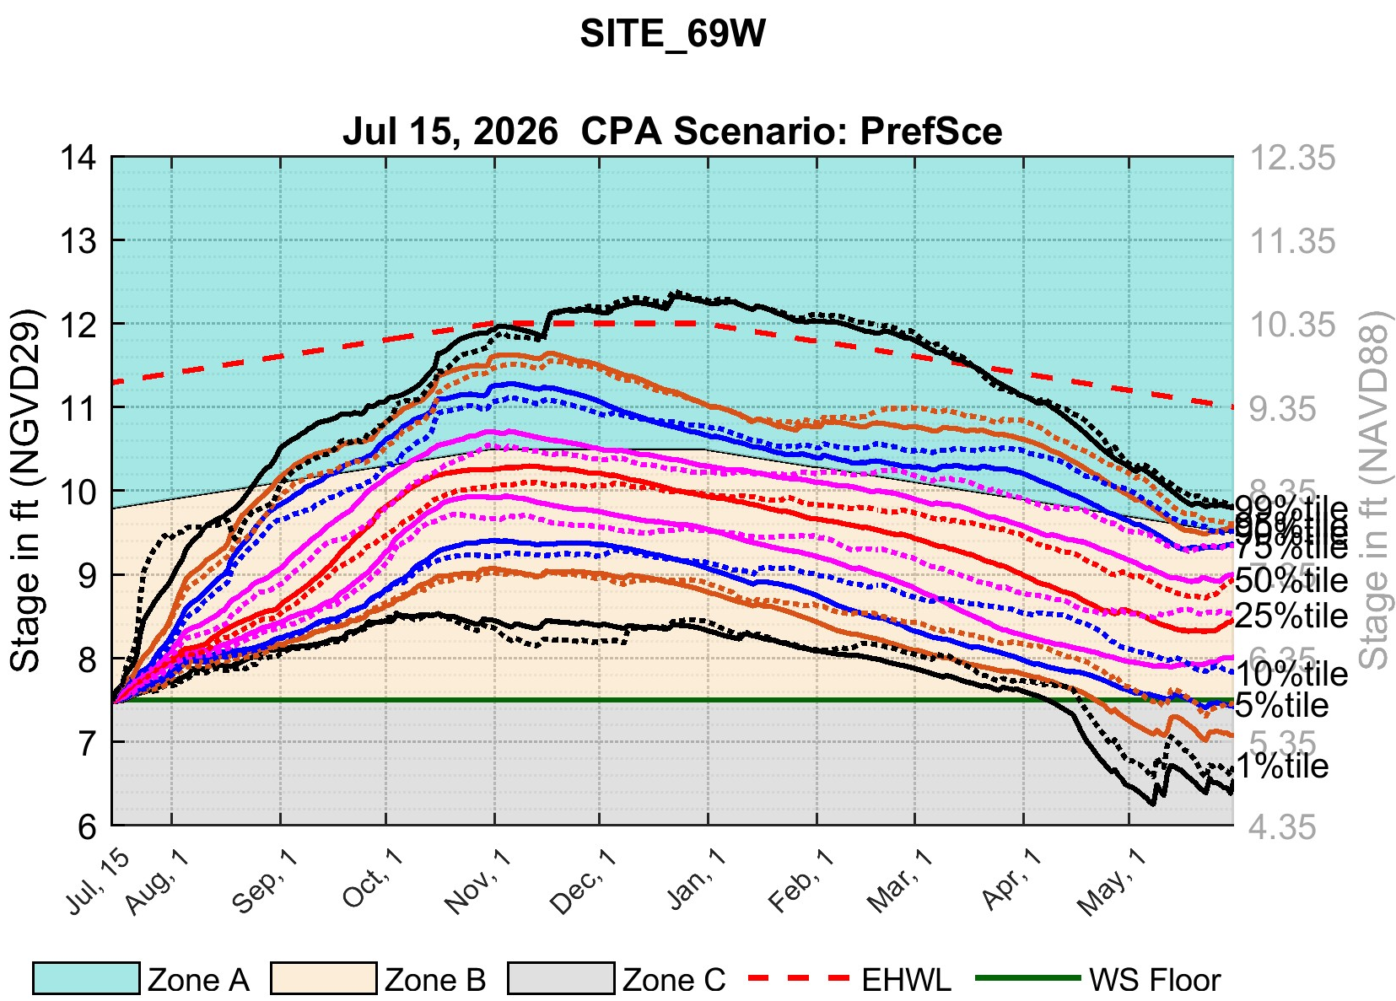
July 15, 2026 CPA: WCA-3A Site-69W
CPC
PrefSce
WCA-3A Site-69W
WCA-3A Site-69W
Secondary vertical axis shows stages in NAVD88. These stages are based on agreed upon regulation schedule conversion offsets between NGVD29 and NAVD88 (1.65 ft for WCA-3A Site-69W).

Slide 15
July 15, 2026: CPA Implementation
LAKE ISTOKPOGA

Slide 16
Lake Istokpoga CPA Implementation Overview
CPA is implemented for Lake Istokpoga using a daily mass-balance based Lake Istokpoga Position Analysis (PA) model for the following scenarios:
  Baseline Release Logic: Release based on standard Lake Istokpoga Regulation Schedule (Zones A/B/C). Deliveries not allowed below Zone B.
    G207/208 Operational
    G207/208 Not Operational
  C1 Temporary Deviation: Lake Istokpoga Regulation Schedule (Zones A/B/C1/C) implemented with the 2026 temporary deviation line as the active water-supply floor. Deliveries allowed below standard Zone B but stop when stage falls below Zone C1.
    G207/208 Operational
    G207/208 Not Operational

Slide 17
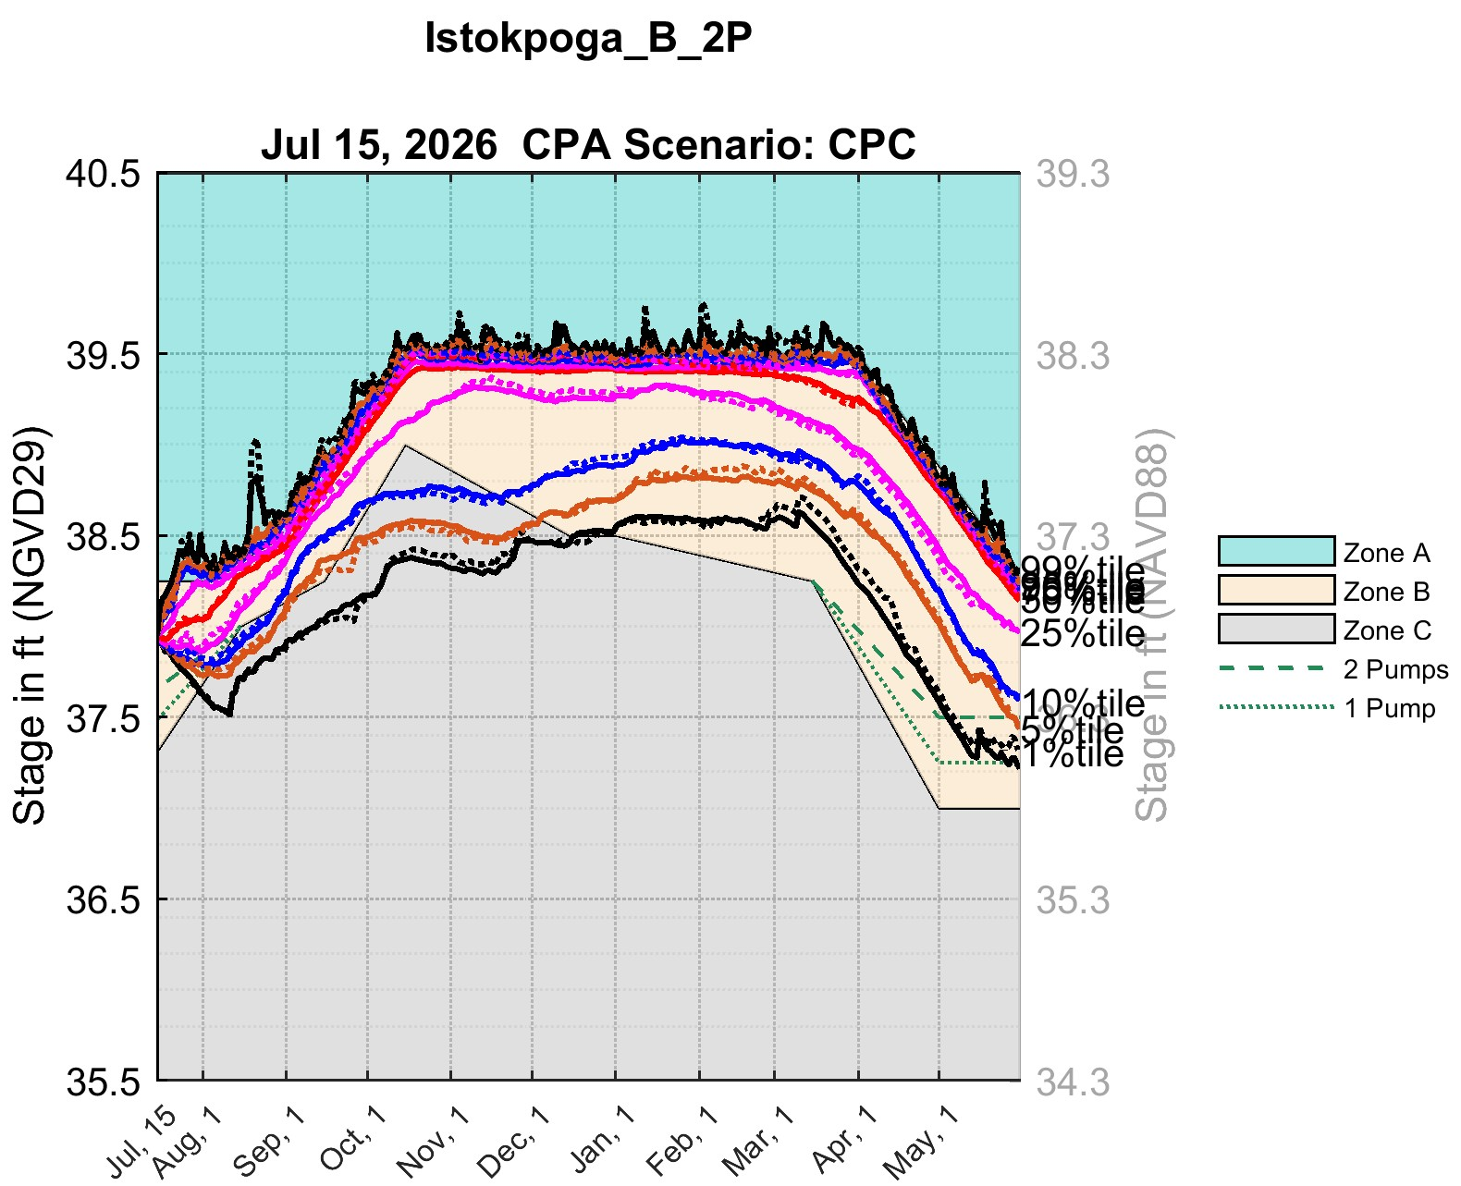
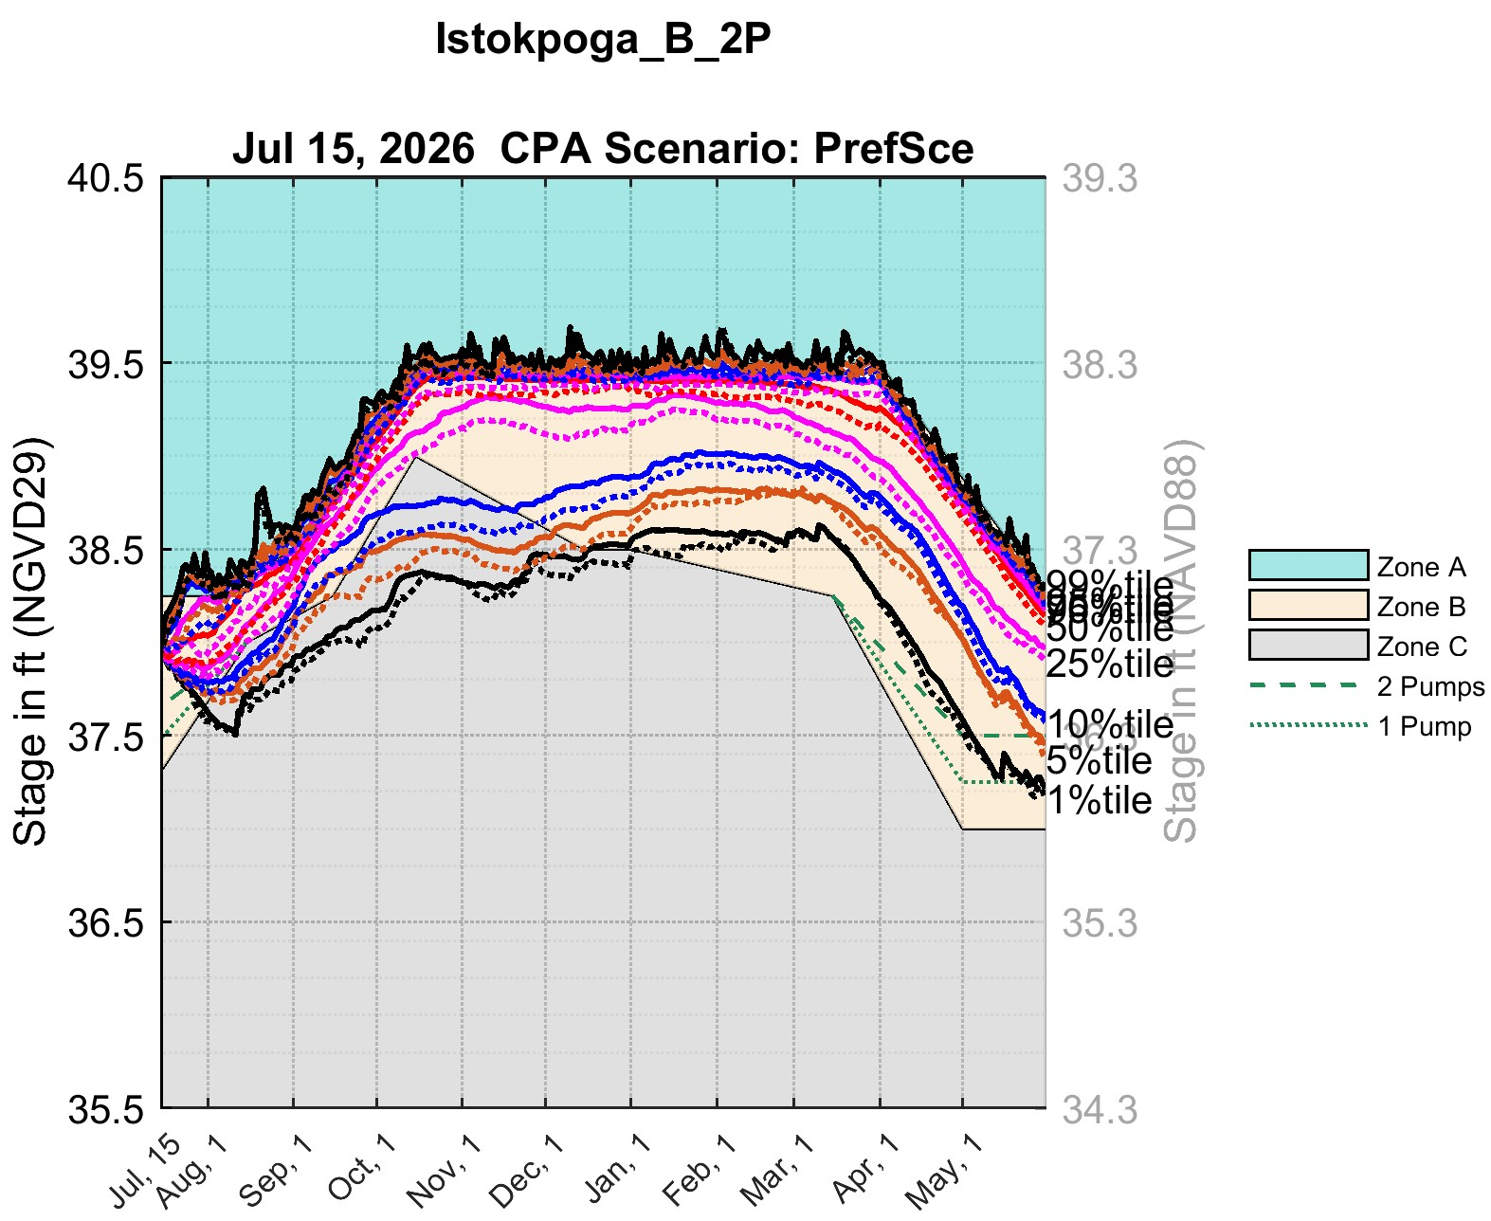
July 15, 2026 CPA: Lake Istokpoga
Baseline Release (demands not delivered below Zone B) and G207/G208 pumps operational
CPC
PrefSce
Lake Istokpoga
Lake Istokpoga
Demands not delivered below Zone B
G207 & G208 operational
Demands not delivered below Zone B
G207 & G208 operational
Regulation Schedule: Baseline Lake Istokpoga Regulation Schedule (Zones A/B/C)
Regulation Schedule: Baseline Lake Istokpoga Regulation Schedule (Zones A/B/C)
Secondary vertical axis shows stages in NAVD88. These stages are based on the agreed upon regulation schedule conversion offsets between NGVD29 and NAVD88 (1.2 ft for Lake Istokpoga).

Slide 18
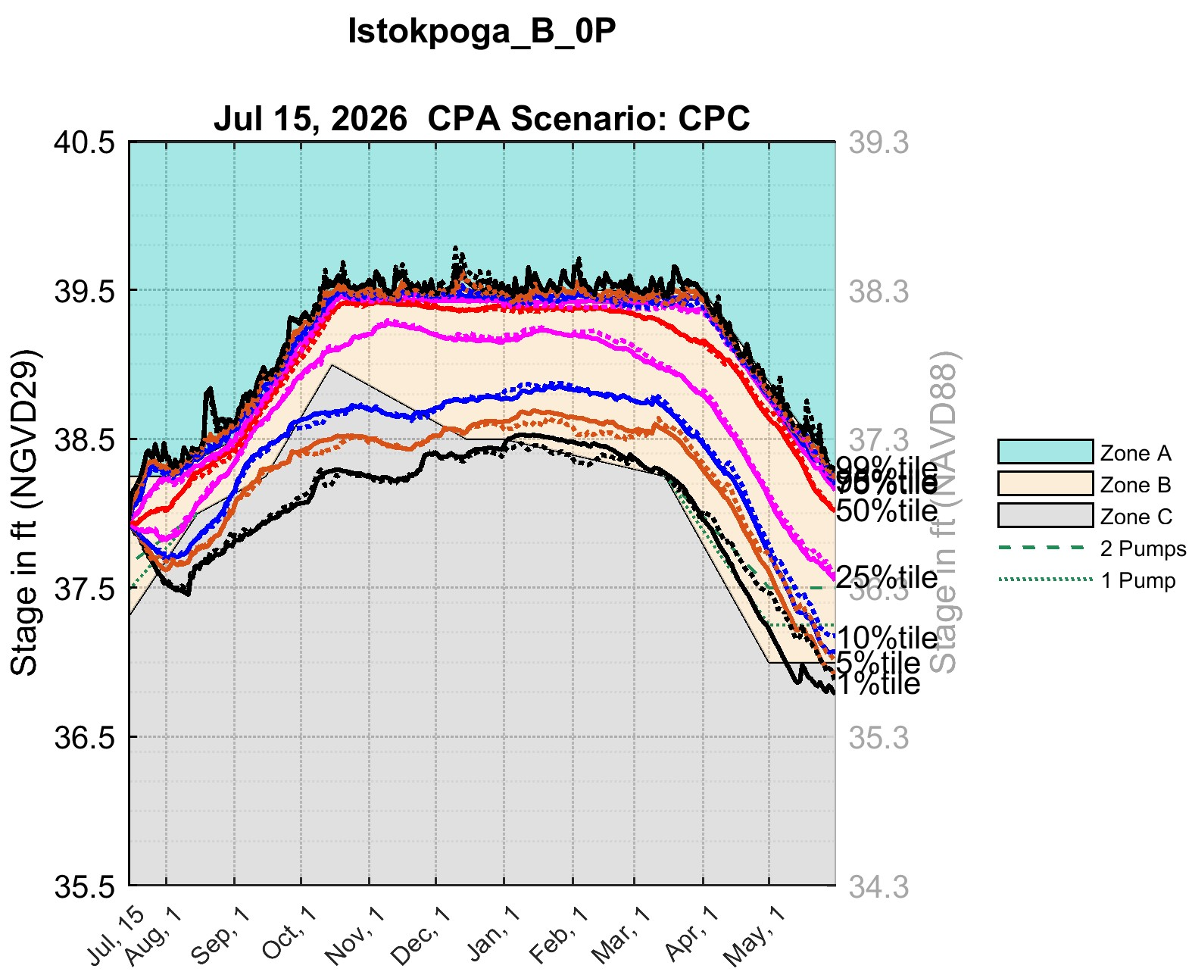
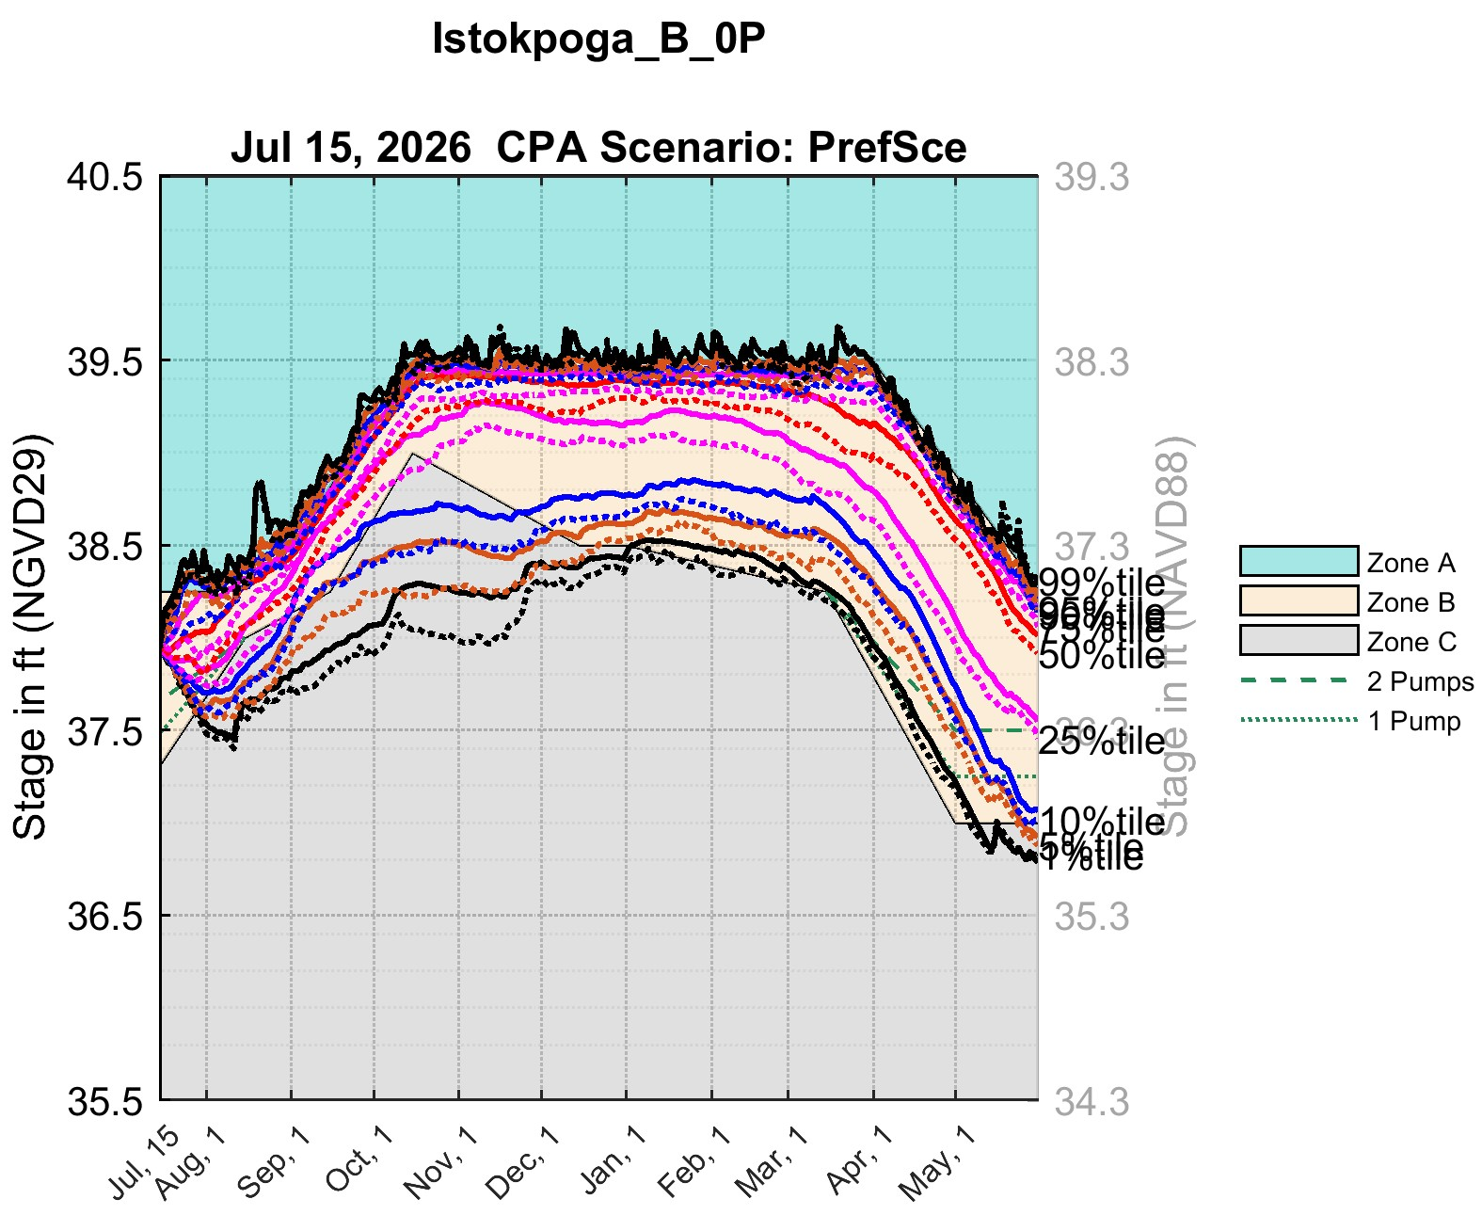
July 15, 2026 CPA: Lake Istokpoga
Baseline Release (demands not delivered below Zone B) and G207/G208 pumps not operational
CPC
PrefSce
Lake Istokpoga
Lake Istokpoga
Demands not delivered below Zone B
G207 & G208 not operational
Demands not delivered below Zone B
G207 & G208 not operational
Regulation Schedule: Baseline Lake Istokpoga Regulation Schedule (Zones A/B/C)
Regulation Schedule: Baseline Lake Istokpoga Regulation Schedule (Zones A/B/C)
Secondary vertical axis shows stages in NAVD88. These stages are based on the agreed upon regulation schedule conversion offsets between NGVD29 and NAVD88 (1.2 ft for Lake Istokpoga).

Slide 19
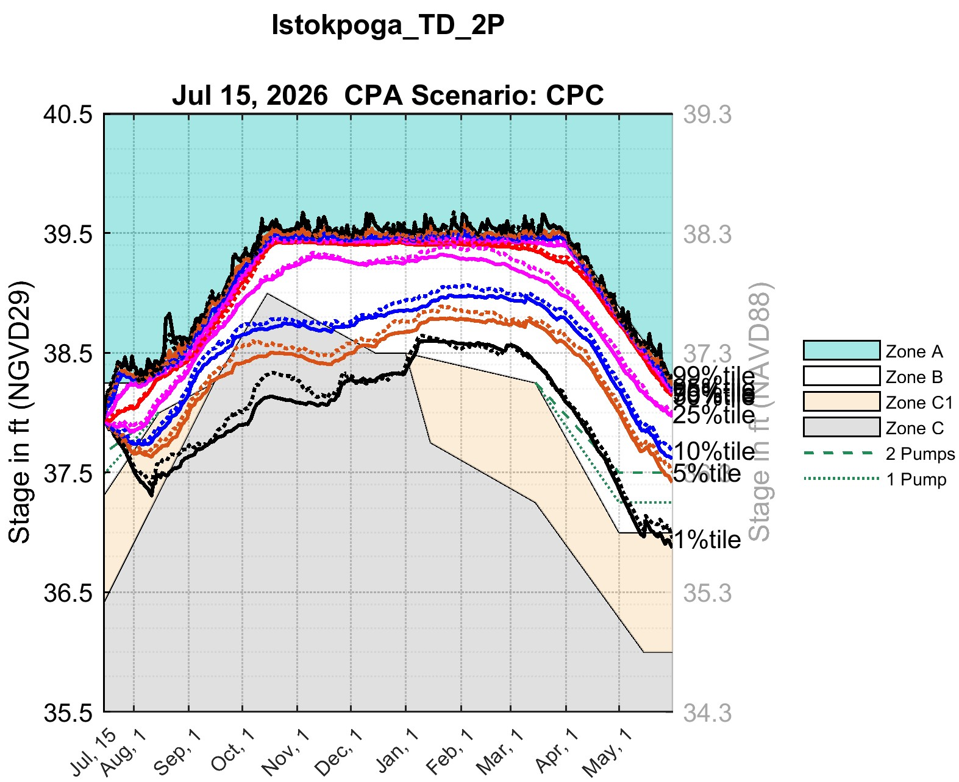
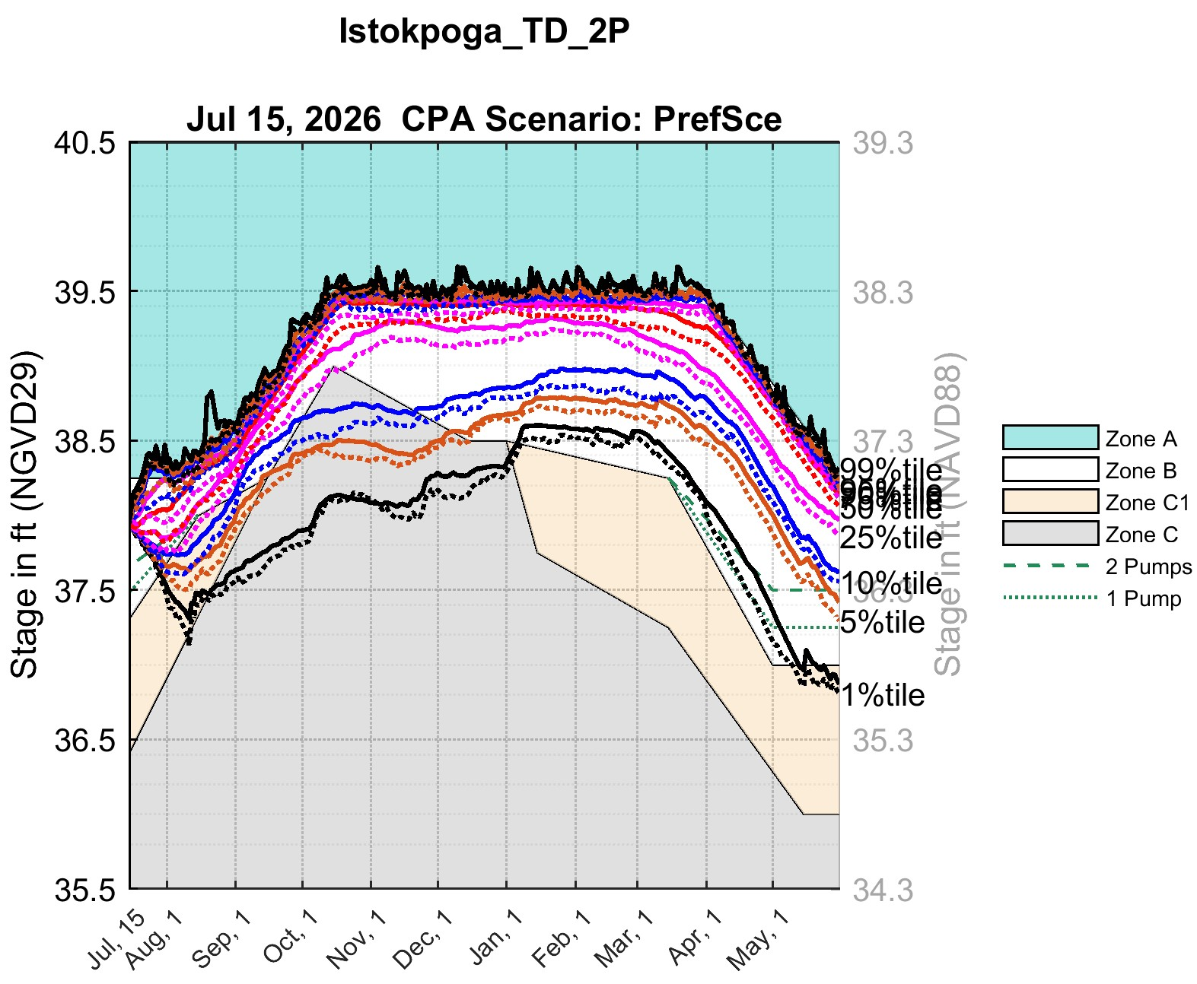
July 15, 2026 CPA: Lake Istokpoga
C1 Temporary Deviation (demands not delivered in Zone C) and G207/G208 pumps operational
CPC
PrefSce
Lake Istokpoga
Lake Istokpoga
Demands not delivered in Zone C
G207 & G208 operational
Demands not delivered in Zone C
G207 & G208 operational
Regulation Schedule: Lake Istokpoga Regulation Schedule (Zones A/B/C1/C) implemented with the 2026 temporary deviation line as the active water-supply floor
Regulation Schedule: Lake Istokpoga Regulation Schedule (Zones A/B/C1/C) implemented with the 2026 temporary deviation line as the active water-supply floor
Secondary vertical axis shows stages in NAVD88. These stages are based on the agreed agreed upon regulation schedule conversion offsets between NGVD29 and NAVD88 (1.2 ft for Lake Istokpoga).

Slide 20
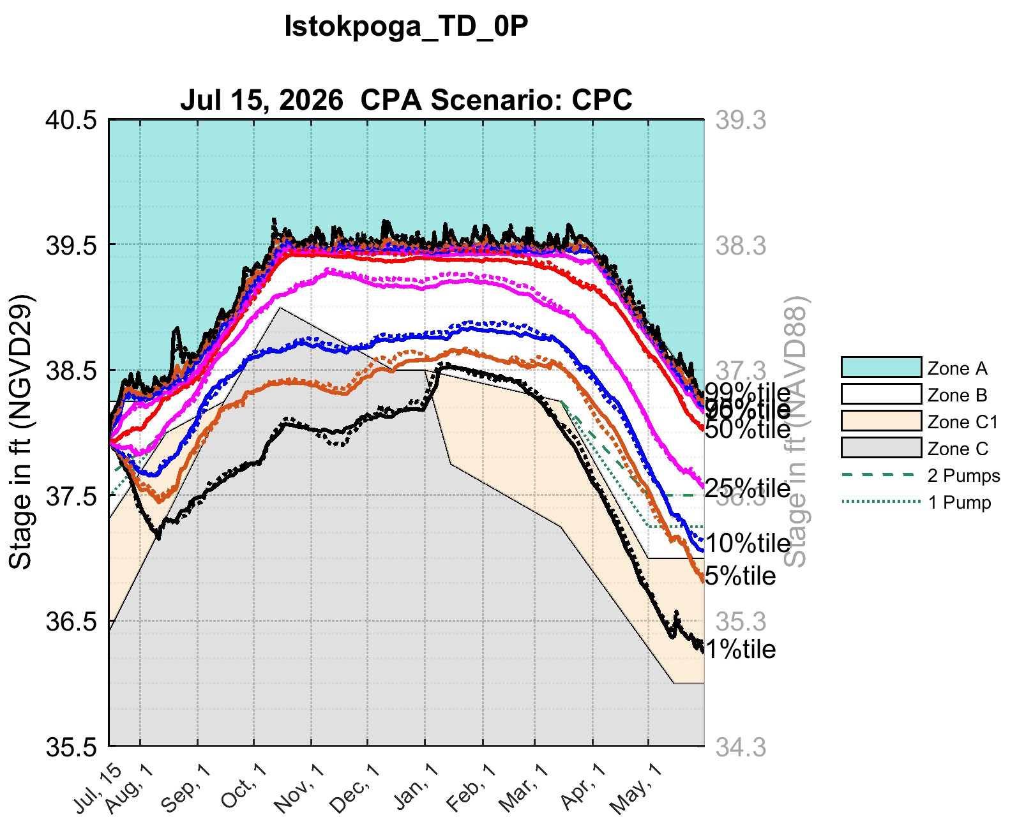
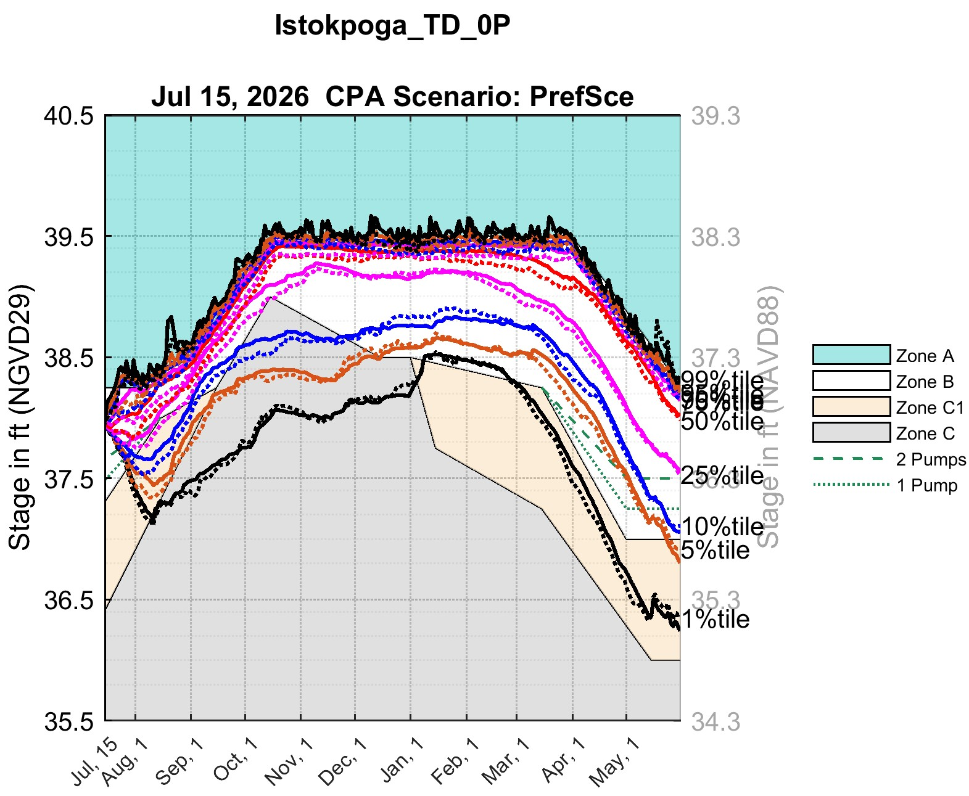
July 15, 2026 CPA: Lake Istokpoga
C1 Temporary Deviation (demands not delivered in Zone C) and G207/G208 pumps not operational
CPC
PrefSce
Lake Istokpoga
Lake Istokpoga
Demands not delivered in Zone C
G207 & G208 not operational
Demands not delivered in Zone C
G207 & G208 not operational
Regulation Schedule: Lake Istokpoga Regulation Schedule (Zones A/B/C1/C) implemented with the 2026 temporary deviation line as the active water-supply floor
Regulation Schedule: Lake Istokpoga Regulation Schedule (Zones A/B/C1/C) implemented with the 2026 temporary deviation line as the active water-supply floor
Secondary vertical axis shows stages in NAVD88. These stages are based on the agreed upon regulation schedule conversion offsets between NGVD29 and NAVD88 (1.2 ft for Lake Istokpoga).

