Slide 1
Extended Hydrologic Outlook
September 10, 2024
The Climate Prediction Center (CPC) is forecasting above normal rainfall for September through November.
ENSO-neutral conditions are present. ENSO-neutral is expected to continue for the next several months, with La Niña favored to emerge during September-November (66% chance) and persist through winter 2024-25 (74% chance during November-January).
Atlantic Multidecadal Oscillation (AMO) is currently in the warm phase:
Average annual inflow to Lake Okeechobee is nearly 50% greater during the warm phase compared to the cold phase.
Notes:
http://www.cpc.ncep.noaa.gov/products/analysis_monitoring/lanina/enso_evolution-status-fcsts-web.ppt
http://www.cpc.ncep.noaa.gov/products/analysis_monitoring/enso_advisory/ensodisc.shtml
https://www.cpc.ncep.noaa.gov/products/predictions/90day/
https://www.cpc.ncep.noaa.gov/products/predictions/90day/fxus05.html

Slide 2
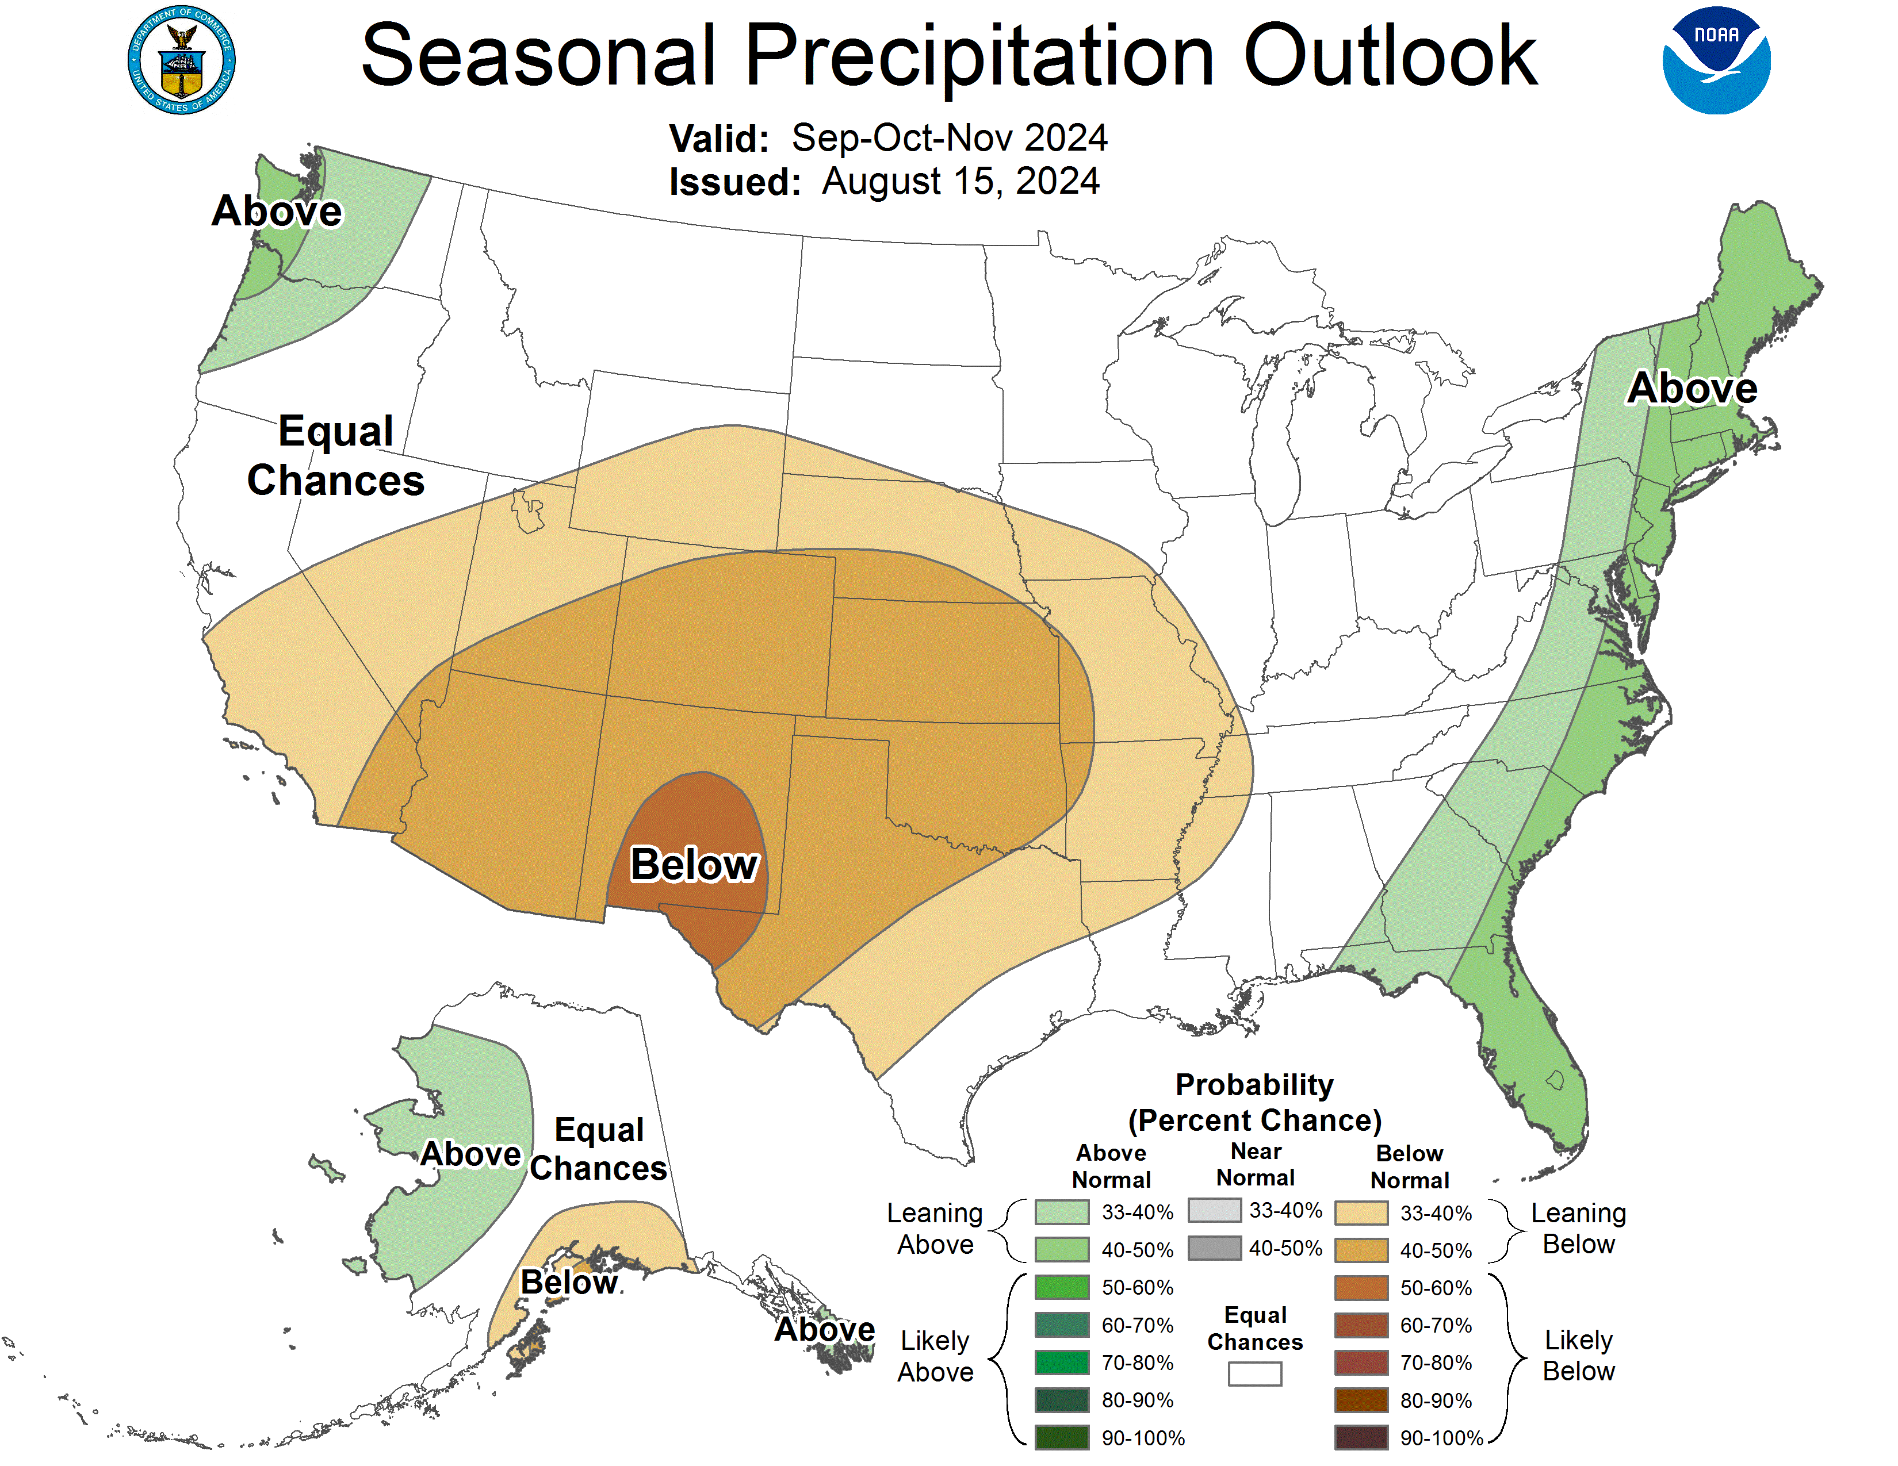
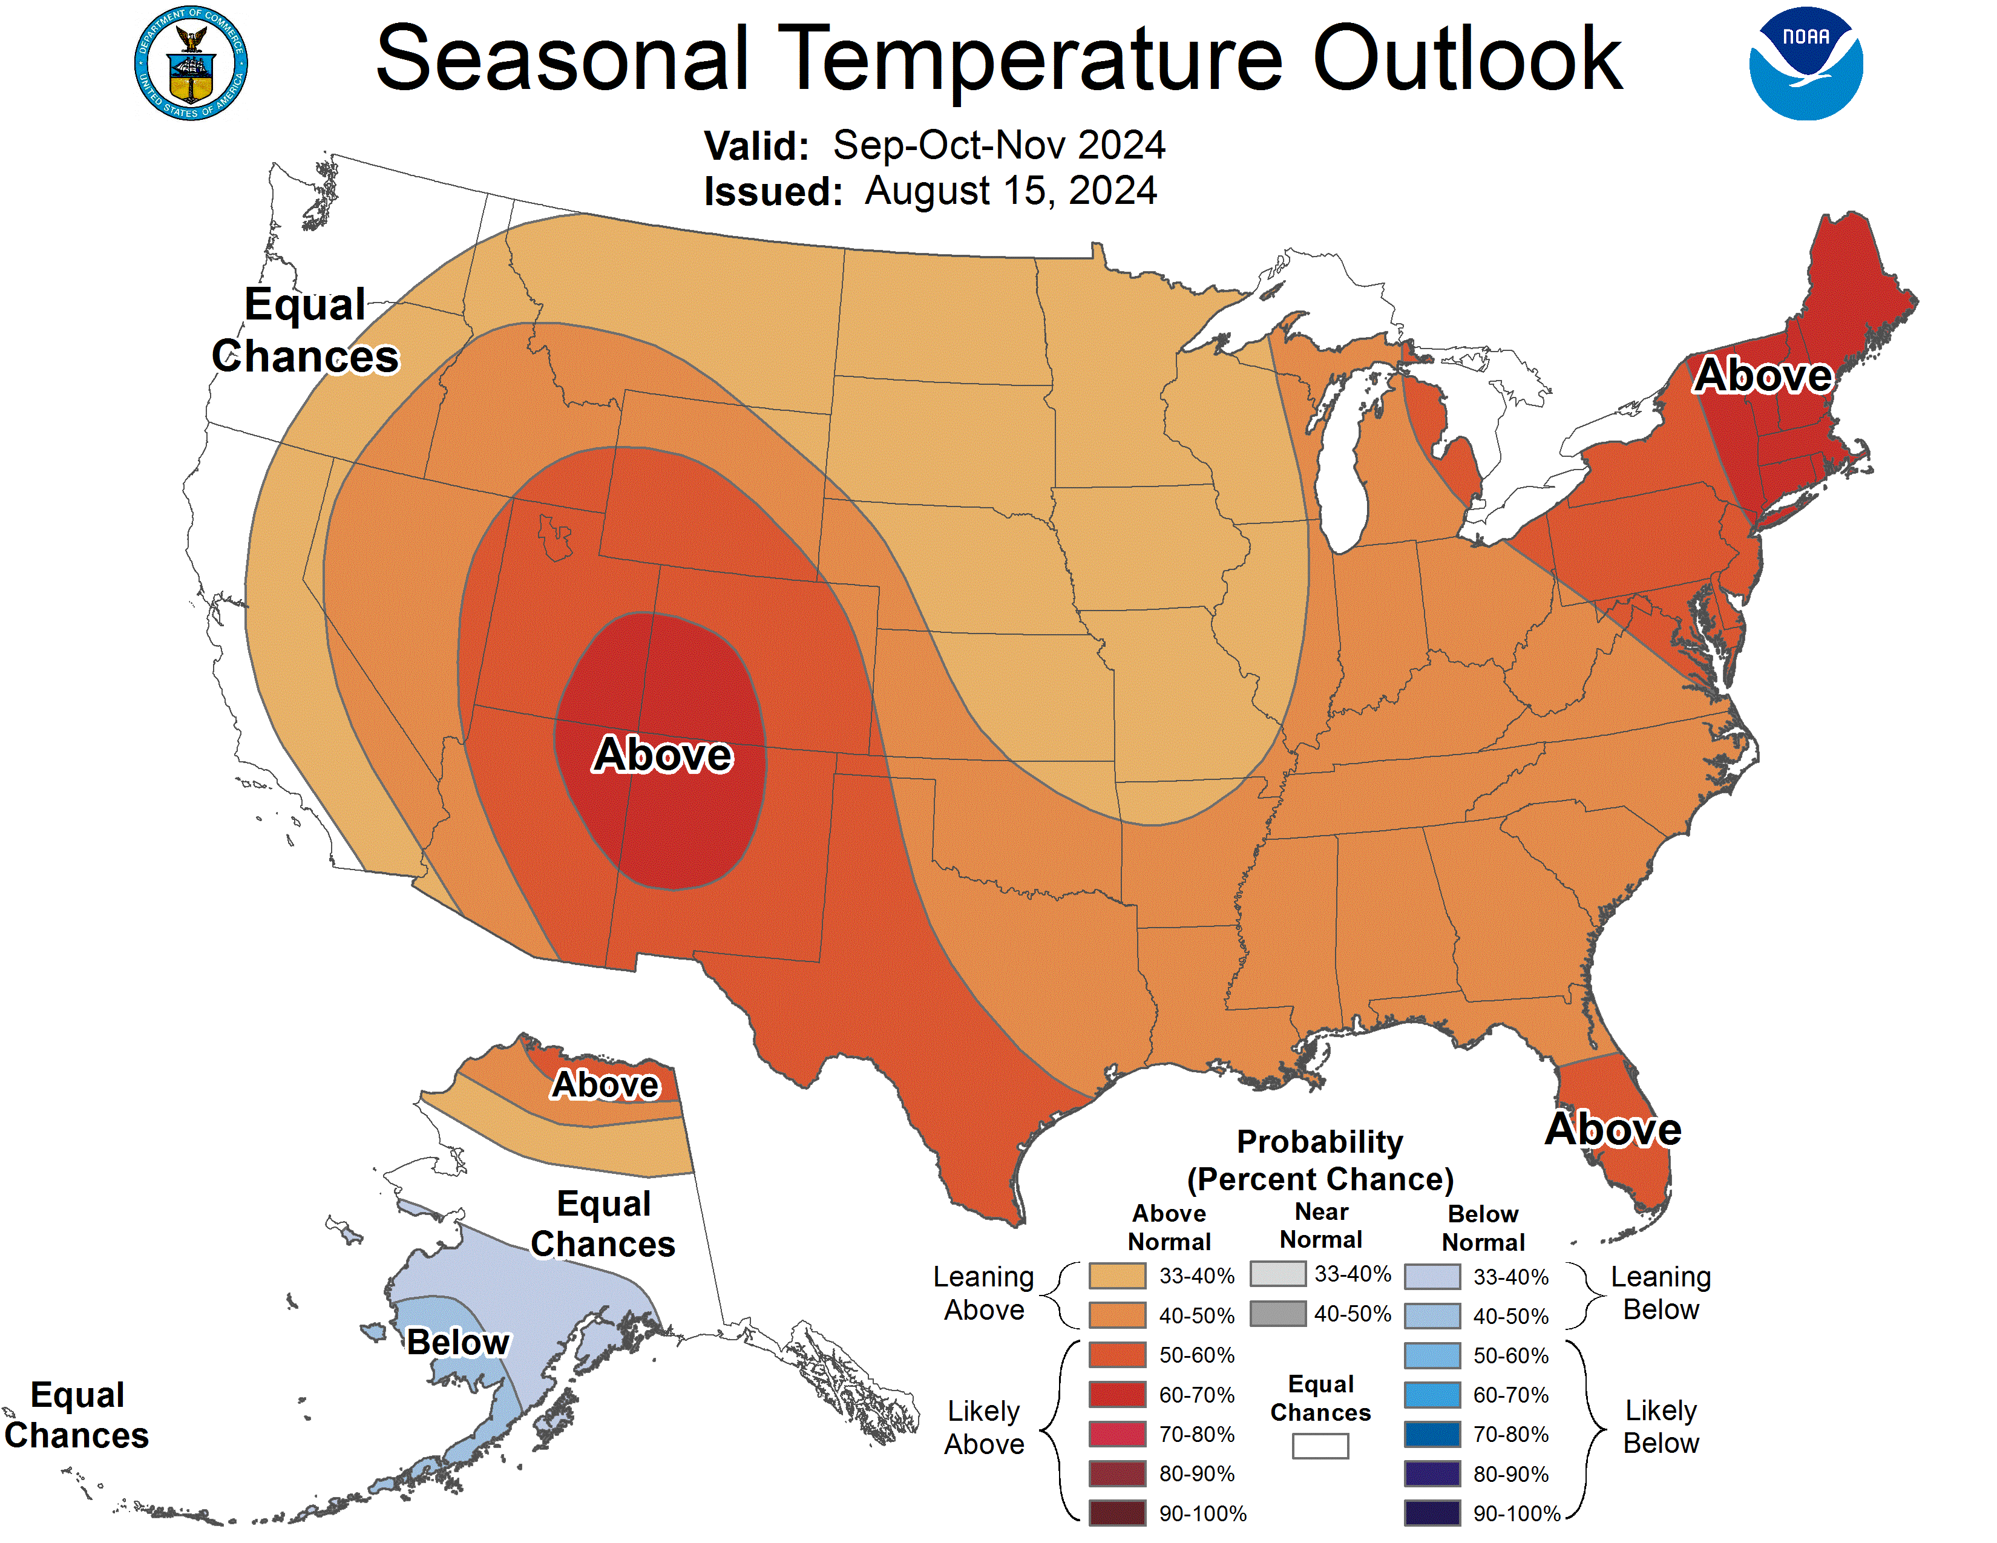
U. S. Seasonal Outlooks
September– November 2024
The seasonal outlooks combine the effects of long-term trends, soil moisture, and, when appropriate, ENSO.
Precipitation
Temperature
Prepared by: Climate Prediction Center/NCEP
Notes:
http://www.cpc.ncep.noaa.gov/products/analysis_monitoring/enso_advisory/ensodisc.shtml
https://www.cpc.ncep.noaa.gov/products/predictions/90day/fxus05.html ←Discussion of CPC forecast
http://www.cpc.ncep.noaa.gov/products/analysis_monitoring/lanina/enso_evolution-status-fcsts-web.ppt
http://www.cpc.ncep.noaa.gov/products/expert_assessment/sdo_discussion.php
http://www.cpc.ncep.noaa.gov/products/predictions/long_range/seasonal.php?lead=1 (check to see if it’s the latest one)
http://www.cpc.ncep.noaa.gov/products/analysis_monitoring/
http://www.cpc.ncep.noaa.gov/products/precip/CWlink/MJO/enso.shtml
http://www.cpc.ncep.noaa.gov/products/analysis_monitoring/lanina/enso_evolution-status-fcsts-web.ppt
http://www.cpc.ncep.noaa.gov/products/expert_assessment/ (Weekly)
http://www.cpc.ncep.noaa.gov/products/analysis_monitoring/enso_advisory/ (Monthly)
http://www.cpc.ncep.noaa.gov/products/predictions/long_range/seasonal.php?lead=1 (Seasonal)
http://www.cpc.ncep.noaa.gov/products/predictions/30day/ (Monthly)

Slide 3
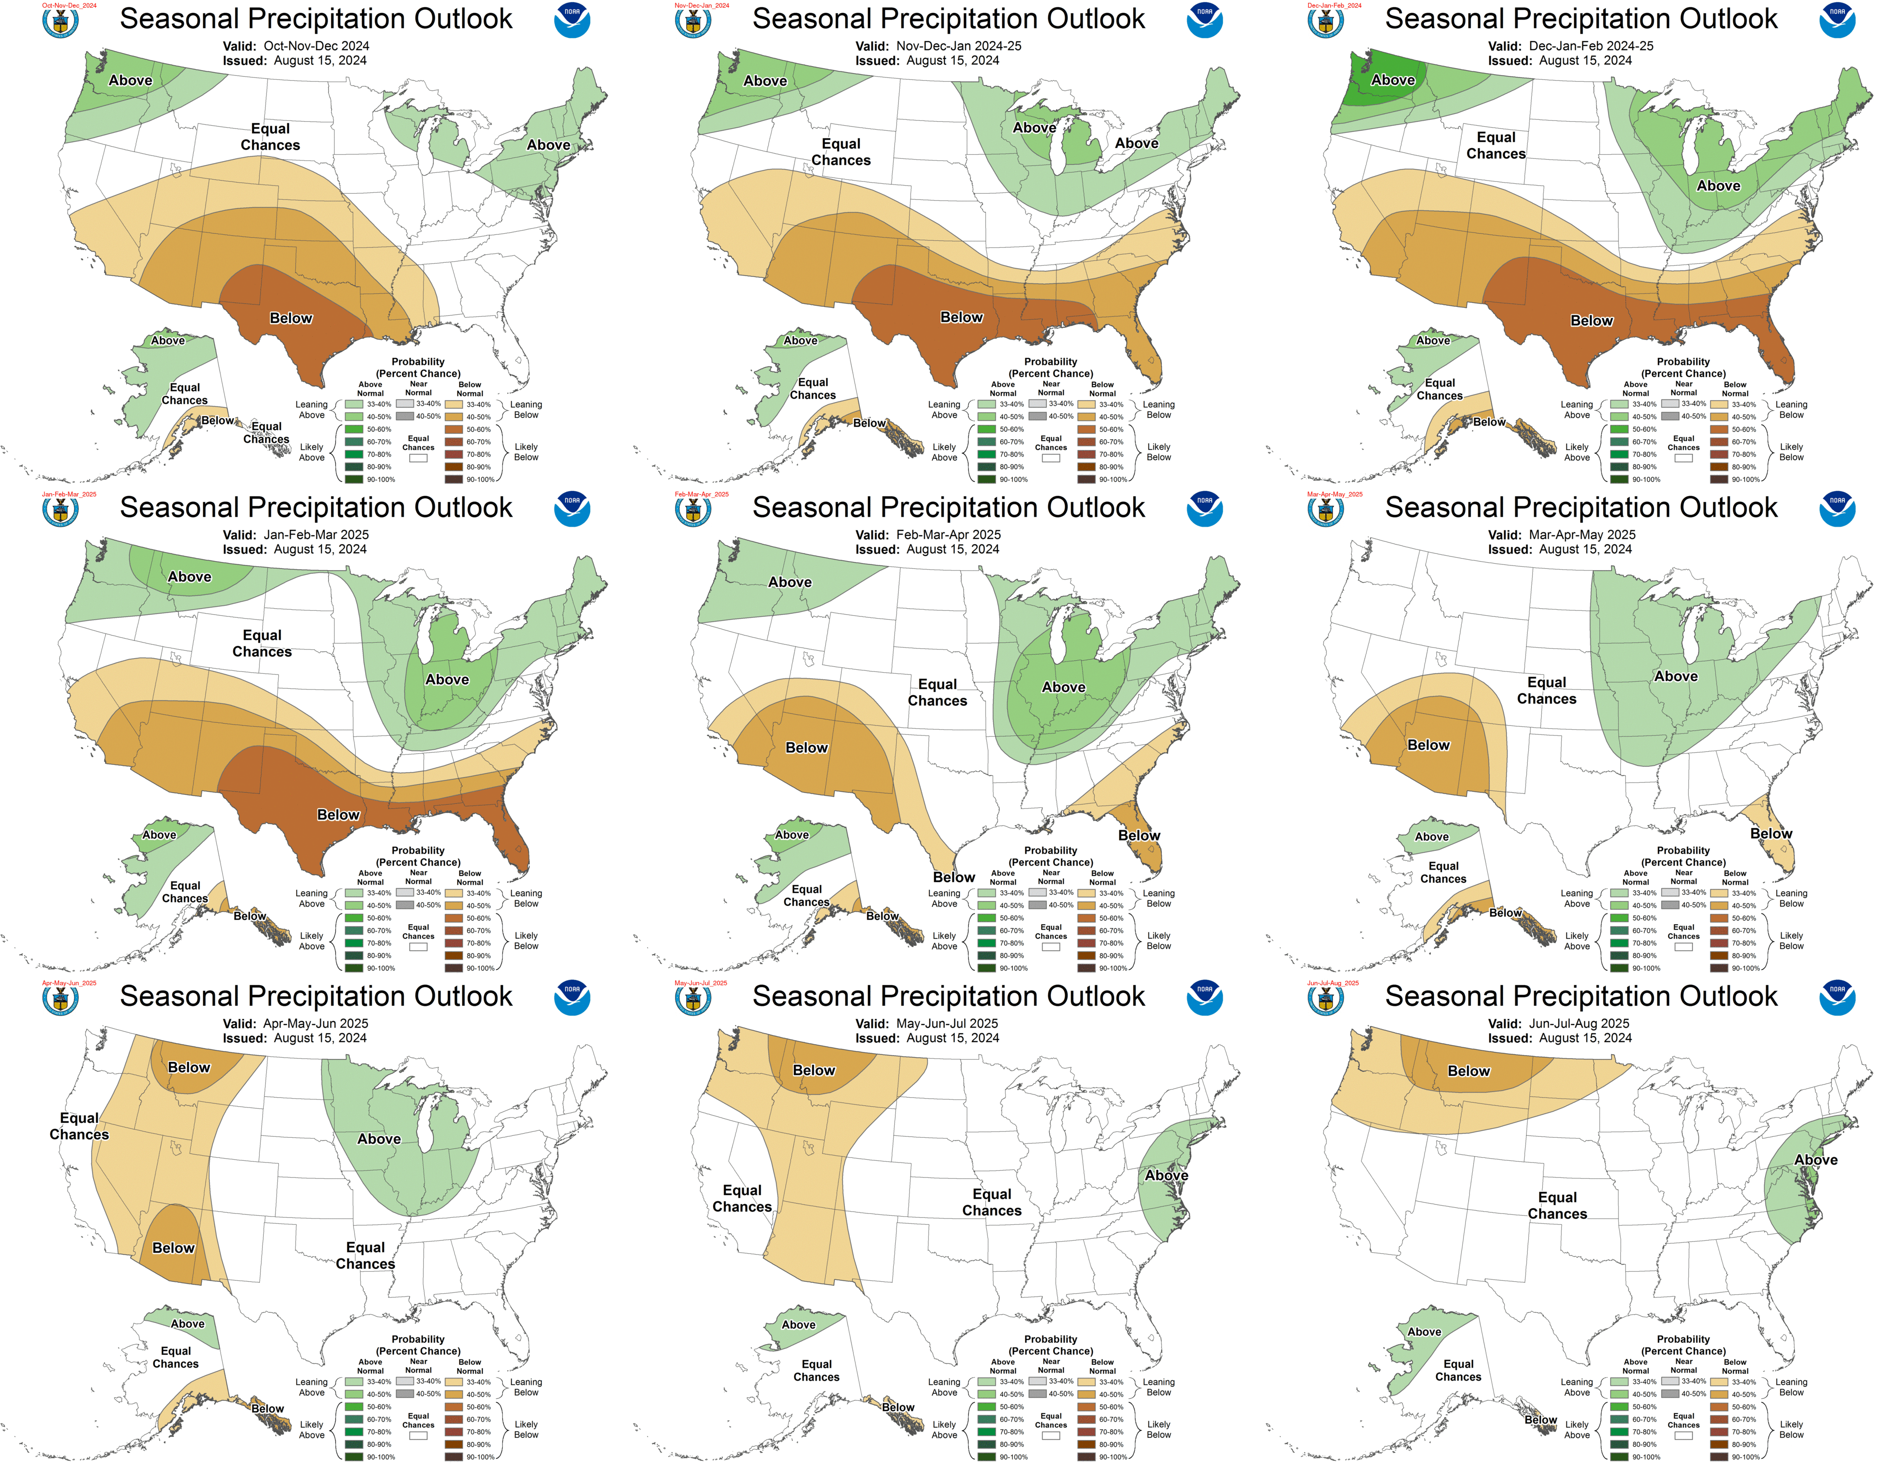
Prepared by: Climate Prediction Center/NCEP
Notes:
http://www.cpc.ncep.noaa.gov/products/predictions/multi_season/13_seasonal_outlooks/color/p.gif

Slide 4
Teleconnections to South Florida
Climate anomalies being related to each other at large distances:
El Niño Southern Oscillation (ENSO)
El Niño increases the chances of a wetter-than-normal dry season and decreased tropical activity, La Niña increases the chances of a drier-than-normal dry season and increased tropical activity (both have most influence in south Florida from November through March)
Pacific Decadal Oscillation (PDO)
Increases variations in south Florida dry season rainfall, positive leads to more El Niño events, negative leads to more La Niña events
The current PDO is negative
Atlantic Multidecadal Oscillation (AMO)
Average annual inflow to Lake Okeechobee is nearly 50% greater during the warm phase compared to the cold phase of the AMO, easterly flow toward south Florida affected by phase
The AMO is currently in the warm phase

Slide 5
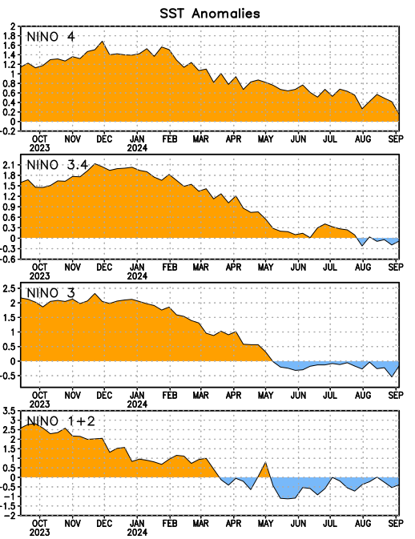
Niño Region SST Departures (ºC) Recent Evolution
The latest weekly SST departures are:
Niño 4
0.2ºC
Niño 3.4
-0.1ºC
Niño 3
-0.2ºC
Niño 1+2
-0.4ºC
This weekly sea surface temperature data is based on OISSTv2.1 (Huang et al., 2021).
Prepared by: Climate Prediction Center/NCEP
Notes:
http://www.cpc.ncep.noaa.gov/products/precip/CWlink/MJO/enso.shtml
http://www.cpc.ncep.noaa.gov/products/analysis_monitoring/enso_advisory/

Slide 6
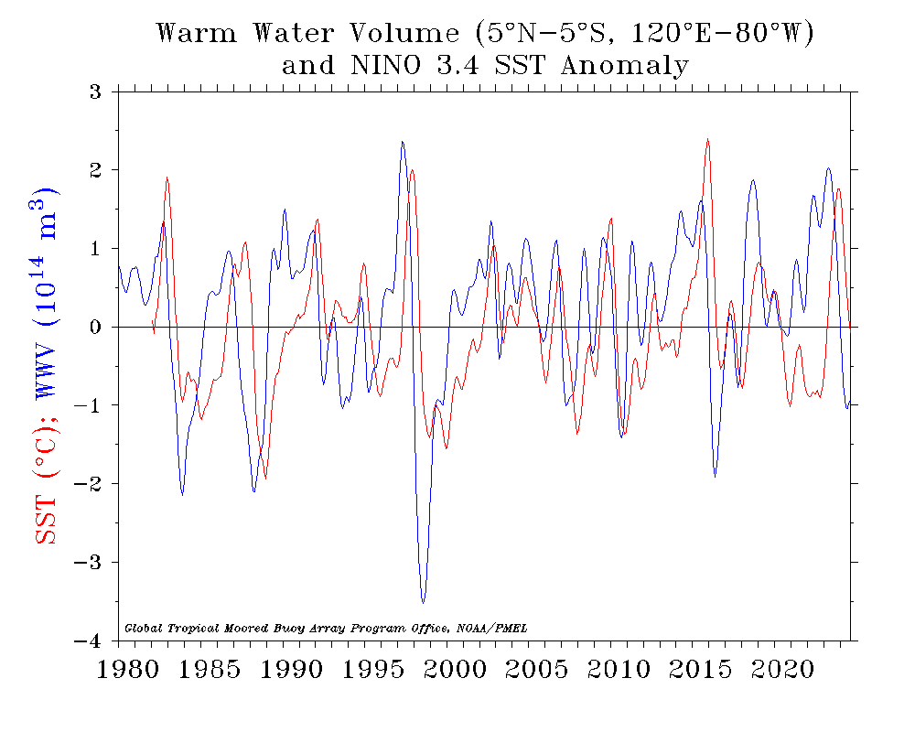
Notes:
https://www.pmel.noaa.gov/tao/wwv/gif/wwv_nino.gif
Data: https://www.pmel.noaa.gov/tao/wwv/data/wwv.dat
https://www.pmel.noaa.gov/elnino/upper-ocean-heat-content-and-enso
Volume of Water Above 20 Degree Celsius Isotherm (integrated warm water volume (WWV) above the 20°C isotherm between 5°N-5°S, 120°E to 80°W)

Slide 7
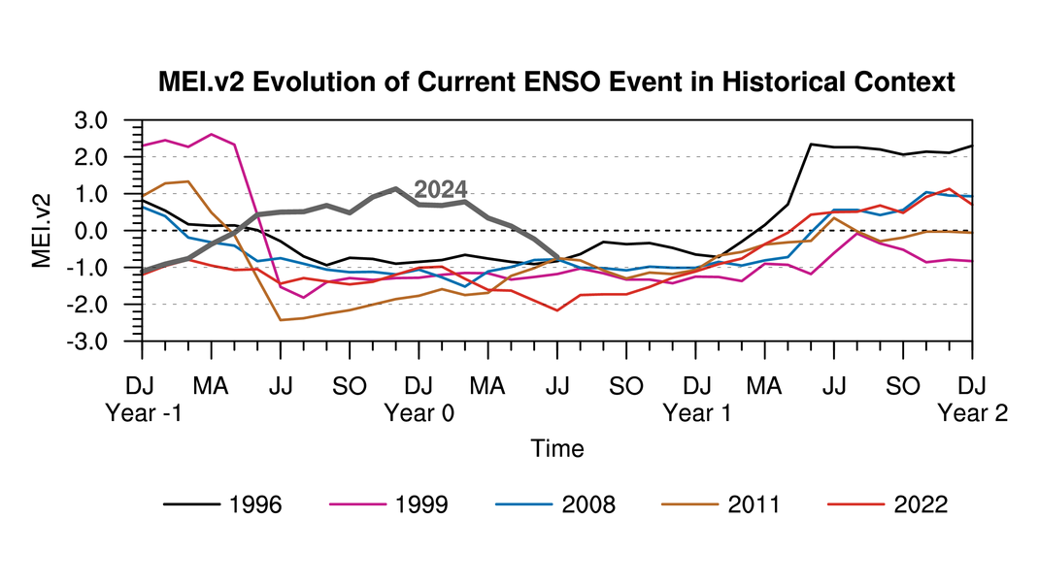
*The JRA-55 dataset used for the MEI V2 has been discontinued by the Japanese Meteorological Agency as of January 2024. We have switched to using the JRA3Q reanalysis which yields very similar results.
Prepared by: NOAA Physical Sciences Laboratory
Notes:
https://www.esrl.noaa.gov/psd/enso/mei/
Years plotted are La Nina events

Slide 8
2024 Tropical Outlook
Notes:
http://www.noaa.gov/media-releases
https://tropical.colostate.edu/forecasting.html

Slide 9
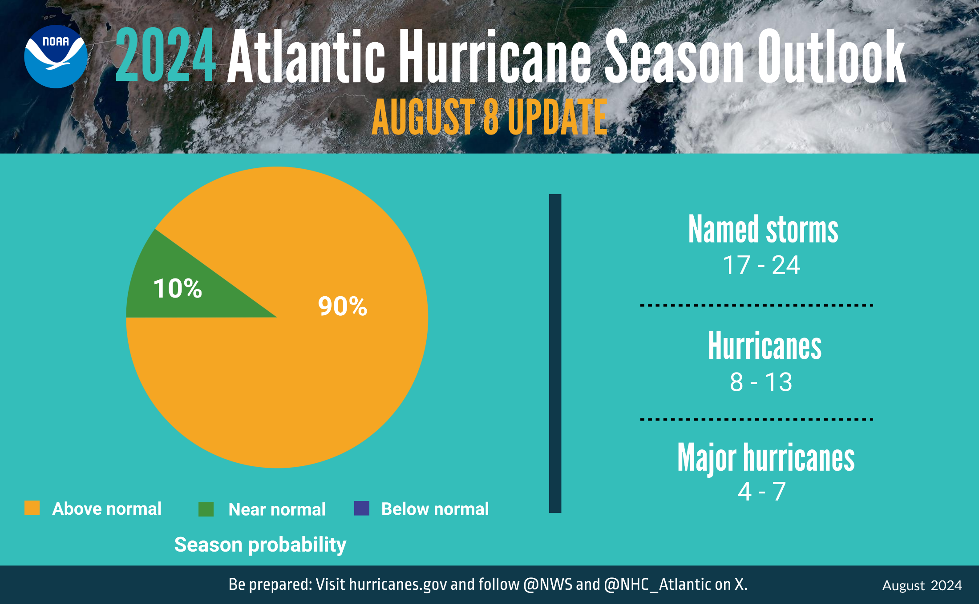
Source: National Hurricane Center
Notes:
http://www.noaa.gov/media-releases
near-record warm ocean temperatures in the Atlantic Ocean, development of La Niña conditions in the Pacific, reduced Atlantic trade winds and less wind shear
Published around May 25th

Slide 10
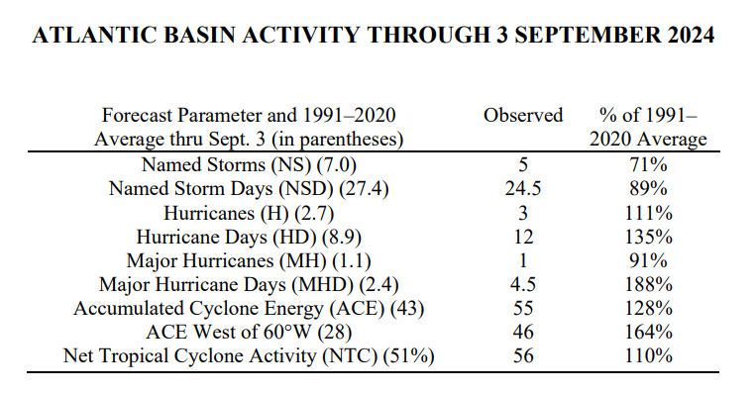
Recent Quiet Period for Atlantic Hurricane Activity
Northward-shifted monsoon trough
Upper-tropospheric warming
Too much easterly shear in the eastern Atlantic
Recent unfavorable large-scale conditions from the Madden-Julian oscillation
(Source: https://tropical.colostate.edu/Forecast/2024_0903_seasondiscussion.pdf)
Source: Colorado State University (Tropical Meteorology Project)
Notes:
https://tropical.colostate.edu/forecasting.html
https://tropical.colostate.edu/Forecast/2024_0903_seasondiscussion.pdf ←update about low activity so far in 2024

Slide 11
September 2024 DPA Assumptions
The September 1, 2024 Dynamic Position Analysis (DPA) simulation is based on historical climatic conditions spanning the period 1965-2016. This DPA posting is made with the South Florida Water Management Model (SFWMM) v7.3.3.
The September 1, 2024 DPA resets the initial stages for Lake Okeechobee (LOK) and the Water Conservation Areas (WCAs) on August 1st of each year of the DPA simulation and conditions the simulation to real time data during August to achieve real time stages on September 1st for LOK and WCAs.
The Lake Okeechobee operations follow the Lake Okeechobee System Operating Manual (LOSOM). Modeling assumptions are consistent with modeling performed for LOSOM Supplemental Environmental Impact Statement (SEIS).
LOK Temporary Forward Pump operations will be in place, whenever necessary, to improve water supply deliveries from LOK under low LOK stages.
STA surface area values are modified to reflect current flowways under operation. STA depths are maintained to a minimum of 6 inches using Lake Okeechobee releases.
Lake Okeechobee Water Shortage Management (LOWSM) is included in the simulation which reflects the currently approved 40E-21 and 40E-22 water shortage rules.

Slide 12
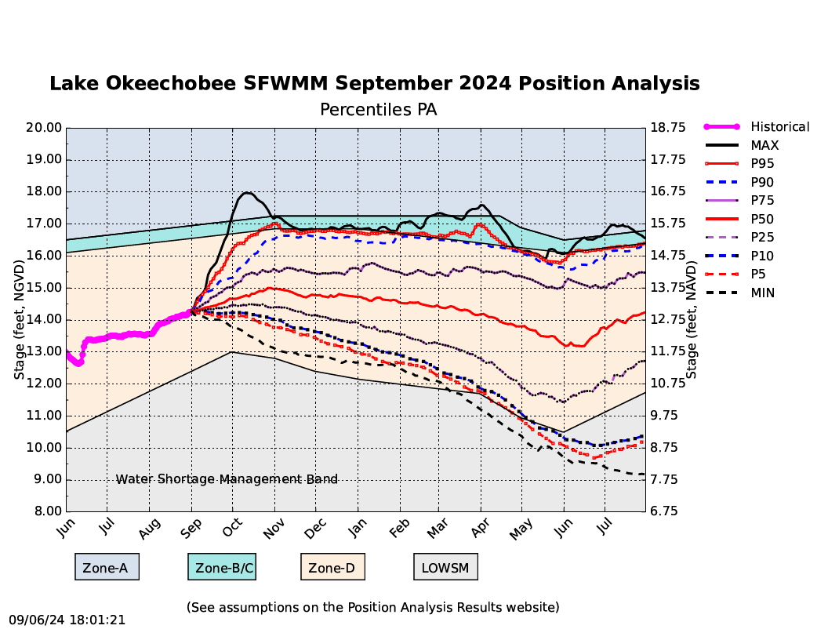

Slide 13
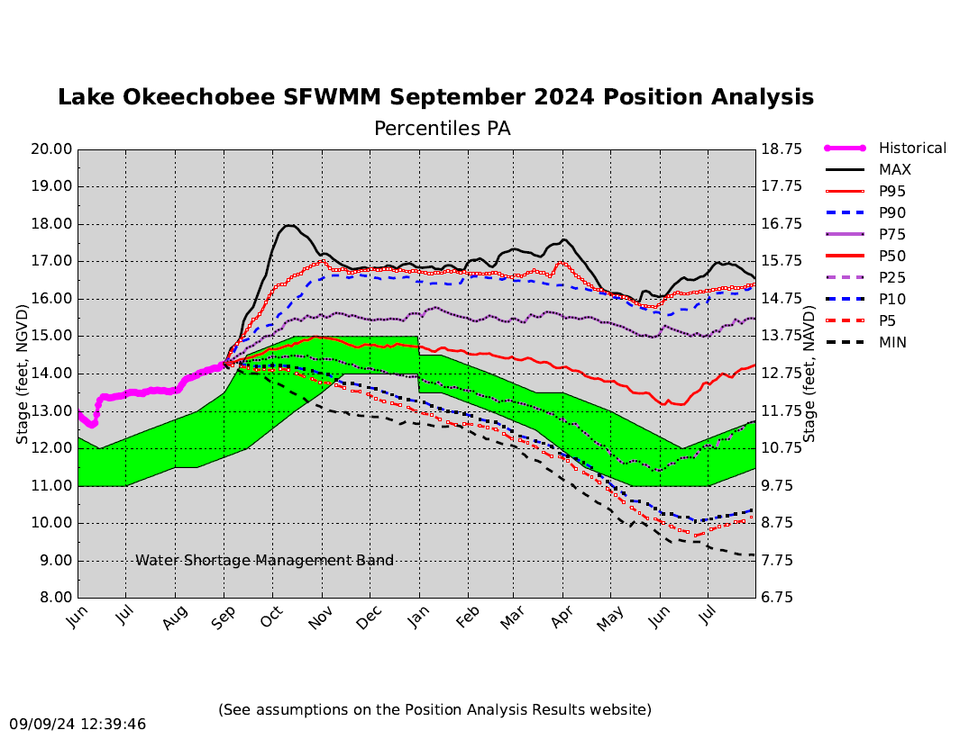

Slide 14
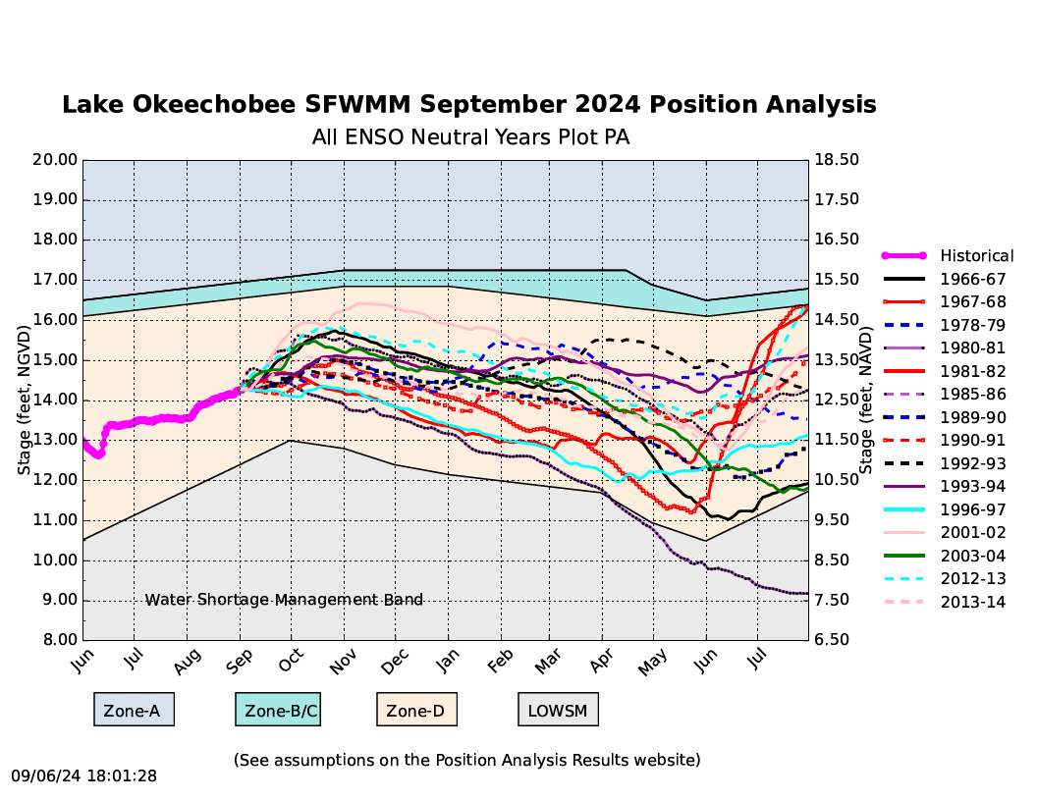

Slide 15
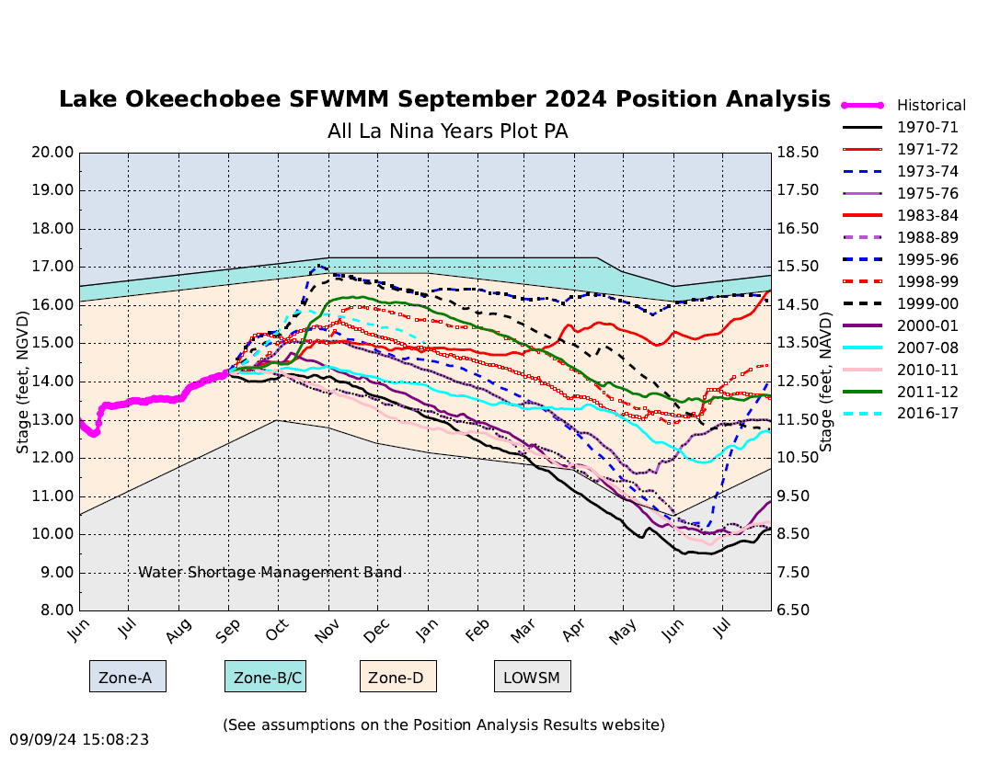
Notes:
La Nina Years

Slide 16
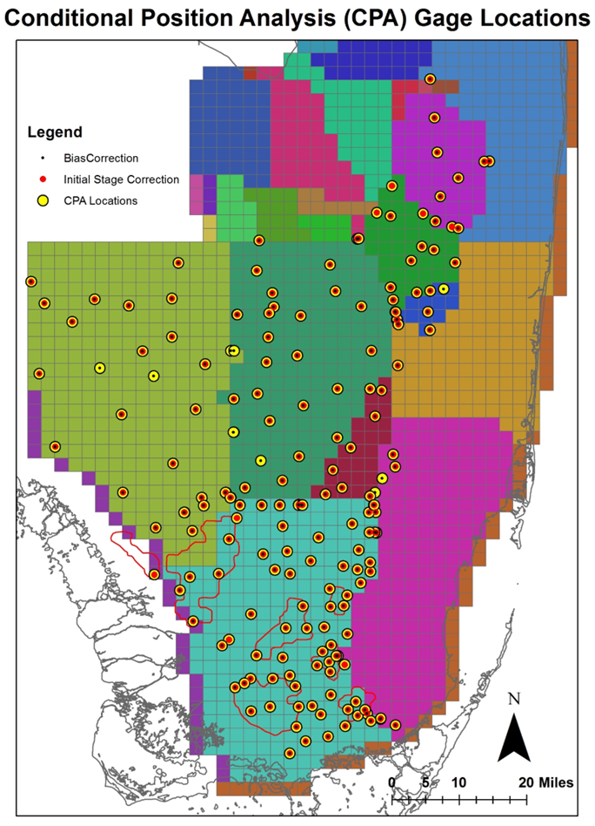
CPA Overview
CPA is a stochastic framework that transforms stages obtained from Dynamic Position Analysis (DPA) based on forecasted rainfall conditions over the next twelve months (Ali, 2016).
CPA depends on DPA - DPA stage outputs are used as inputs to CPA.
CPA is implemented for 200+ locations in the Everglades including Lake Okeechobee.

Slide 17
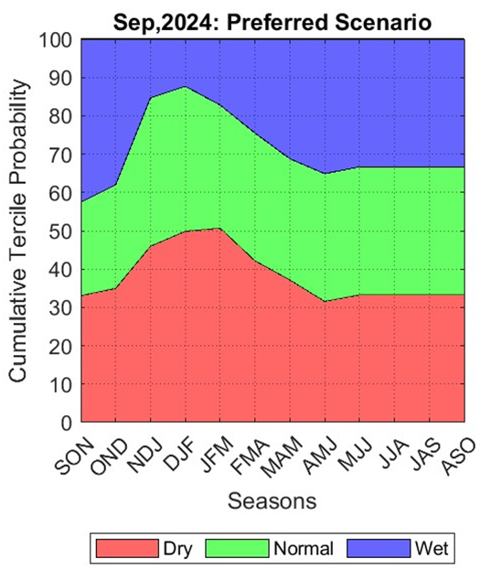
September 2024 CPA: Rainfall Scenarios
Rainfall probabilities are calculated based on historical data and projected Niño-3.4 Index (Climate Prediction Center - El Nino Southern Oscillation (noaa.gov) published by CPC.

Slide 18
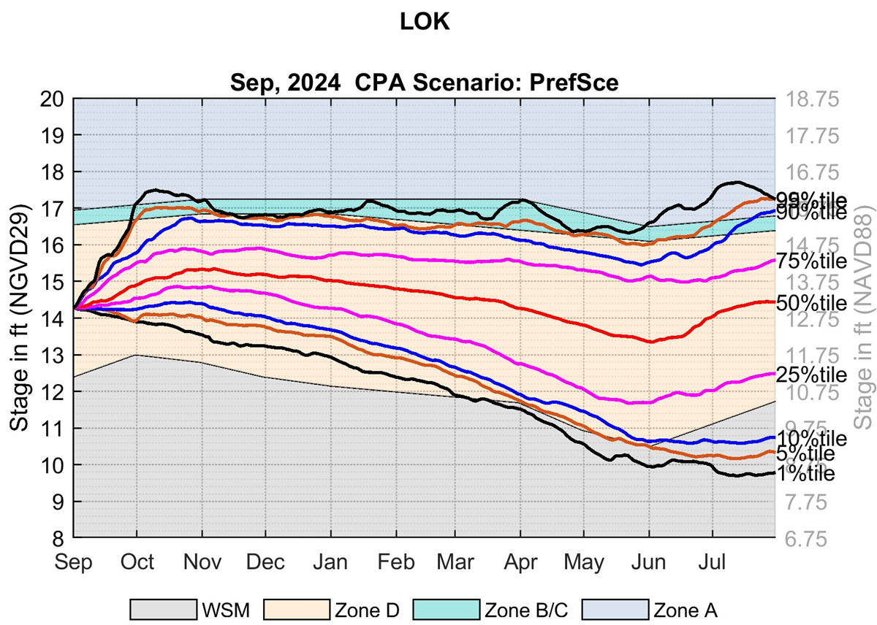
Lake Okeechobee – LOSOM CPA implementation shows the percentile lines slightly shift upward until March 2025, though the stage recession rate are slightly higher from November 2024 compared to DPA percentile lines.

Slide 19
Additional slides

Slide 20
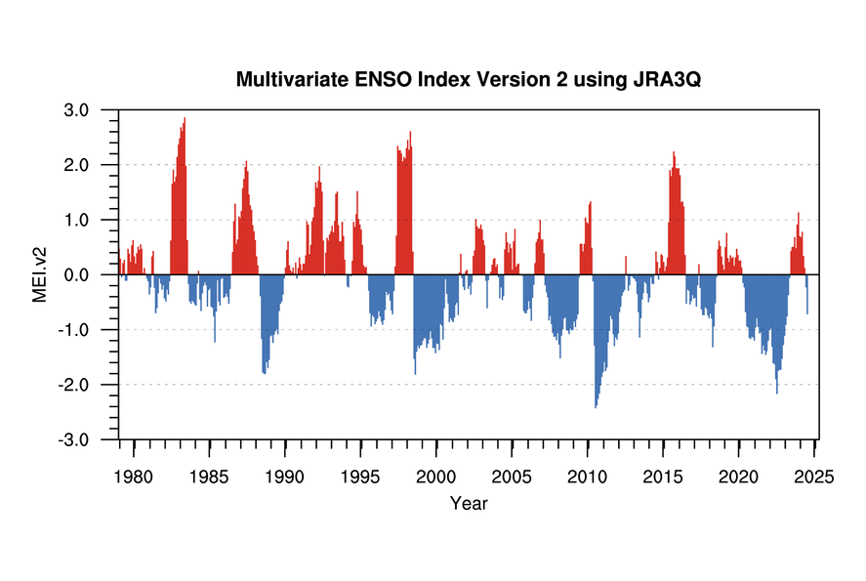
*The JRA-55 dataset used for the MEI V2 has been discontinued by the Japanese Meteorological Agency as of January 2024. We have switched to using the JRA3Q reanalysis which yields very similar results.
Prepared by: NOAA Physical Sciences Laboratory
Notes:
https://www.esrl.noaa.gov/psd/enso/mei/

Slide 21
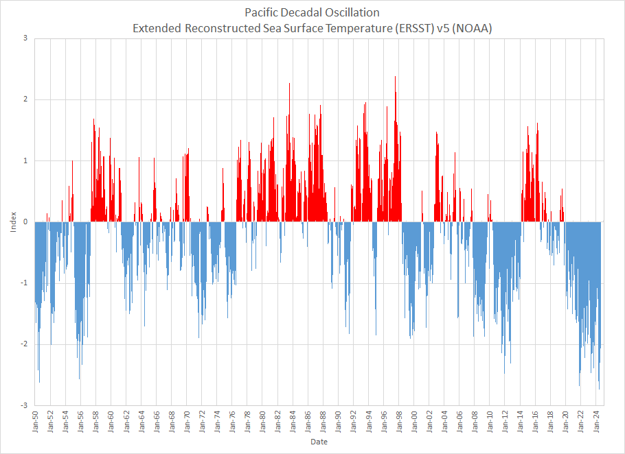
Notes:
https://psl.noaa.gov/pdo/
https://www.ncdc.noaa.gov/teleconnections/pdo/

Slide 22
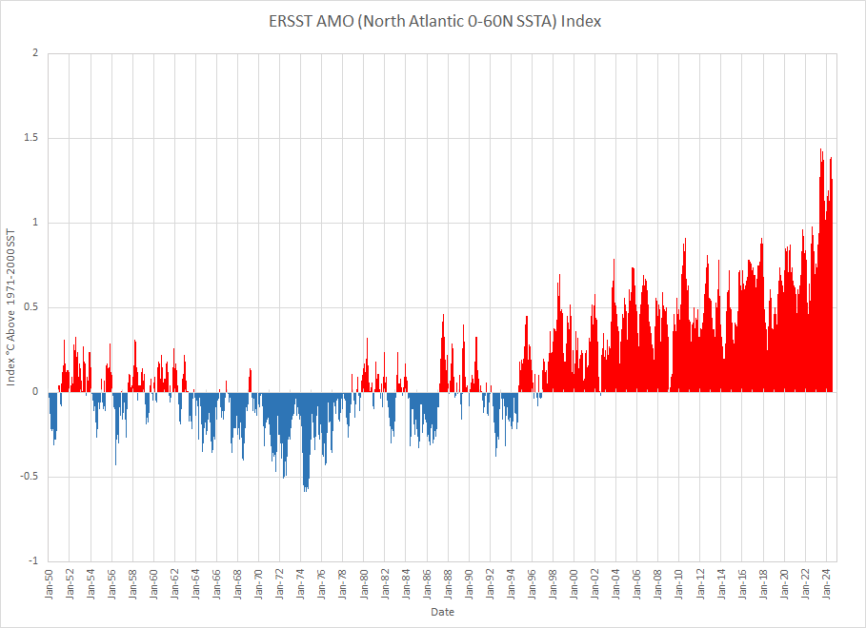
Notes:
https://www1.ncdc.noaa.gov/pub/data/cmb/ersst/v5/index/ersst.v5.amo.dat
https://www.esrl.noaa.gov/psd/data/correlation/amon.us.data

Slide 23
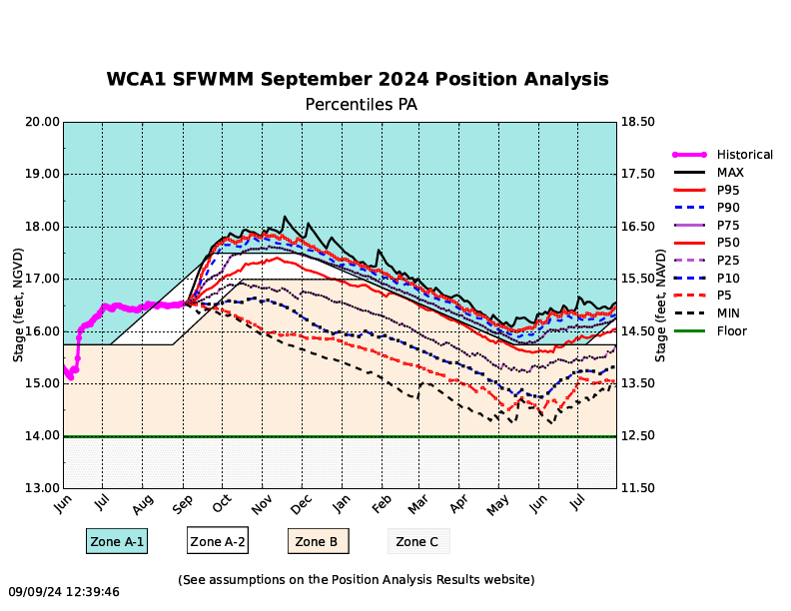

Slide 24
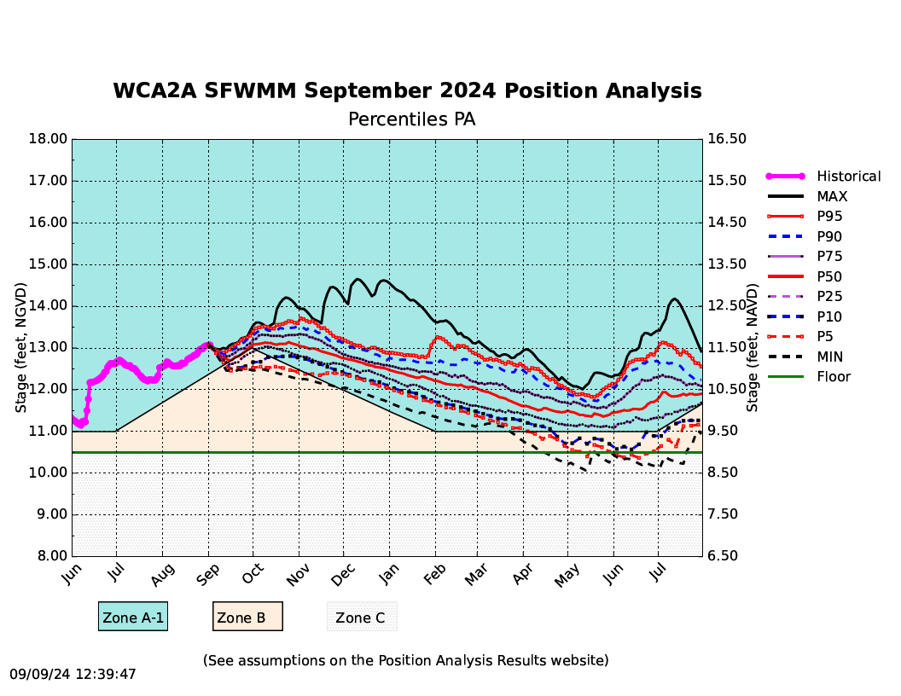

Slide 25
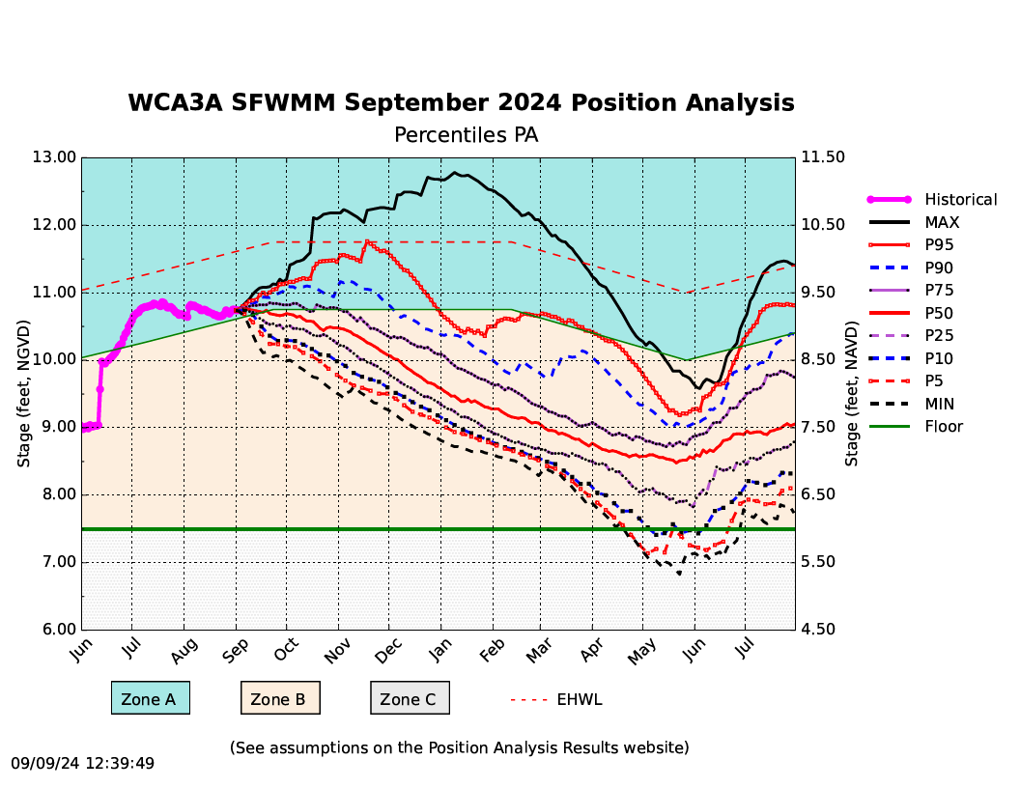

Slide 26
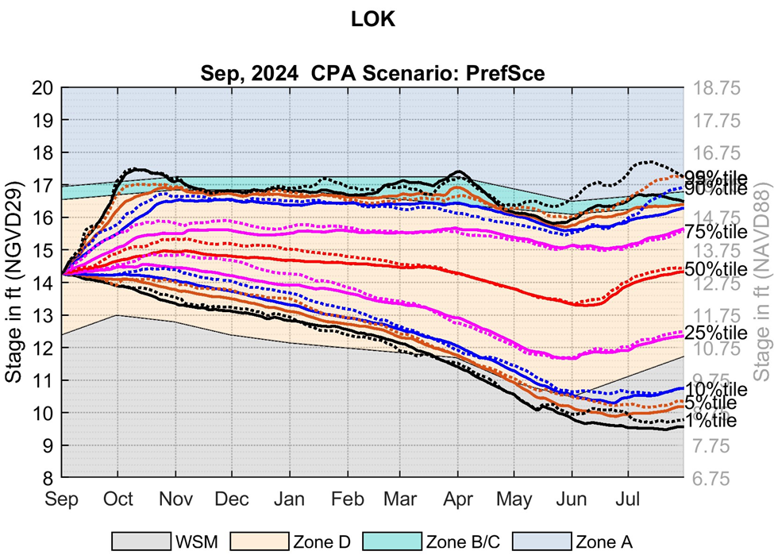

Slide 27
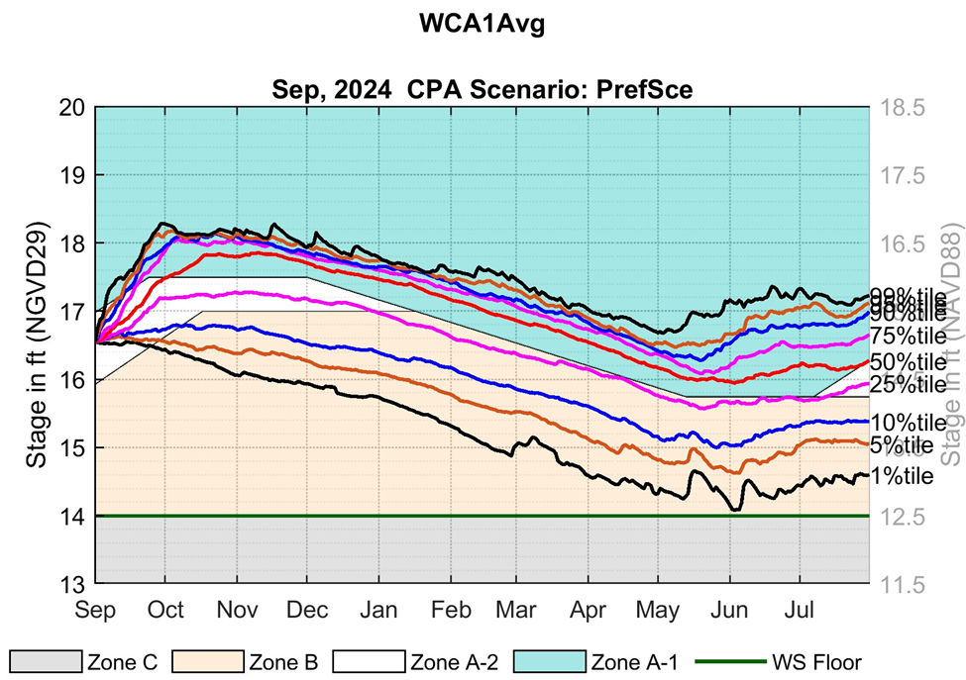

Slide 28
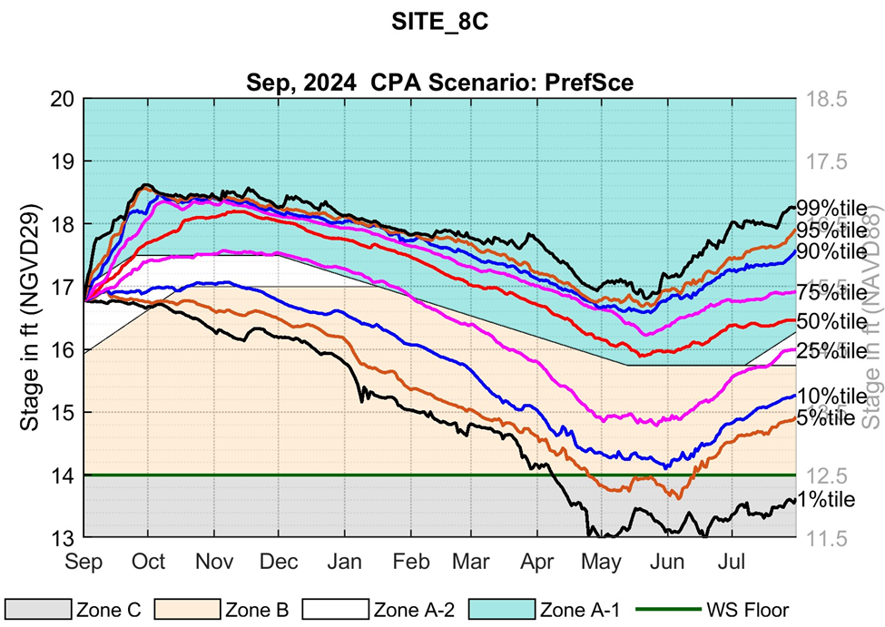

Slide 29
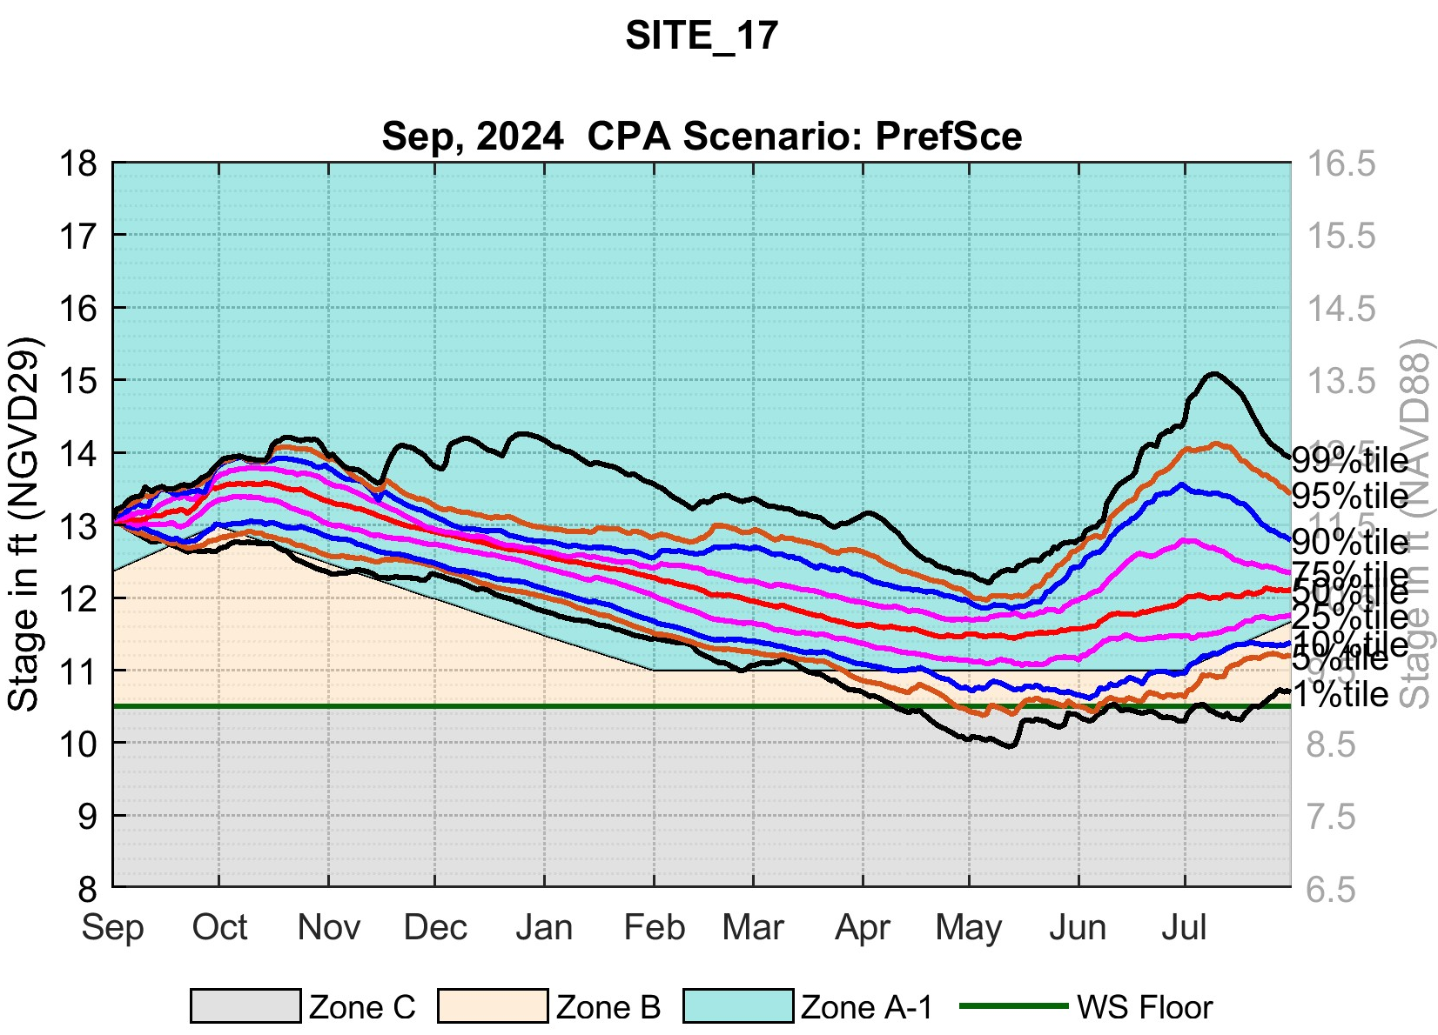

Slide 30
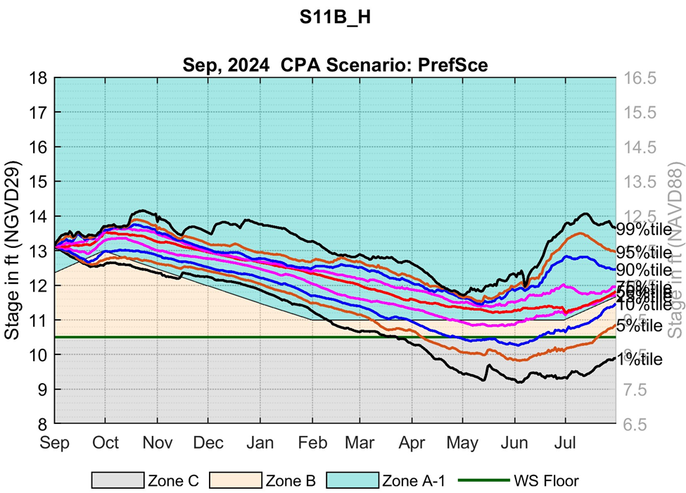

Slide 31
