Slide 1
April 2024: Conditional Positional Analysis (CPA) Implementation
H&H Bureau, Systems Modeling Unit
SFWMD

Slide 2
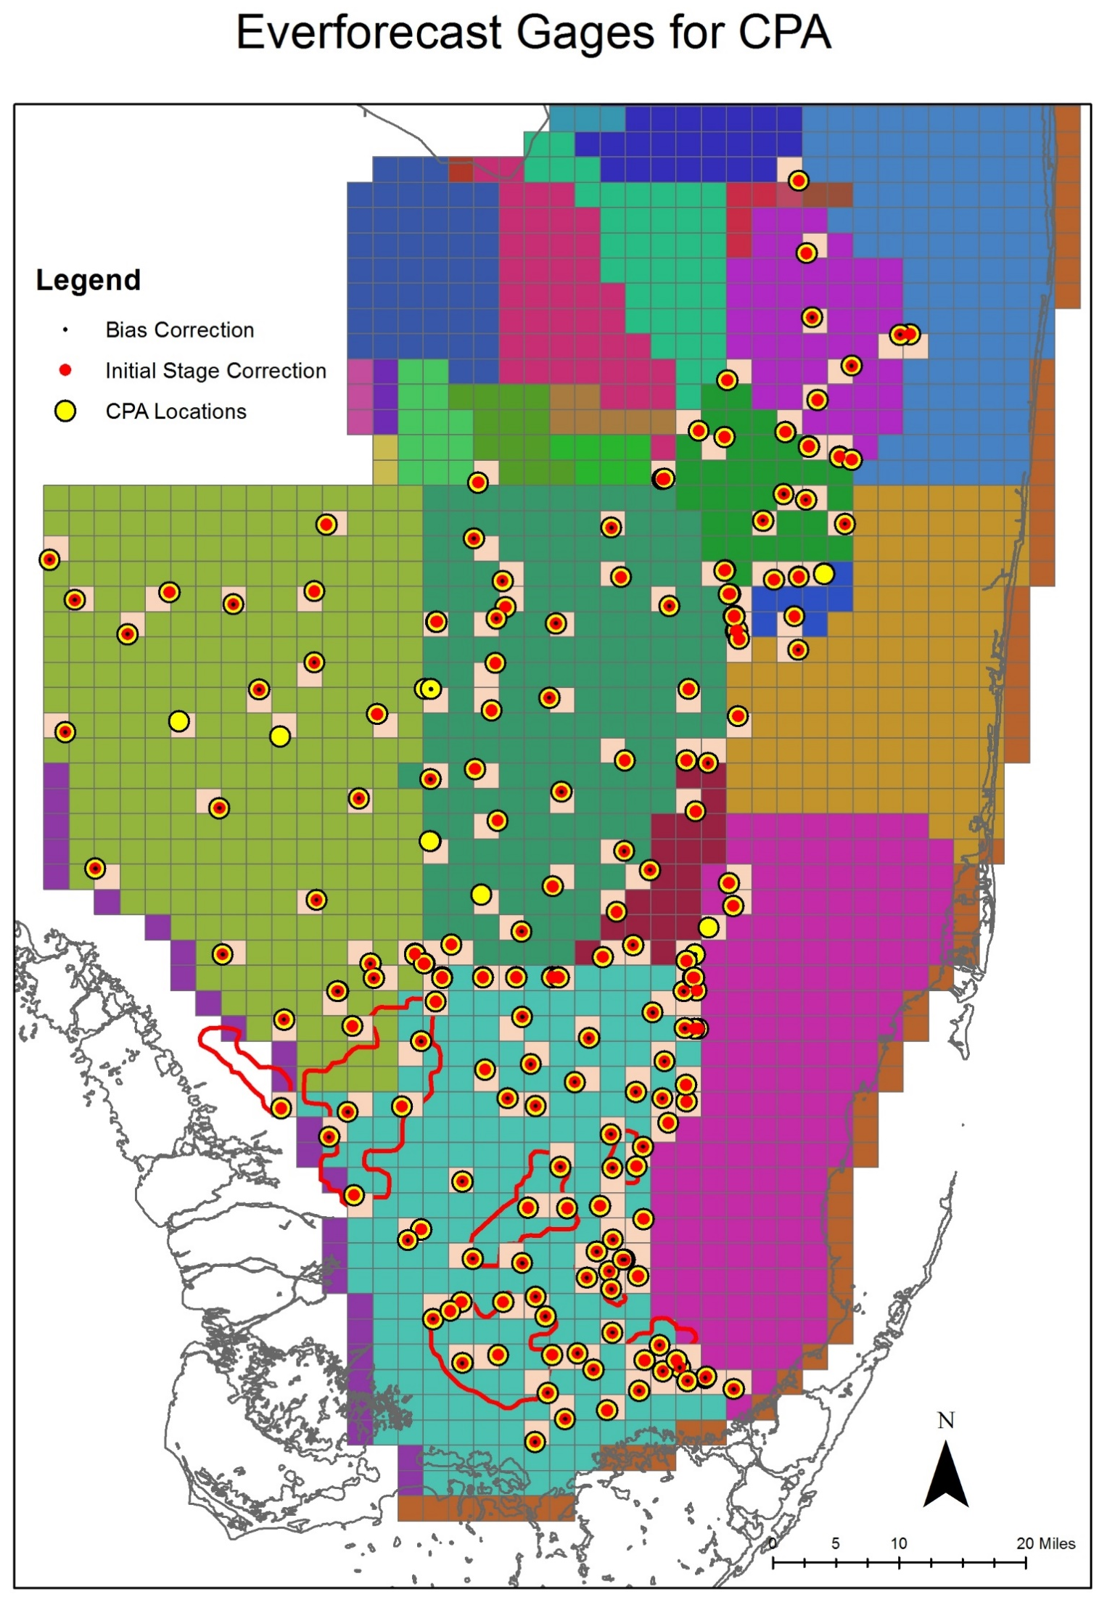
CPA Overview
CPA Locations
CPA is a stochastic framework (CPA Overview) that transforms stages obtained from Dynamic Position Analysis (DPA) based on forecasted rainfall conditions over the next twelve months (Ali, 2016).
CPA depends on DPA - DPA stage outputs are used as inputs to CPA (DPA).
3 rainfall outlook scenarios (climatological, CPC, and Preferred Scenario) are used compare potential stage outlooks.
April 2024 CPA was conducted for two Lake Okeechobee regulation plans - LORS2008 and LOSOM.
CPA is implemented for 200 locations in the Everglades including Lake Okeechobee. Additionally, CPA was implemented for WCA1Avg (avg of Site 7, Site 8T, and Site 9) and WCA3AAvg (avg of Site 63, Site 64, and Site 65) stages (Khare et al., 2024, UF WI Symposium 2024 Presentation).

Slide 3
CPA Overview
CPA Locations
CPA Outputs
  CPA forecasted stage percentiles from ‘Climatological’ scenario are first collapsed on DPA stage percentiles. Corresponding adjustments are then applied to stage percentile lines for all other rainfall scenarios.
  Even though CPA methodology considers current operational protocols as it transforms rainfall probability outlook into stage change probability outlook via a Transition Probability Matrix, CPA generated extreme stages (i.e., extreme percentile) may not always be captured by the available model data sets.
  Currently, efforts are underway to develop mechanism to constrain CPA generated stages such that even extreme stages would conform to practically possible stages under current operational protocols.

Slide 4
CPA: Rainfall Scenarios
Climatological
  Climatological scenario assumes equal chances of below-normal/dry, normal, and above-normal/wet rainfall conditions over next twelve 3 monthly seasons (slide 5).
  This scenario is the connecting link between DPA and all other scenarios simulated under CPA.
CPC
  This is based on official rainfall forecasts published by NOAA’s Climate Prediction Center (CPC) every month (Climate Prediction Center - Forecasts & Outlook Maps, Graphs and tables (noaa.gov)).
  It is also used by JEM’s EverForecast tool for stage prediction.
Preferred Scenario (PrefSce)
  Seasonal rainfall probabilities are calculated based on historical data and projected Niño-3.4 Index (Climate Prediction Center - El Nino Southern Oscillation (noaa.gov) published by CPC.
  This scenario developed by System Modeling Unit (PrefSce Overview) represents a best professional judgement rainfall outlook and is typically more aggressive in terms of shifts from Climatological probabilities compared to CPC.

Slide 5
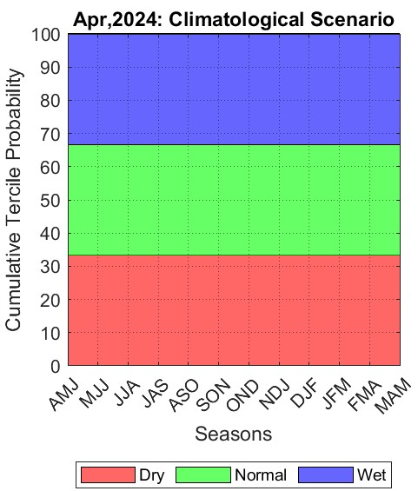
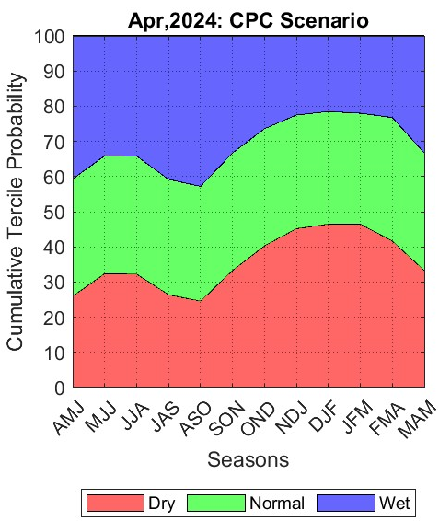
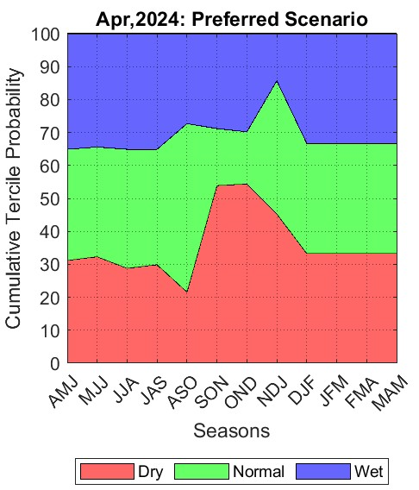
April 2024 CPA: Rainfall Scenarios

Slide 6
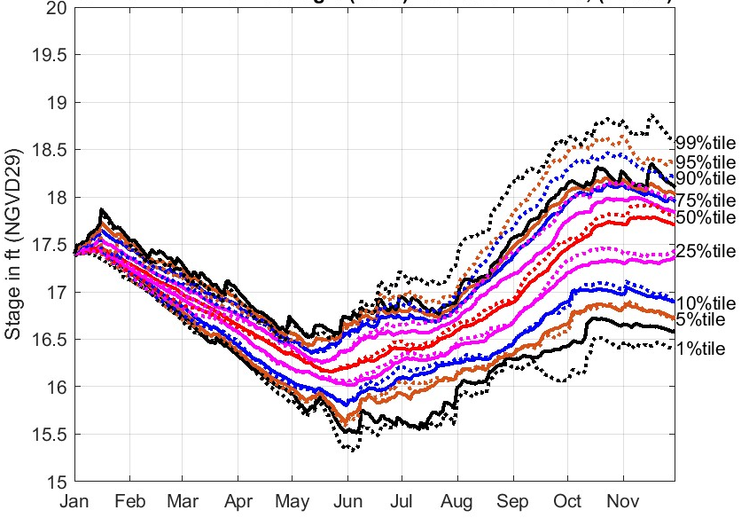
CPA: Key to Reading Results
Solid lines → Climatological Scenario/DPA
Dotted lines → Alternative Rainfall Scenario
Black lines → 1% and 99%
Brown lines → 5% and 95%
Blue lines → 10% and 90%
Pink lines → 25% and 75%
Red lines → 50%
Need to focus on how DPA percentile lines shift under Alternate Rainfall Scenario

Slide 7
LORS2008

Slide 8
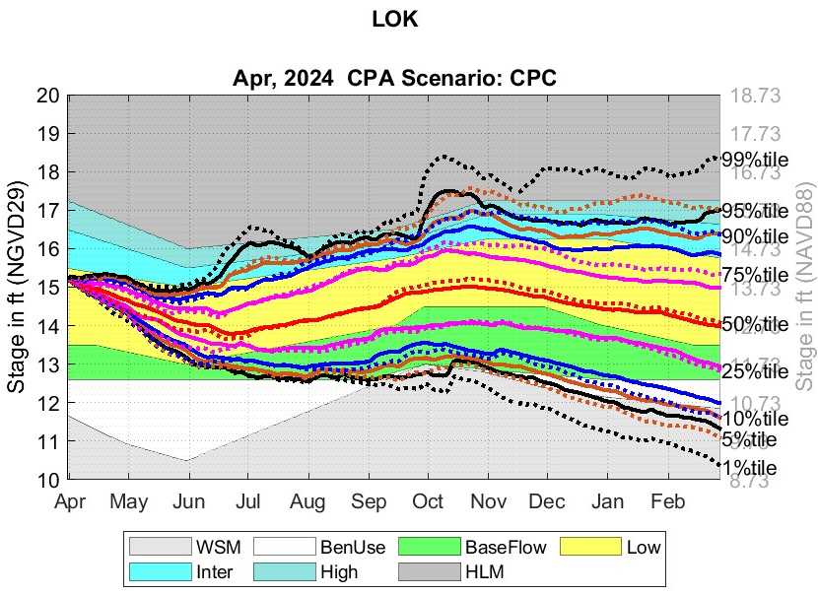
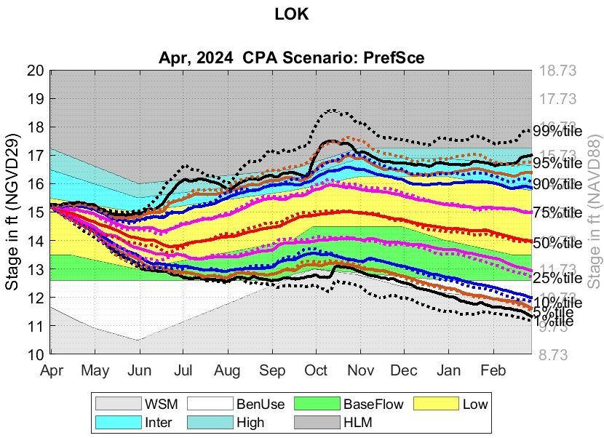
April 2024 CPA: LOK under LORS2008
CPC
PrefSce

Slide 9
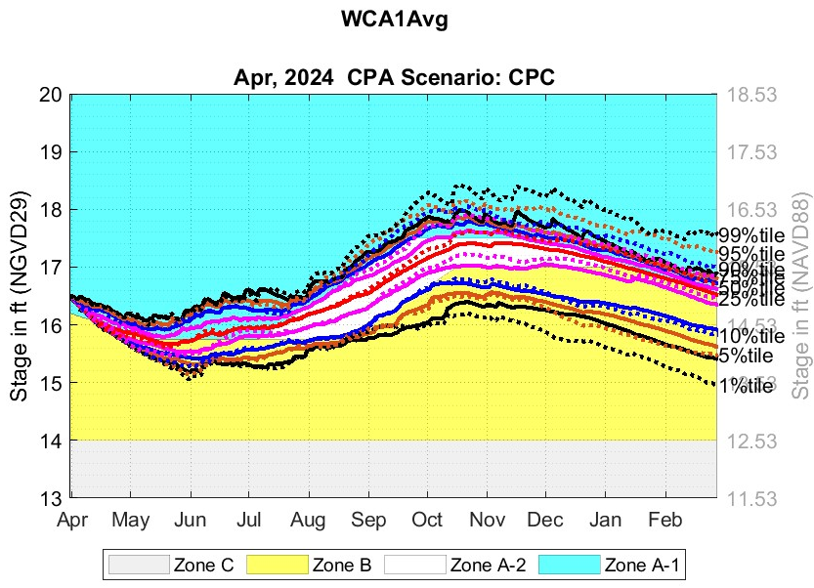
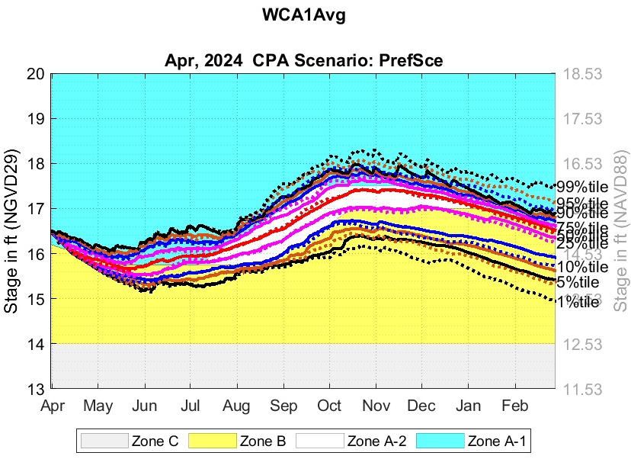
April 2024 CPA: WCA1Avg under LORS2008
CPC
PrefSce

Slide 10
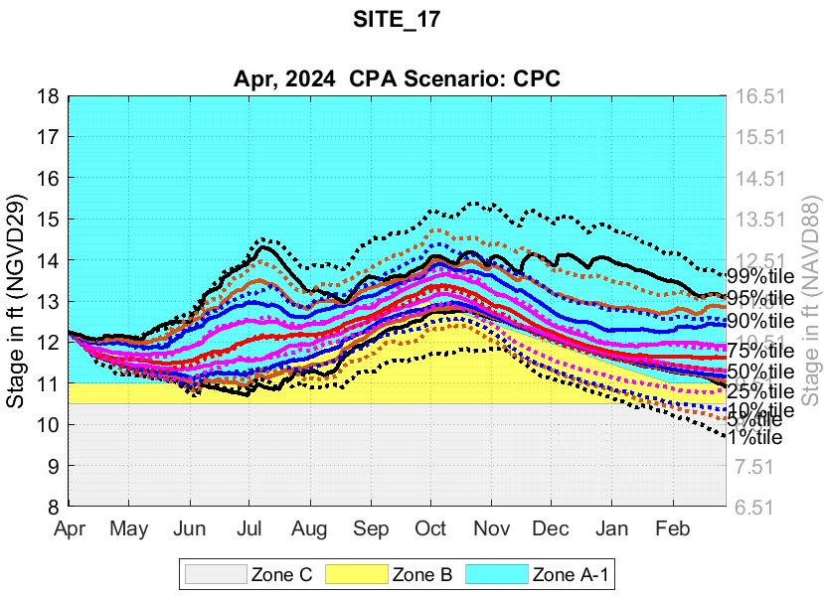
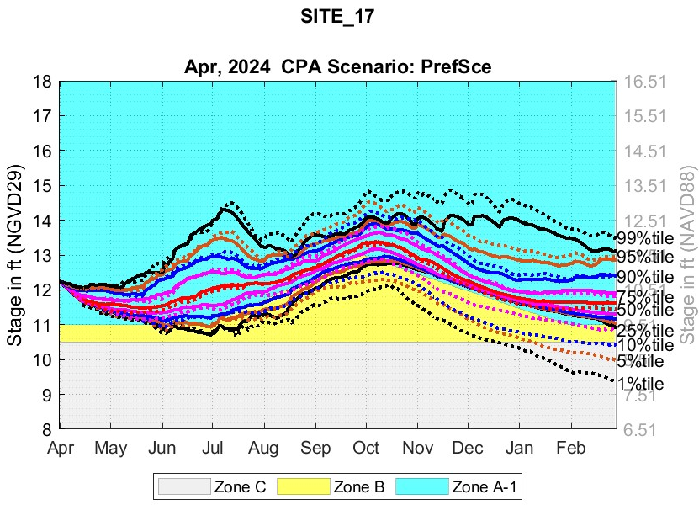
April 2024 CPA: WCA2A under LORS2008
CPC
PrefSce
WCA2Avg
WCA2Avg

Slide 11
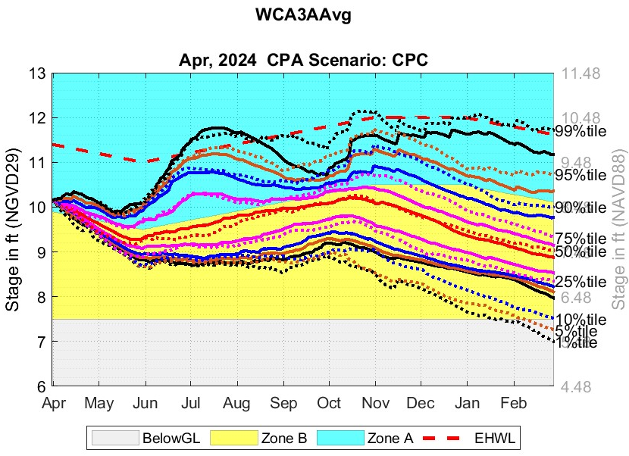

Apr 2024 CPA: WCA3AAvg under LORS2008
CPC
PrefSce

Slide 12
LOSOM

Slide 13
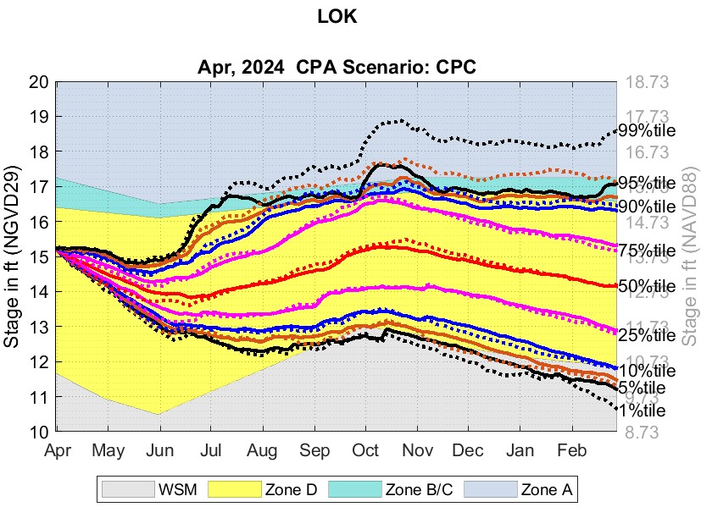
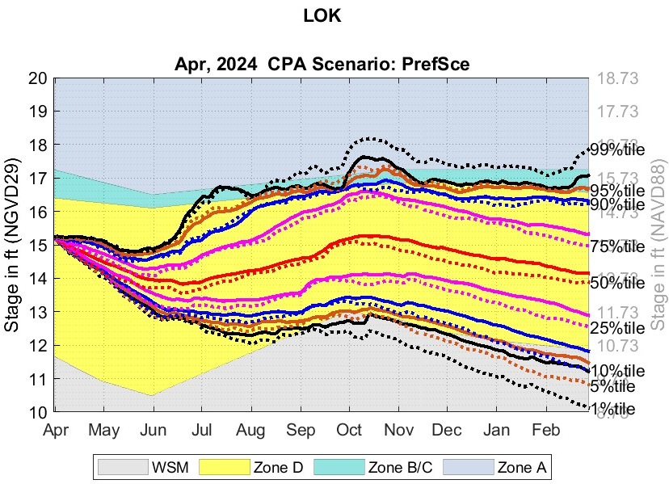
April 2024 CPA: LOK under LOSOM
CPC
PrefSce

Slide 14
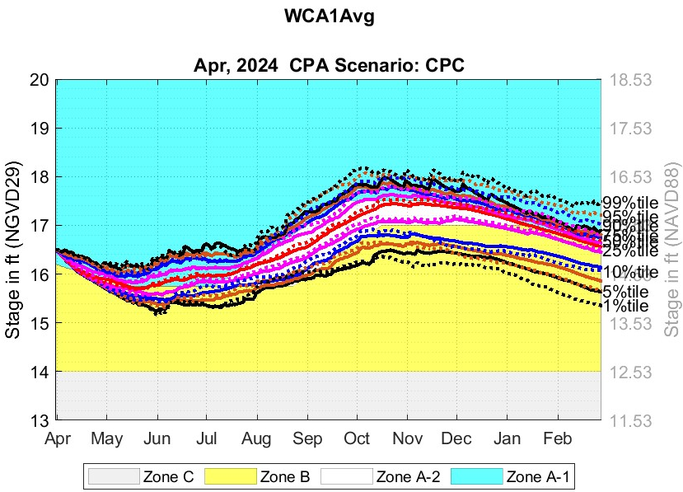
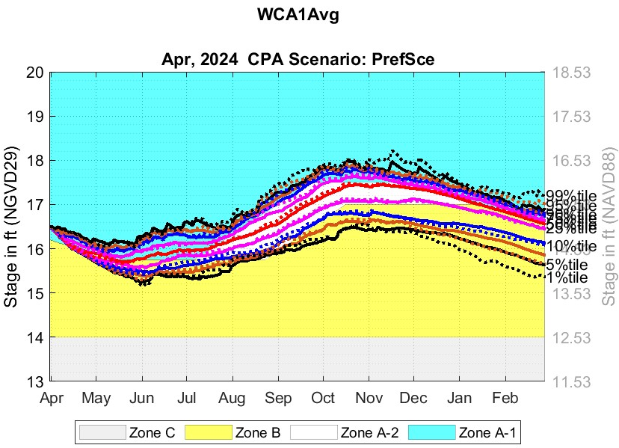
April 2024 CPA: WCA1Avg under LOSOM
CPC
PrefSce

Slide 15
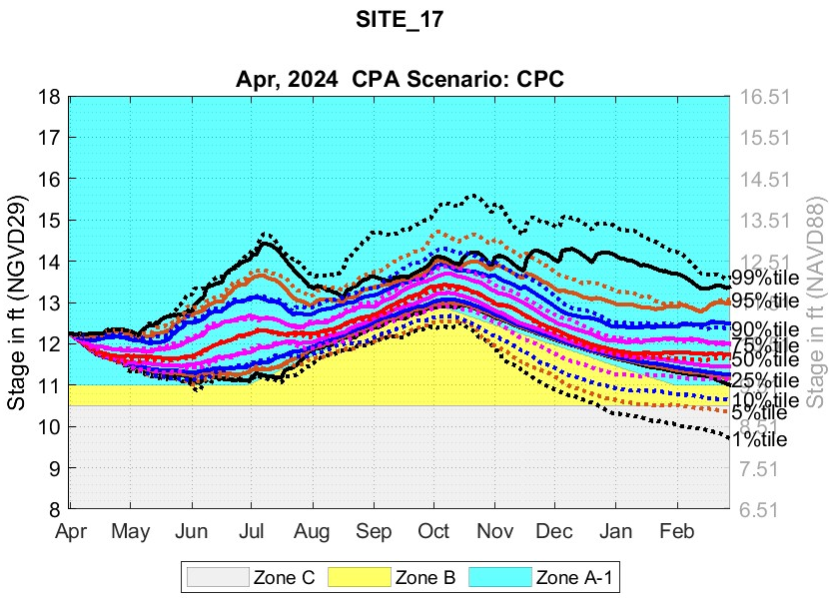
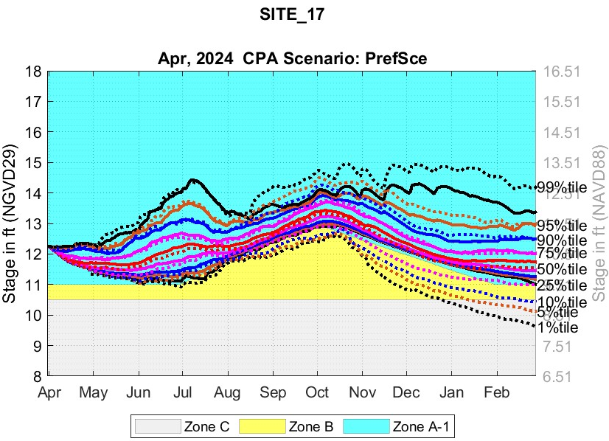
April 2024 CPA: WCA2A under LOSOM
CPC
PrefSce
WCA2Avg
WCA2Avg

Slide 16
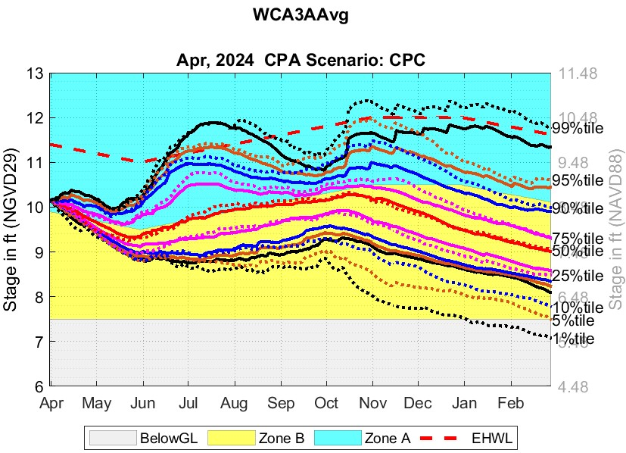
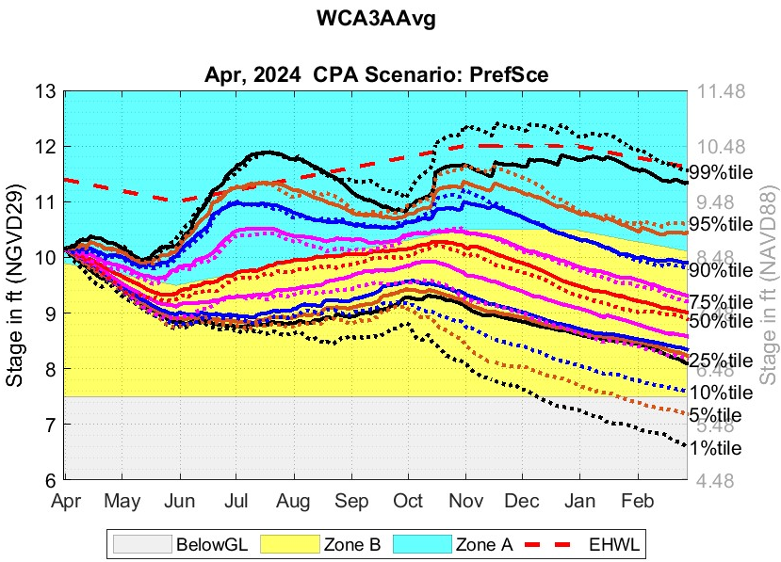
April 2024 CPA: WCA3AAvg under LOSOM
CPC
PrefSce

