Slide 1
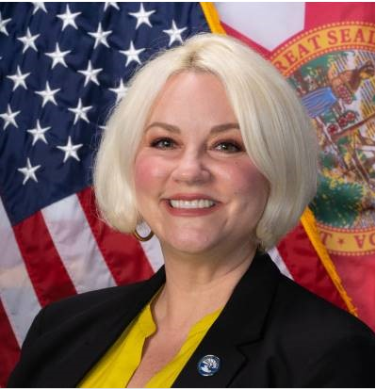
SFWMD Fiscal Year 2022-2023 First Public Budget Hearing
Tax and Budget Presentation
September 8, 2022
5:15 PM
Candida Heater Administrative Services Division Director
Notes:
This is the first of 2 public hearings required by Chapter 200, F.S. (TRIM) to adopt millage rates and a budget for Fiscal Year 2022-2023. The second hearing is scheduled to be here at Headquarters in the B1 Building Auditorium and will also be available on Zoom Tuesday September 20 at 5:15 p.m. The Zoom link may be found on our District web at www.sfwmd.gov. We have IT staff on standby for this meeting for technical assistance if a member from the public encounters technical issues.
This evening staff will request action on 7 resolutions:
4 resolutions for the adoption of tentative Fiscal Year 2022-2023 millage rates
2 resolutions for adoption of the Everglades Agricultural Privilege Tax Rolls (one for the Everglades Agricultural Area and one for the C-139 Basin.)
1 resolution adopting the Fiscal Year 2022-2023 Tentative Budget.
There are strict statutory guidelines that must be followed in adopting tentative millage rates & budget.

Slide 2
Fiscal Year 2022-2023 Tentative Millage Rates
Millage Rates | Fiscal Year 2022-2023 Rolled-Back Millage Rates | Fiscal Year 2022-2023 Tentative Millage Rates | % Change from Rolled-Back Millage Rates
District-wide | 0.0948 | 0.0948 | 0.00%
Big Cypress Basin | 0.0978 | 0.0978 | 0.00%
Okeechobee Basin | 0.1026 | 0.1026 | 0.00%
Everglades Construction Project | 0.0327 | 0.0327 | 0.00%
The Millage Rate is applied to the Taxable Value of the Property as Determined by the Property Appraiser Annually (Assessed Value – Exemptions = Taxable Value) Within the Big Cypress Basin Represents a Combined Rate of 0.1926 or $19.26 per $100,000 of taxable value Within the Okeechobee Basin Represents a Combined Rate of 0.2301 or $23.01 per $100,000 of taxable value.
Presenter: Candida Heater
Notes:
The first substantive issue to be discussed is the percentage increase in the millage rates over the rolled-back rates necessary to fund the budget, if any, and the specific purposes for which ad valorem tax revenues are being increased.
With the Tentative rates being proposed this evening at the Rolled-Back millage Rates , there is NO increase in ad valorem taxes to be discussed pursuant to the statute.
The tentative millage rates are as follows:
District-wide, 0.0948 mill at the Rolled-Back Rate
Big Cypress Basin, 0.0978 mill at the Rolled-Back Rate
Okeechobee Basin, 0.1026 mill at the Rolled-Back Rate
Everglades Construction Project, 0.0327 mill at the Rolled-Back Rate
For a Total Combined Big Cypress Basin Millage Rate of 0.1926 mill
In the Big Cypress Basin - Collier and a Small Portion of Mainland Monroe Counties -These Rates Represent $19.26 per $100,000 of Taxable Value.
For a Total Combined Okeechobee Basin Millage Rate of 0.2301 mill
In the Okeechobee Basin – 15 of 16 Counties – These Rates Represent $23.01 per $100,000 of Taxable Value
Mr. Chairman, I turn the meeting back over to you prior to considering the next four resolutions on the millage rates.
Chairman:
Any Board Member questions before we move on to consider the resolutions?
Please proceed with the resolutions Ms. Heater

Slide 3
Fiscal Year 2022-2023 Tentative Millage Rates Adoption Resolutions
Adopt Resolution 2022-0913:
Adopt the District-wide Tentative Millage Rate (0.0948 mill) within the Okeechobee Basin and Big Cypress Basin of the South Florida Water Management District for Fiscal Year 2022-2023
Adopt Resolution 2022-0914:
Adopt the Tentative Millage Rate for the Big Cypress Basin (0.0978 mill) within the Big Cypress Basin of the South Florida Water Management District for Fiscal Year 2022-2023
Presenter: Candida Heater
Notes:
The staff considerations related to the four tentative millage rates outlined as two on this slide and two on the following slide, and each must be separately voted on.
Mr. Chairman, I turn the meeting back over to you to vote on the next four millage resolutions separately:
Chairman:
Call the Question to adopt tentative millage rate for the District-wide, Resolution 2022-0913
Poll Board members participating by phone
Announce result of the vote
Chairman:
Call the Question to adopt tentative millage rate for the Big Cypress Basin, Resolution 2022-0914
Poll Board members participating by phone
Announce result of the vote

Slide 4
Fiscal Year 2022-2023 Tentative Millage Rates Adoption Resolutions
Adopt Resolution 2022-0915:
Adopt the Tentative Millage Rate for the Okeechobee Basin (0.1026 mill) within the Okeechobee Basin of the South Florida Water Management District for Fiscal Year 2022-2023
Adopt Resolution 2022-0916:
Adopt the Tentative Millage Rate for the Everglades Construction Project (0.0327 mill) within the Okeechobee Basin of the South Florida Water Management District for Fiscal Year 2022-2023
Presenter: Candida Heater
Notes:
Chairman:
Call the Question to adopt tentative millage rate for the Okeechobee Basin, Resolution 2022-0915
Poll Board members participating by phone
Announce result of the vote
Chairman:
Call the Question to adopt tentative millage rate for the Everglades Construction Project, Resolution 2022-0916
Poll Board members participating by phone
Announce result of the vote

Slide 5
Agricultural Privilege Tax Roll Certification
Everglades Agricultural Area And C-139 Basin
Presenter: Candida Heater
Notes:
This portion of the presentation pertains to the Agricultural Privilege Tax which is Non Ad Valorem “per acre tax” on actively farmed parcels located within the Everglades Agricultural Area (EAA) and the C-139 Basin in Palm Beach and Hendry Counties.
The EAA spans across both Palm Beach and Hendry Counties while the C-139 Basin is located solely in Hendry County.

Slide 6
Everglades Agricultural Area
Number of Vegetable Deferral Applications: -0-
1996, 2000 & 2016 Deferrals Continue in Effect
Appendix A: 11,883.62 Acres
Appendix B: 6,186.43 Acres
Appendix C: 4,048.03 Acres
Agricultural Privilege Tax Rate per acre $25.00
Total Taxable Acres 441,250.32
Total Gross Non Ad Valorem Tax Revenue $11,031,258.00
Less: Budgeted Discount ($441,250.32)
Fiscal Year 2022-2023 Budgeted Revenue $10,590,008.00
Presenter: Candida Heater
Notes:
Beginning with the Agricultural Privilege Tax for the Everglades Agricultural Area;
Staff requests for consideration that the Governing Board take action to adopt a resolution that . . .
Approves previous vegetable acreage disaster tax deferrals from 1996, 2000 & 2016
Approves and certifies the Everglades Agricultural Area Tax Roll
No new vegetable deferral applications were received.
The current tax rate is $25 per acre pursuant to section 373.4592 F.S. The rate to be applied to the deferral acres is $25.00
For the 441,250.32 acres at $25.00 per acre, total revenue generates taxes totaling $11,031,258
Staff applies a budgeted discount of $441,250.32 to account for early payment discount and budget trends, for a total budgeted revenue for the EAA at $10,590,008.
Mr. Chairman, I turn the meeting back over to you prior to considering the adoption of the EAA Resolution.
Chairman:
Any Board Member questions before we move on to consider the EAA resolution?
Please proceed with the resolution Ms. Heater

Slide 7
Fiscal Year 2022 -2023 Everglades Agricultural Privilege Tax Resolution
Adopt Resolution 2022-0917
Relating to the Everglades Agricultural Privilege Tax; providing the disposition of applications for classification as vegetable acreage; applying the deferral of agricultural privilege taxes for the 1996, 2000 and 2016 vegetable classified acreage; approving and certifying the Everglades Agricultural Privilege Tax Roll for 2022
Presenter: Candida Heater
Notes:
The staff Presents for Consideration Resolution 2022-0917;
Chairman:
Call the Question to adopt the Everglades Agricultural Privilege Tax, Resolution 2022-0917
Poll Board members participating by phone:
Announce result of the vote

Slide 8
C-139 Basin
Number of Vegetable Deferral Applications: -0-
Agricultural Privilege Tax Rate Per Acre $1.80
Total Taxable Acres 125,747.87
Total Gross Non Ad Valorem Tax Revenue $226,346.00
Less: Budgeted Discount ($9,054.00)
Fiscal Year 2022-2023 Budgeted Revenue $217,292.00
Presenter: Candida Heater
Notes:
For the Agricultural Privilege Tax for the C-139 Basin,
Staff requests for consideration that the Governing Board take action to adopt a resolution that . . .
Grants Vegetable Acreage Applications (if any) and
Approves and Certifies the C-139 Basin Tax Roll
No Deferral vegetable applications were received.
The agricultural privilege tax rate per acre of $1.80 is assessed on the total taxable acres in the C-139 basin of 125,747.87 which yields a total tax of $226,346.
Staff applies a budgeted discount of $9,054 to account for early payment discount and budget trends.
The total 2022-2023 budgeted revenue from the C-139 Basin is estimated at $217,292
Mr. Chairman, I turn the meeting back over to you prior to considering the adoption of the C-139 Basin Resolution.
Chairman:
Any Board Member questions before we move on to consider the C-139 Basin Resolution?
Please proceed with the resolution Ms. Heater

Slide 9
Fiscal Year 2022-2023 C-139 Resolution
Adopt Resolution 2022-0918
Relating to C-139 Agricultural Privilege Tax; providing the disposition of applications for classification as vegetable acreage; approving and certifying the C-139 Agricultural Privilege Tax Roll for 2022
Presenter: Candida Heater
Notes:
The staff Presents for Consideration Resolution 2022-00918:
Chairman:
Call the Question to adopt the C-139 Agricultural Privilege Tax, Resolution 2022-0918
Poll Board members participating by phone
Announce result of the vote

Slide 10
Tentative Budget
Revenue and Expenditure Budget
Presenter: Candida Heater
Notes:
This portion of the presentation pertains to the Fiscal Year 2022-2023 Tentative Budget amount of $1,226,394,713 to be considered this evening for both revenues and expenditures.

Slide 11
Fiscal Year 2022-2023 Budget Update August 1 Tentative Submittal to September = $4.7 Million Increase
Fiscal Year 2022-2023 August 1 Tentative Budget |  | $1,221.7 Million
Item | Funding Source | Amount (million)
Restoration Strategies - (FY2021-22 Budget Amendment) | State | -45.0
Green Heart of the Everglades - (FY2021-22 Budget Amendment) | State | -0.3
FEMA BRIC Grant – S-28 | Federal | 50.0
Fiscal Year 2022-2023 September Tentative Budget |  | $1,226.4 Million
Note: In Addition to Changes Above, Revenue loss in Agricultural Privilege Taxes of $4,801
Presenter: Candida Heater
Notes:
First, I would like to highlight the changes that have been added to the budget from the July/August Tentative Budget Submittal.
The budget has Increased by $4.7M from a $1,221.7M to $1,226.4M.
The decreases are attributed to state funds, Federal, and Ag Tax,

Slide 12
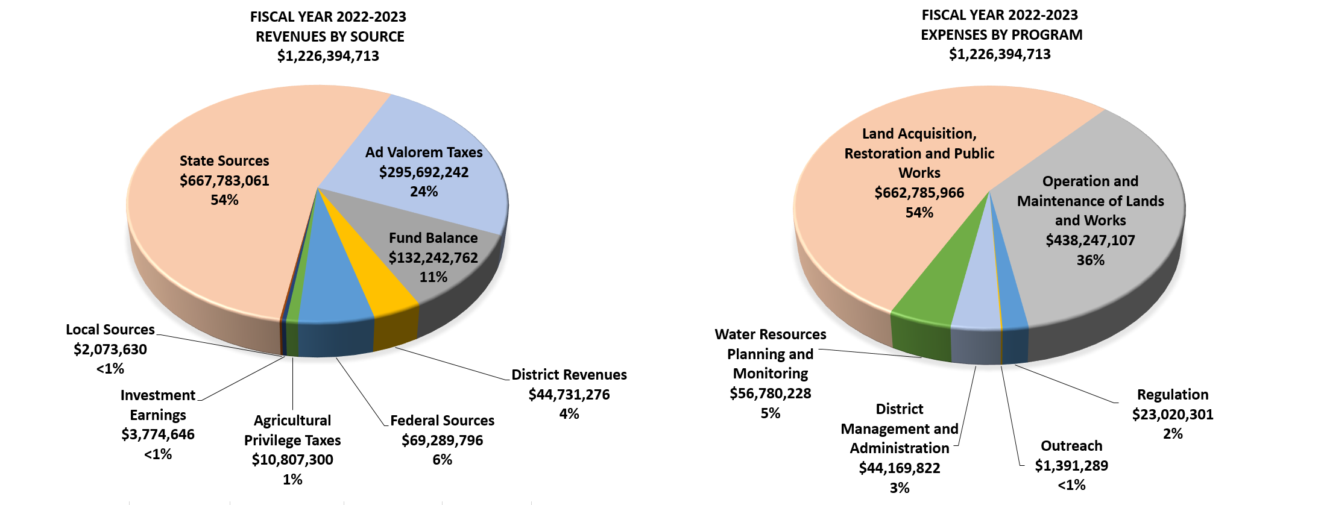
Fiscal Year 2022-2023 Tentative Budget $1,226,394,713
Presenter: Candida Heater
Notes:
The Pie Chart to the Left illustrates the Revenues: Ad valorem and State Sources make up 78% of revenue and Fund Balance 11%.
Ad Valorem: The estimated ad valorem revenue of $295 million includes $4.2 million net increase over last year due to New Construction ($6.1M) and Prior Year Taxable Value Reduction (-$1.9M).
State: $667 million includes over $500 million in new state funds from the legislature for Everglades Restoration and $61M for resiliency, $22M for AWS, $14M for water quality projects through potential DEP Grant opportunities, $31M to continue work on the lower Kissimmee STA project through a grant from DEP, $7 million from FWC for exotic controls, 200K FDACS Prescribed Burn, 263K Everglades License Tag and Snook IRL License Tag funds.
The Fund Balance total 11%. This includes the $61 million emergency hurricane reserves that is reallocated each year.
The Pie Chart to the Right Illustrates the Projected Expenses by Program:
90% of the budget continues to support Restoration and Operations and Maintenance
Restoration of $662 million which is 54% of the budget. This includes the majority of the $667 million in state funding for Everglades Restoration for such projects as Restoration Strategies, CERP, NEEP and AWS, and WQ Grants that District Staff are seeking funding for through DEP.
Operations and Maintenance of Lands and Works is $438 million which is 36% of the budget. This includes the O&M Capital Refurbishment program at $58 million (52.4M C&SF, STA + $1.6M one-time funding & $4.1 BCB), $61 million emergency reserves and over $90 million for STA, C&SF and BCB operations and maintenance, and over $111M Coastal Resiliency and Sea Level Rise, and over $60M for land management & Exotic control, including the $14M Abiaki C-139 Restoration Project.

Slide 13
Comments on the Budget
No Legislative Committee Chairs Comments Received to Date
Due September 5 of Each Year Pursuant to Section 373.536 Florida Statutes
September 13, 2022 - Governor & Legislative Budget Commission comments due 5 business days before final Public Budget Hearing pursuant to Section 373.536 Florida Statutes
Final Hearing September 20, 2022 at 5:15 p.m.
Presenter: Candida Heater
Notes:
There are two deadlines for legislative comments –
September 5 General Legislative committee and sub-committee comments were due. Staff received No comments.
September 13 the Executive Office of the Governor and the Legislative Budget Commission comments are due.
Mr. Chairman, I turn the meeting back over to you prior to considering the tentative budget adoption resolution.
Chairman:
Any Board Member questions before we consider the Tentative Budget?
Please proceed Ms. Heater

Slide 14
Fiscal Year 2022-2023 Tentative Budget Adoption Resolution
Adopt Resolution 2022-0919:
Adopt the Tentative Budget of $1,226,394,713 for Fiscal Year 2022-2023
Presenter: Candida Heater
Notes:
The staff Presents for Consideration, Resolution 2022-0919, adopting the tentative budget in the amount of
$1,226,394,713
One Billion
Two hundred twenty-six million,
Three hundred ninety-four thousand,
Seven hundred and thirteen dollars.
Chairman:
Call the Question to adopt the Fiscal Year 2022-2023 Tentative Budget, Resolution 2022-0919
Poll Board members participating by phone
Announce result of the vote

Slide 15
Thank You
Presenter: Candida Heater
Notes:
Candida will thank Governing Board and Executive Management for support and Direction and budget staff for all their hard work bringing us down the home stretch.
************************************************************
Chairman:
Call the question
Announce adjournment
You Are DONE!!! ☺

