Slide 1
Technical Oversight Committee Meeting
March 2, 2010
Trace Metal Monitoring
Pete Rawlik Restoration Sciences Department SFWMD
March 2, 2010

Slide 2
Trace Metal Monitoring
In January 2009, SFWMD asked the TOC to consider dropping the last of trace metal monitoring from the Settlement Agreement
NSID1 and S5A
Cadmium (Cd), Copper (Cu) and Zinc (Zn)
The TOC
wanted more data on metals at NSID1
approved dropping Cd and Zn from S5A
suggested Cu at S5A was a potential concern

Slide 3
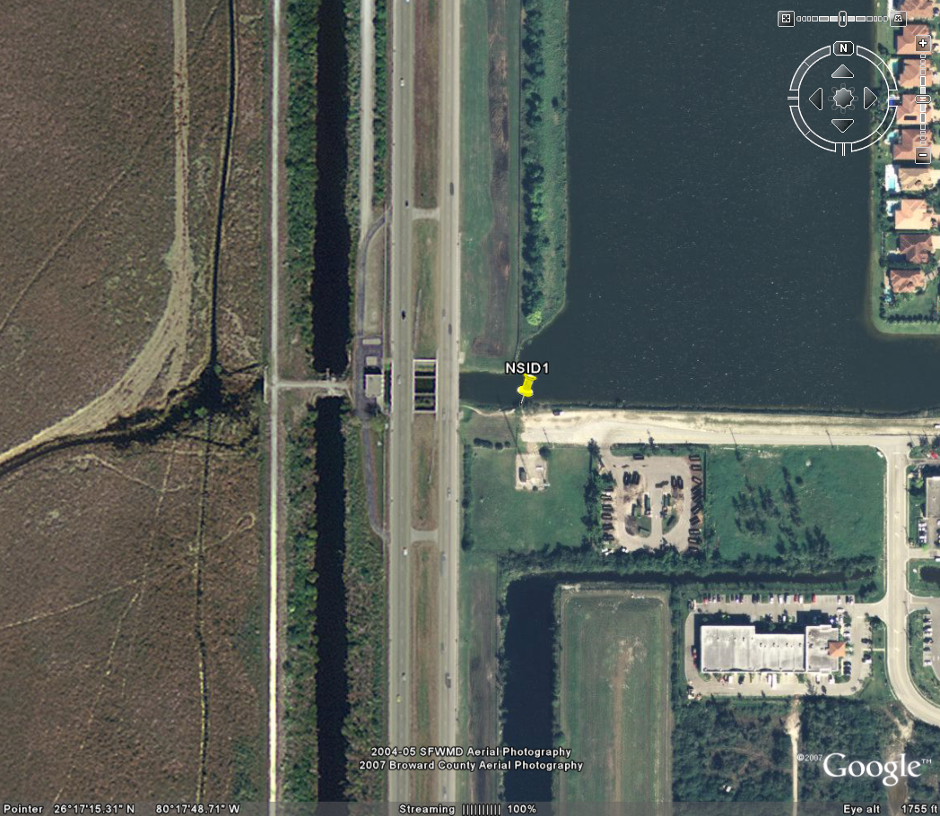
NSID1 on the eastern side of WCA2A

Slide 4
Copper at S38B/NSID1
Copper (ug/L)
All values below 5 ug/L
MDL = 2 ug/L

Slide 5
Zinc at S38B/NSID1
Zinc (ug/L)
MDL = 4 ug/L

Slide 6
Cadmium at S38B/NSID1
PQL = 1.2 ug/L
Cadmium (ug/L)
PQL = 0.4 ug/L
MDL = 0.3 ug/L
MDL = 0.1 ug/L

Slide 7
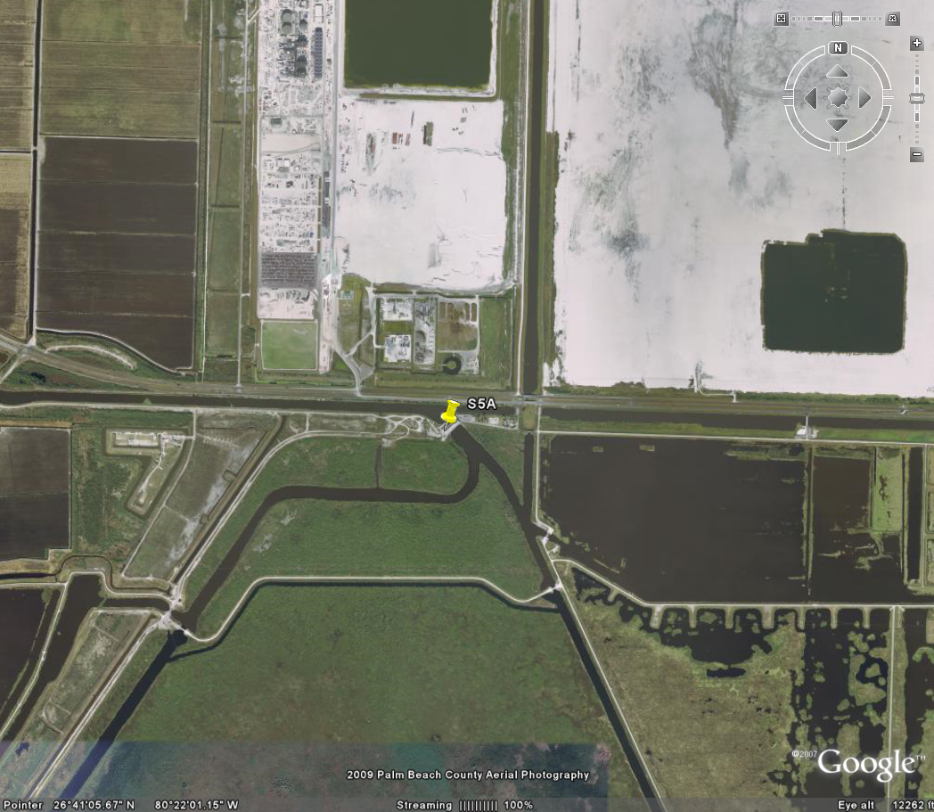
S5A on the north side of WCA1

Slide 8
Copper at S5A
Copper (ug/L)
All values below 10 ug/L
Average =2.5 ug/L
MDL = 2 ug/L

Slide 9
Conclusions
There is little evidence to suggest a history of issues with trace metals at either S5A or NSID1/S38B.

Slide 10
Request
Eliminate the monitoring of Cd, Cu, and Zn at NSID1
Eliminate monitoring of Cu at S5A

